Slide 1
Module Evaluation:
Technology Approach
Amber Thomas
Service Owner, Academic Technology, ITS

Slide 2
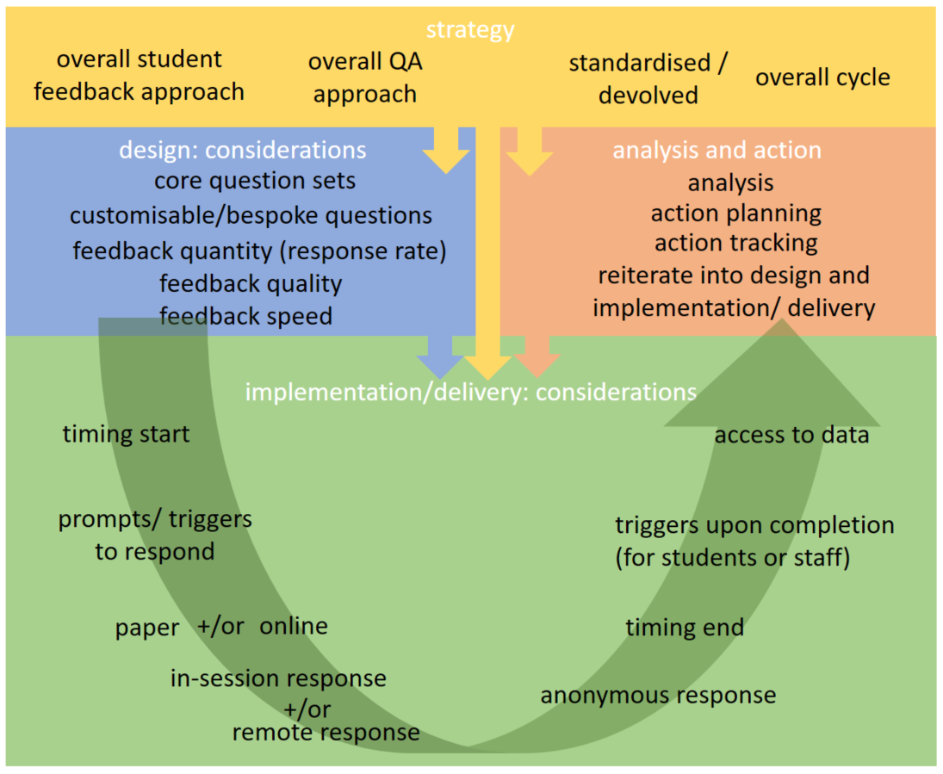
Module Evaluation Review 2018
Overall Consultation
Including Open Workshops
WIHEA learning circle
Including Core Questions
Policy Group
Technology Approach Group
Including Requirements Survey

Slide 3
Module Evaluation: Technical Requirements Survey
The survey was run from 7/01-6/02/2018 and all departments were invited to participate
We received 37 responses, with more than one response from some departments, good spread cross all Faculties
Collected data used by departments in various ways: academic promotion, sharing with students, internal consultations

Slide 4
Technical Requirements Survey:
Most important features
Easy to use customisable templates 5.38
Ease of customisation of optional questions 5.30
Respondent anonymity 5.31
Fast access to collected data 5.32
Easy to use customisable reports 5.24
Ease of analytics 5.14
Ease of access to data for export 5.23
Ability to track trends and comparisons 5.11

Slide 5
Technical Requirements Survey:
Main concerns
Student engagement/Response rates
Confidentiality of results
Data access for departments/central services
Possibility of additional questions to be added by departments
How long is the data going to be kept for
Who will have access to the data

Slide 6
Technical Requirements Survey:
It would be great if:
"Students were incentivised centrally to complete module/course review forms"
"Would be good if departments could be rewarded for high response rates"
"The software is able to compare the feedback over years, so we can see the changes over time"
"Moodle seems to do all the things we might need evaluations to do - it is usable, flexible, and generates clear forms of information. If moving from one to another, we need to ensure there is adequate time and training provided. Otherwise take-up will be partial."

Slide 7
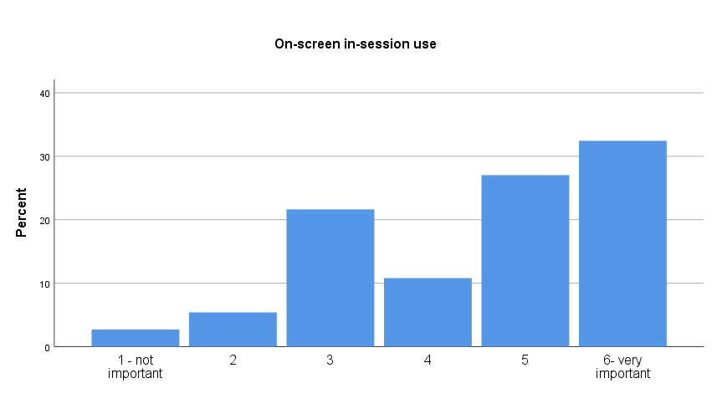
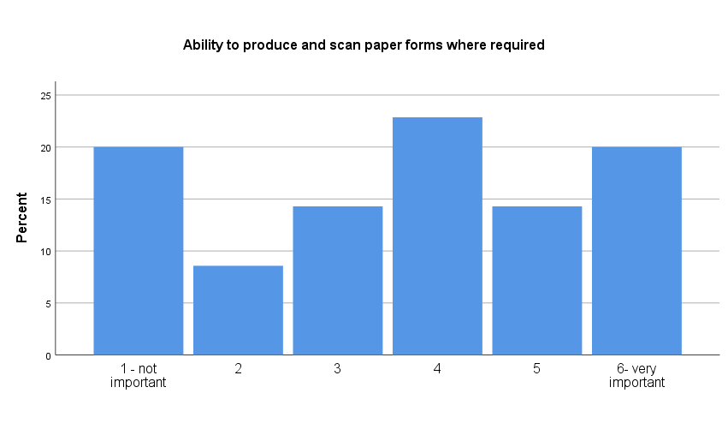
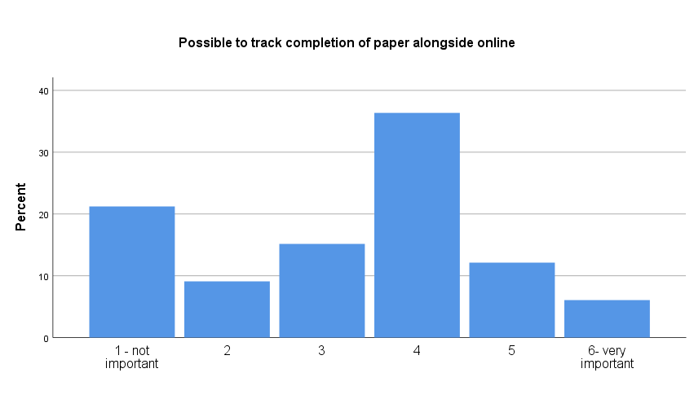

Slide 8
Module Evaluation Lifecycle
Survey Design
Survey Release
Survey Completion
Chasing/
Prompts
Data access
Reports/
Analytics
Data storage
Action

Slide 9
Options and Considerations
one tool or mixture of tools?
TIME
purchase new custom software package?
existing functionality in Moodle?
develop new functionality in-house?
retain central database for archived reports?
retain paper scanning option for longer (paid)?
COST
QUALITY

Slide 10
Next steps
https://warwick.ac.uk/services/its/servicessupport/academictechnology/projects/modevaltech
Technology Approach: Session (date TBC: soon!)
Contact Natasha.Nakariakova@Warwick.ac.uk to get involved

