Slide 1
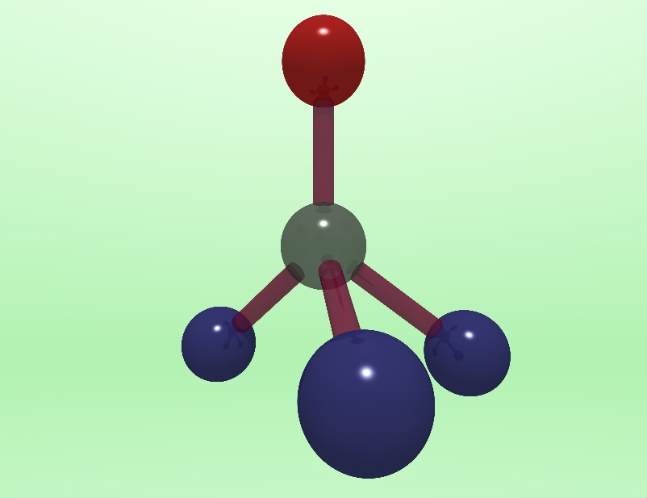
Quantum technology with diamond & silicon
Gavin Morley, Department of Physics, University of Warwick
Nitrogen
Vacancy

Slide 2
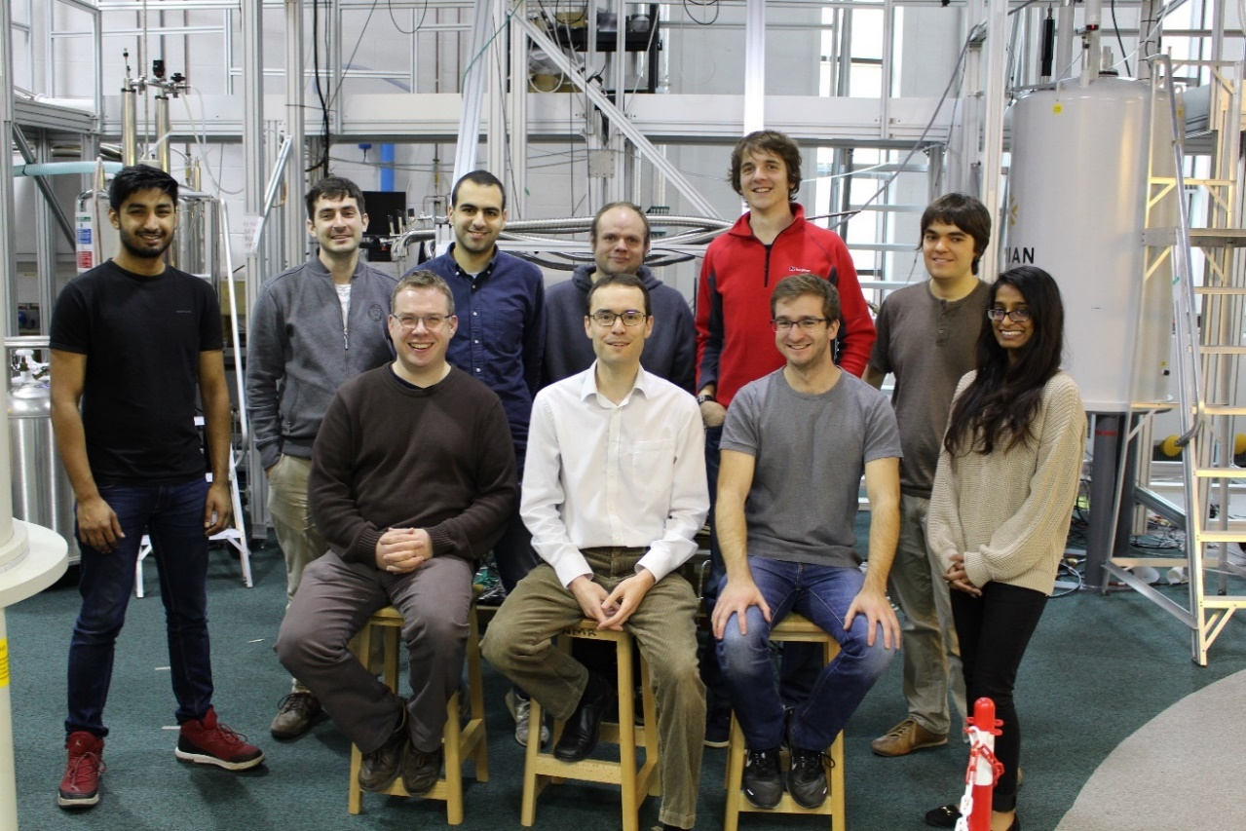






Quantum technology with diamond & silicon
Gavin Morley, Department of Physics, University of Warwick

Slide 3
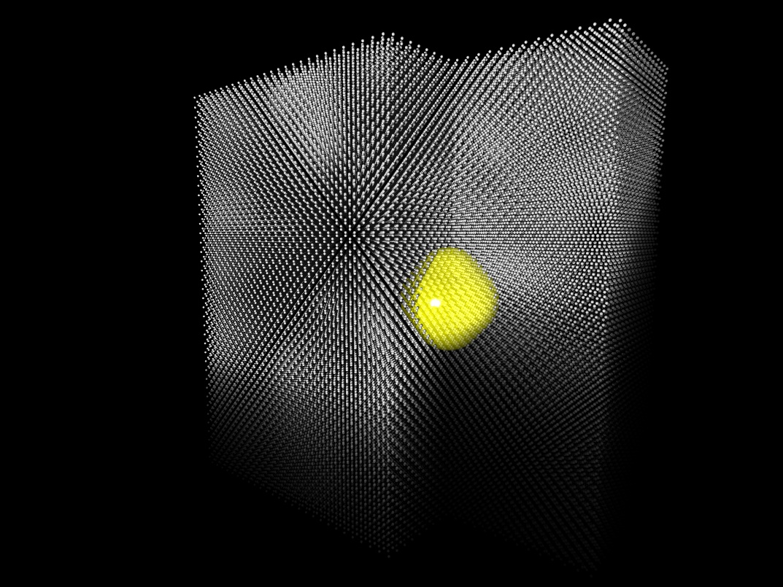
Dopants in crystals are like trapped ions
Their unpaired electron spins are qubits
Picture by Manuel Voegtli

Slide 4
Structure of these lectures
Solid state physics background (diamond and silicon)
Magnetic resonance background
Spin qubits in silicon
Spin qubits in diamond
Picture by Manuel Voegtli

Slide 5
Structure of these lectures
Solid state physics background (diamond and silicon)
Magnetic resonance background
Spin qubits in silicon
Spin qubits in diamond
Picture by Manuel Voegtli

Slide 6
1. Solid state physics background
- Why is diamond an insulator, while silicon is a semiconductor?
Atoms
Building crystals from atoms (tight binding model)
Bandstructure
Dopants
Picture by Manuel Voegtli

Slide 7
1. Solid state physics background
- Why is diamond an insulator, while silicon is a semiconductor?
Atoms
Building crystals from atoms (tight binding model)
Bandstructure
Dopants
Picture by Manuel Voegtli

Slide 8
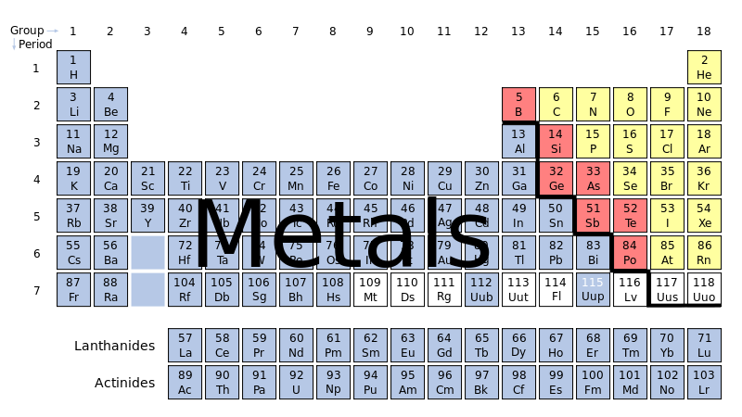
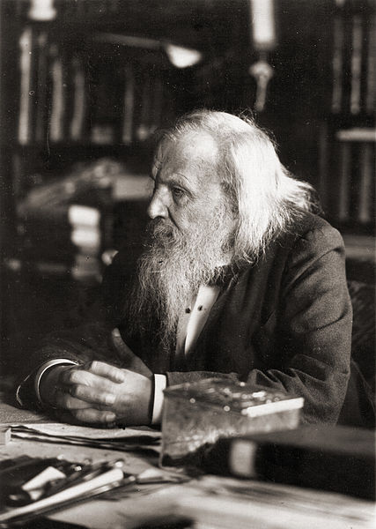
Periodic
Dmitri Mendeleev (1834 – 1907)
Notes:
Diamond is an insulator. Where does this periodic table come from?

Slide 9

What explains the periodicity of the Periodic Table?
The Schrödinger equation
The Schrödinger equation + the Coulomb potential
The Schrödinger equation + the Coulomb potential + electron spin
The Schrödinger equation + the Coulomb potential + electron spin + the Pauli exclusion principle
What your viewers really want to hear about is how to make America great again.
Dmitri Mendeleev (1834 – 1907)
Notes:
d.We need atomic physics to see why the periodic table is periodic.

Slide 10

Classical physics fails to explain atoms
-
-
-
-
-
-
Notes:
Nucleus, yes.
Electrons do have angular momentum.
Not classical orbits as electrons would fall into the middle

Slide 11
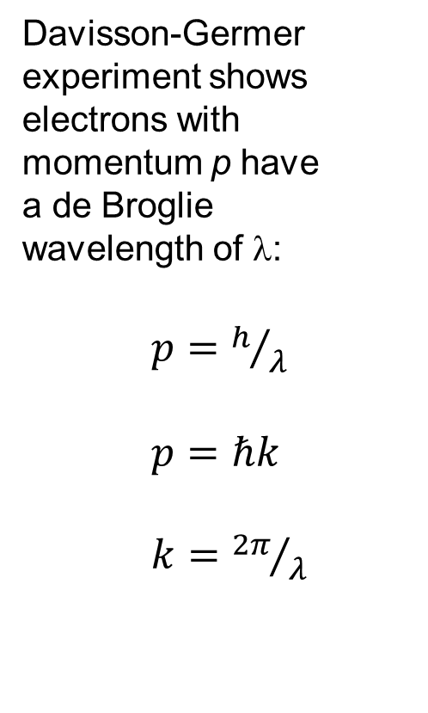
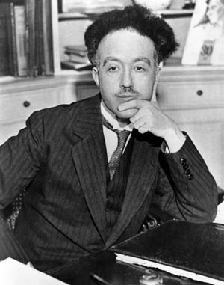
Electrons can behave like waves
Electron gun
Electron detector
Louis de Broglie (1892 – 1987)
crystal
Notes:
1920s: electrons can behave like waves.
X-Ray Diffraction with electrons
Electrons can behave like waves & can behave like particles

Slide 12
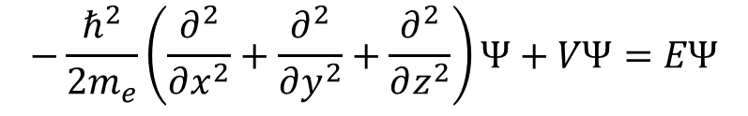

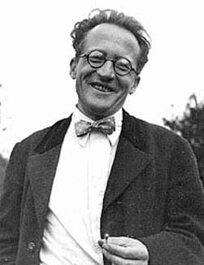
Schrödinger’s equation
is a wave equation:
Boundary
Condition
Erwin Schrödinger (1887 – 1961)
Image from Acoustics Group,
University of Salford, Manchester
Notes:
wave equation for the wavefunction psi
Psi^2: probability of finding the electron
KE, PE, total E
Normal modes: fundamental, 1st harmonic, 2nd
boundary conditions: where the string is held fixed

Slide 13
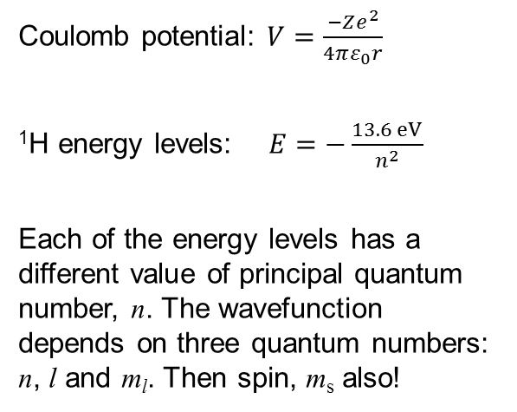
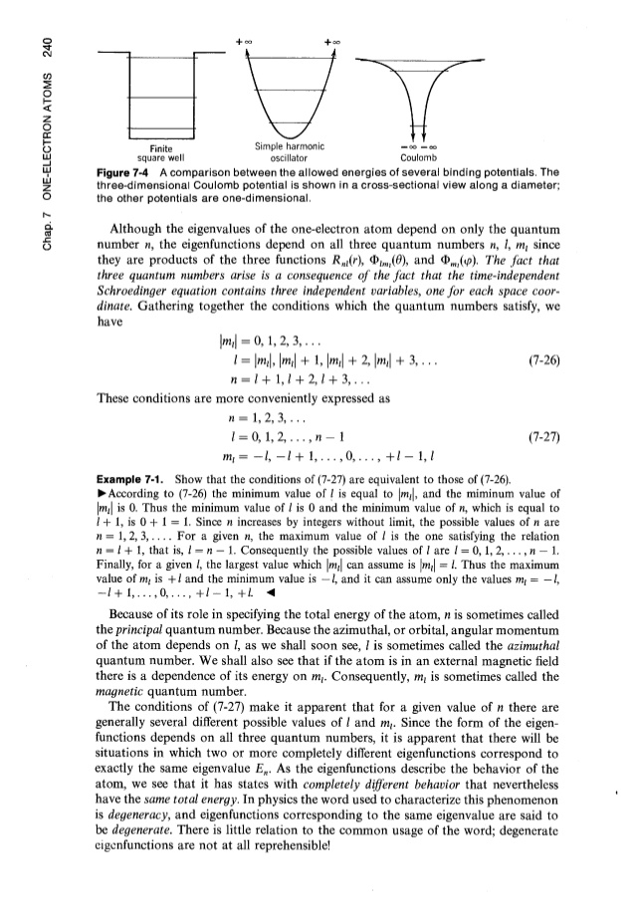
Solve Schrödinger’s equation
for an electron in a box:
→ Discrete energy levels
Erwin Schrödinger (1887 – 1961)
Page 240, Eisberg and Resnick, Quantum Physics of Atoms, Molecules, Solids, Nuclei, and Particles, Wiley 1985
Notes:
electron in a box formed from a potential, V.
Wave equation, boundary conditions → normal modes: discrete energy levels
1H
3+1Quantum Numbers
Electrons stack because of Pauli’s exclusion principle

Slide 14
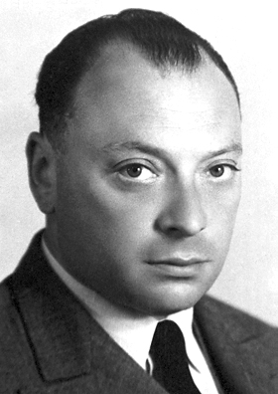
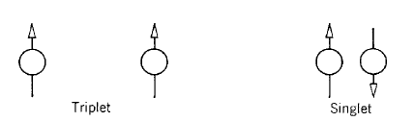
Pauli’s exclusion principle:
Two electrons cannot occupy the same quantum state simultaneously
Wolfgang Pauli (1900 – 1958)
Page 308, Eisberg and Resnick, Quantum Physics of Atoms, Molecules, Solids, Nuclei, and Particles, Wiley 1985
Notes:
Even without interactions
Electrons have spin ½ and are identical

Slide 15
Solve Schrödinger’s equation
for an electron in a box:
→ Discrete energy levels
Erwin Schrödinger (1887 – 1961)
Page 240, Eisberg and Resnick, Quantum Physics of Atoms, Molecules, Solids, Nuclei, and Particles, Wiley 1985
Notes:
Stack up electrons with n,l,m_l,m_s

Slide 16
Solve Schrödinger’s equation for electron in Coulomb potential and include spin
n | 1 | 2 |  | 3
l | 0 | 0 | 1 | 0 | 1 | 2
m_{l} | 0 | 0 | -1,0,+1 | 0 | -1,0,+1 | -2,-1,0,+1,+2
m_{s} | +½,-½ | +½,-½ | +½,-½ | +½,-½ | +½,-½ | +½,-½
Number of degenerate eignenfunctions for each l | 2 | 2 | 6 | 2 | 6 | 10
Subshell name | 1s | 2s | 2p | 3s | 3p | 3d
Page 241, Eisberg and Resnick, Quantum Physics of Atoms, Molecules, Solids, Nuclei, and Particles, Wiley 1985
Notes:
makes the periodic table periodic. Principal quantum number n, the angular momentum quantum number l, and the magnetic quantum number m. Also spin quantum number ms = ±½

Slide 17
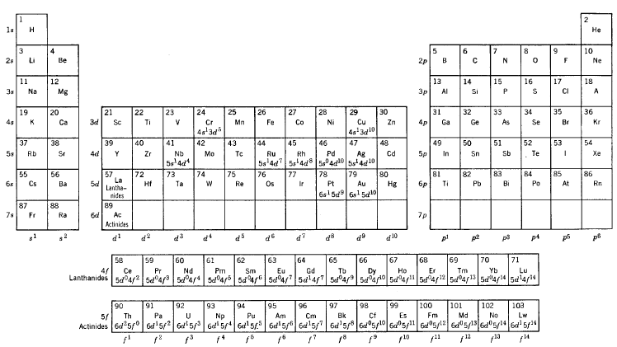
What explains the Periodic Table?
Page 330, Eisberg and Resnick, Quantum Physics of Atoms, Molecules, Solids, Nuclei, and Particles, Wiley 1985
Notes:
1s, 2s, 3s… 2p, 3p, 4p…, from stacking up electrons into a box.
Chemistry is dominated by the outermost electrons

Slide 18
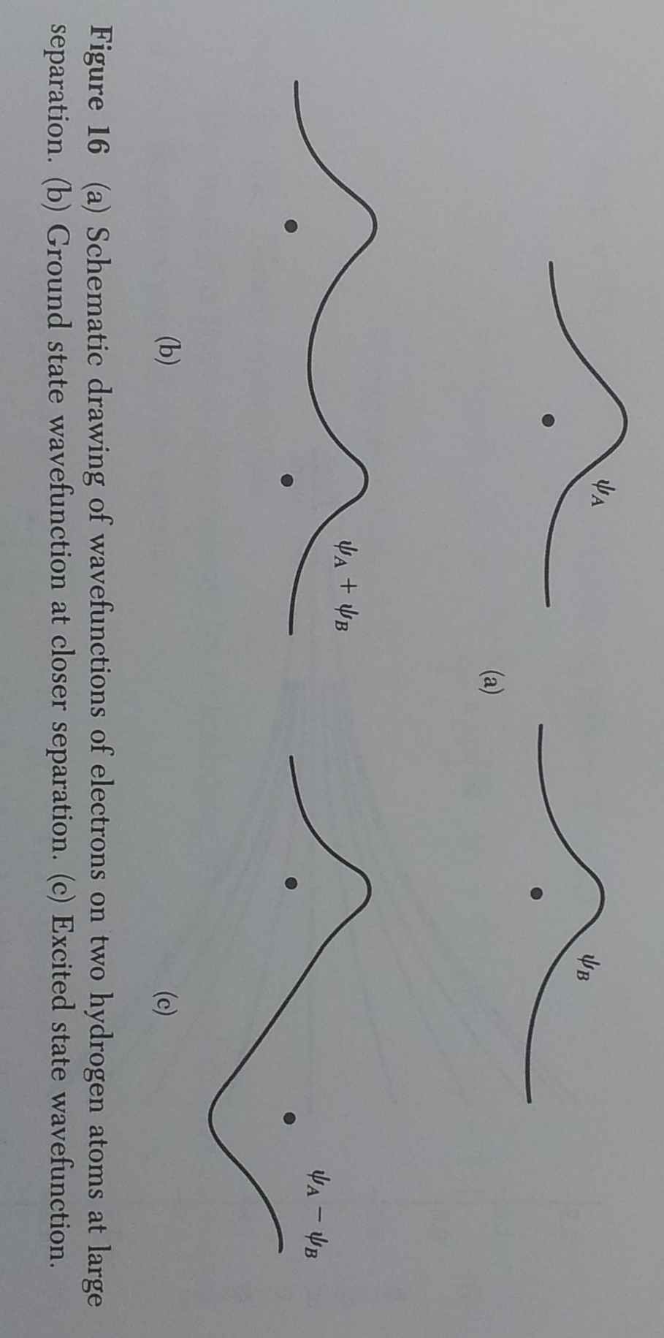

An atom
Schematic drawing of wavefunction for an electron on a hydrogen atom. Page 245, Kittel, Introduction to Solid State Physics, Wiley 1996
Page 240, Eisberg and Resnick, Quantum Physics of Atoms, Molecules, Solids, Nuclei, and Particles, Wiley 1985
Notes:
The square of the electronic wavefunction shows the probability of finding an electron in that position.

Slide 19
Two atoms
Page 240, Eisberg and Resnick, Quantum Physics of Atoms, Molecules, Solids, Nuclei, and Particles, Wiley 1985
(a) Schematic drawing of wavefunctions for electrons on two hydrogen atoms at large separation. Page 245, Kittel, Introduction to Solid State Physics, Wiley 1996
Notes:
Here are the wavefunctions for two hydrogen atoms when they are far apart. Underneath I’ve shown the energy levels which are identical. For example each atom has an s level at the same energy. When we bring these atoms together their wavefunctions overlap and their energy levels change. We will still have the same number of energy levels in the combined system but they will have formed a bonding level and an antibonding level.

Slide 20
Building a molecule from atoms
…a bond
Page 240, Eisberg and Resnick, Quantum Physics of Atoms, Molecules, Solids, Nuclei, and Particles, Wiley 1985
(b) Ground state wavefunction at closer separation.
(c) Excited state wavefunction. Page 245, Kittel, Introduction to Solid State Physics, Wiley 1996
Notes:
(b) shows the covalent chemical bond we get when we bring these identical atoms closer together. The bonding level is the sum of the two wavefunctions, and the antibonding level here in (c) is the difference. The bonding level is lower in energy because of the electrostatics: the Coulombic forces. Where the energy levels before had just one low-lying s-state, the combined system has these two states. So this is H2: we did some chemistry and made a molecule from two atoms. What happens if we have a crystal with a billion atoms? These two energy levels become a billion closely-spaced levels: a band.

Slide 21
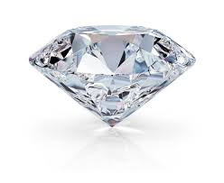
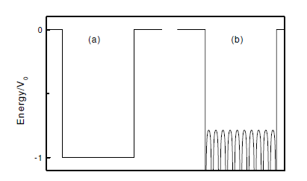
Potentials
Atom Molecule Insulating crystal: tight binding model
1
Potential energy (V)
0
Schematics of the potential due to the ions in the crystal, Page 3, Singleton, Band Theory and Electronic Properties of Solids, OUP 2001
Notes:
After going from an atom to a molecule we can go on to a crystal. There should be more Coulomb potentials for the crystal but then you wouldn’t be able to see them.

Slide 22
The tight-binding model
Atom Molecule Insulating crystal tight binding model
Schematics of the potential due to the ions in the crystal, Page 3, Singleton, Band Theory and Electronic Properties of Solids, OUP 2001
Notes:
With atoms in the 2-electron molecule each atomic energy level became two energy levels. With N atoms (each having one spare electron) in a crystal, each of the single-atom energy levels becomes a band containing N states.

Slide 23
Which of these elements is not in Group IV of the periodic table?
C f) N
Si
Ge
Sn
Pb
Dmitri Mendeleev (1834 – 1907)
Notes:
Here’s another question for you.
Yes, nitrogen is the odd one out of course. There is this huge change in group IV as we go down, from insulating diamond through semiconducting silicon and germanium to metallic tin and lead. Some people call it Group 14 instead of Group IV.

Slide 24
Group IV
Dmitri Mendeleev (1834 – 1907)
Notes:
It’s particularly surprising as diamond, silicon, germanium and tin all have the same diamond crystal structure.

Slide 25
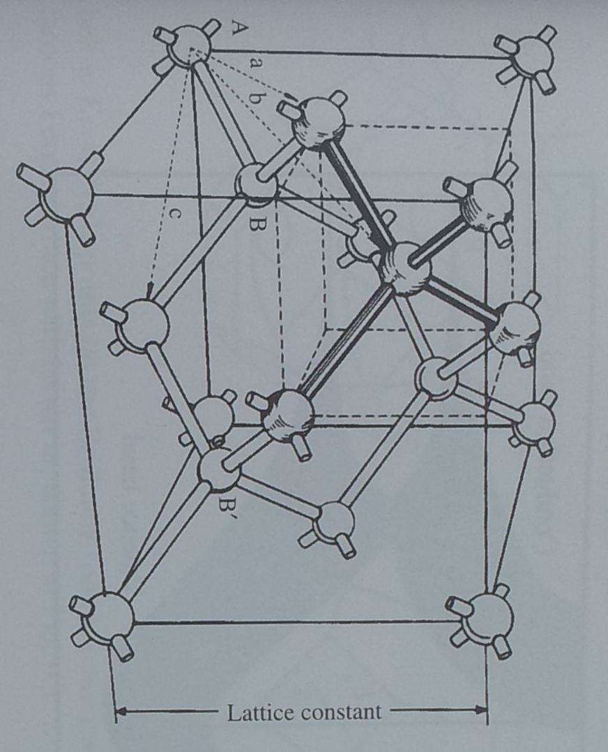

Diamond and silicon:
FCC with two atom basis
Diamond crystal structure. Page 37, Singleton, Band Theory and Electronic Properties of Solids, OUP 2001
Notes:
Here is the diamond crystal structure. Each carbon atom has two legs and two arms like this as you can see in our logo. The crystal structure is two interlocking face-centred cubic (FCC) lattices. It’s an fcc lattice with a two-atom basis: those two atoms are labelled A and B here, and for diamond they are both carbon atoms, but other important semiconductors, like GaAs, have the same structure different A and B atoms, so for GaAs we have A being Ga and B being As. The primitive unit cell for diamond has two carbon atoms.

Slide 26

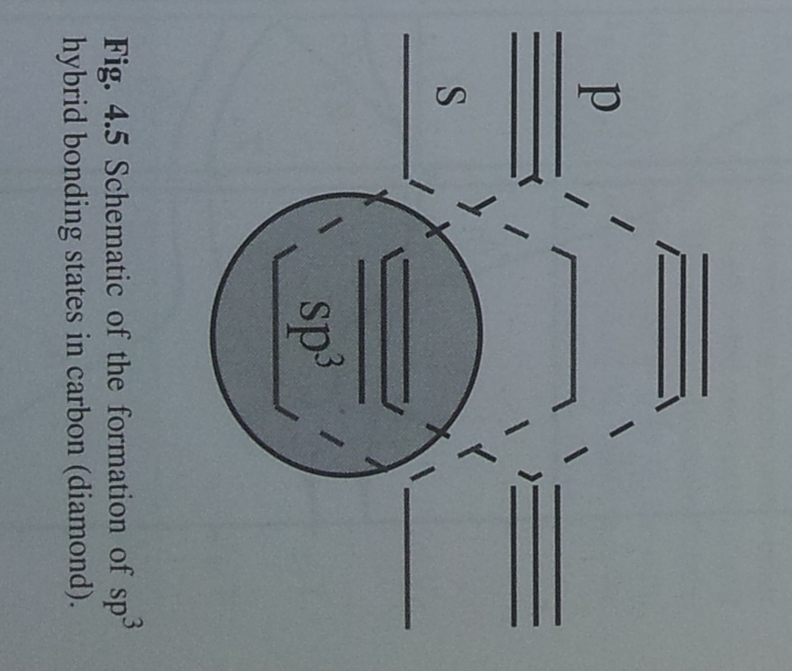
The tight-binding model: diamond
Carbon:
1s² 2s² 2p²
Schematic of the formation of sp³ hybrid bonding states in diamond. Page 37, Singleton, Band Theory and Electronic Properties of Solids, OUP 2001
Notes:
Let’s look at the tight-binding description for diamond. On the left and the right are two isolated carbon atoms each with their 2s and 2p states. Remember we can fit a spin up and a spin down electron into each of these energy levels. Each carbon atom has six electrons: 2 are stuck in the 1s state which is not shown here, and then there are 2 electrons in the 2s state and 2 electrons in the 2p state. When these carbon atoms come close to each other the atoms form bonding and antibonding states for both the s and p orbitals. The four lowest states mix to form sp³ hybrids and then there is an energy gap, shown with this green arrow, before you reach the antibonding states.
Now let’s see how the electrons stack up. Diamond has two atoms in the primitive unit cell so we take the electrons from two atoms and stack them up in the sp³ hybrid states. (Carbon atom has term symbol ^{2S+1}L_{J} = ³P₀ from Hund’s rules where S is the spin quantum number, L is the orbital quantum number with 0,1,2,3=S,P,D,F. Finally, J is |L±S| )

Slide 27
The tight-binding model: diamond
Carbon:
1s² 2s² 2p²
Schematic of the formation of sp³ hybrid bonding states in diamond. Page 37, Singleton, Band Theory and Electronic Properties of Solids, OUP 2001
Notes:
Now all of these hybrid states are full and there is an energy gap up to the antibonding states. So diamond is an insulator. We know that silicon and germanium are semiconductors, and that makes sense too, because the energy gap is just smaller. There is no sharp distinction between a semiconductor and an insulator. But tin is the next element down in group IV and it even has the same crystal structure. So why is tin a metal?

Slide 28
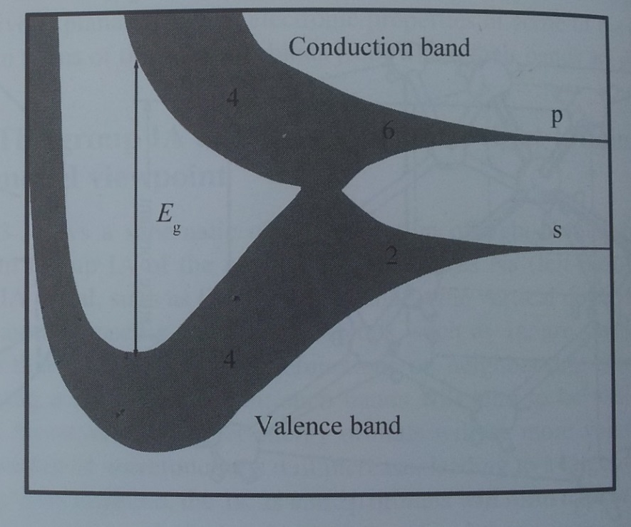
The tight-binding model: Group IV
Electron energy
4
Element | E_{g} (eV) | a (nm)
C | 5.5 | 0.356
Si | 1.1 | 0.543
Ge | 1.0 | 0.566
Sn | metallic | 0.646
6
2
4
Interatomic spacing
Schematic of tight-binding band formation in the group IV elements, Page 38, Singleton, Band Theory and Electronic Properties of Solids, OUP 2001
Notes:
When the atoms are really spaced out here on the right, we have their s and p atomic orbitals. These spread out as bands and overlap here, and that is the interatomic spacing for tin where they overlap. Silicon and germanium have their atoms closer together so there is a bandgap, and then diamond has its atoms even closer together, with stronger bonds, and into this region with an even bigger bandgap, E_{g}.

Slide 29
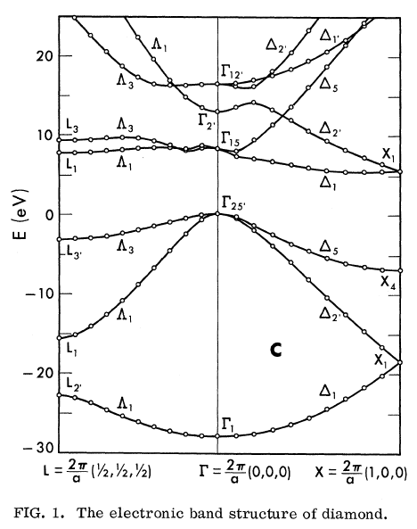
Electronic Bandstructure of diamond
Electron momentum
p = ħ k, for wavevector k
W. Saslow, T. K. Bergstresser, and Marvin L. Cohen, Physical Review Letters 16, 354 (1966)
Notes:
If you look up the electronic bandstructure of diamond in the literature you get something like this. It might look a bit complex but it’s amazingly simple considering that this describes a crystal containing 10^23 atoms. The really good news is that we can ignore most of these levels most of the time. What matters most is the region around the bandgap here, because we can often ignore all of these full states down here and all of these empty states above.

Slide 30
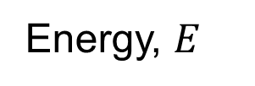
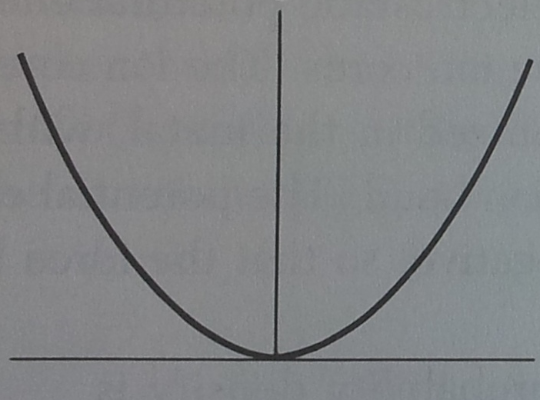
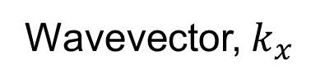
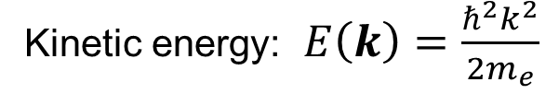
Electronic Bandstructure of diamond
Electron momentum
p = ħ k, for wavevector k
W. Saslow, T. K. Bergstresser, and Marvin L. Cohen, Physical Review Letters 16, 354 (1966)
Notes:
Part of the diamond bandstructure looks like that of a free electron

Slide 31
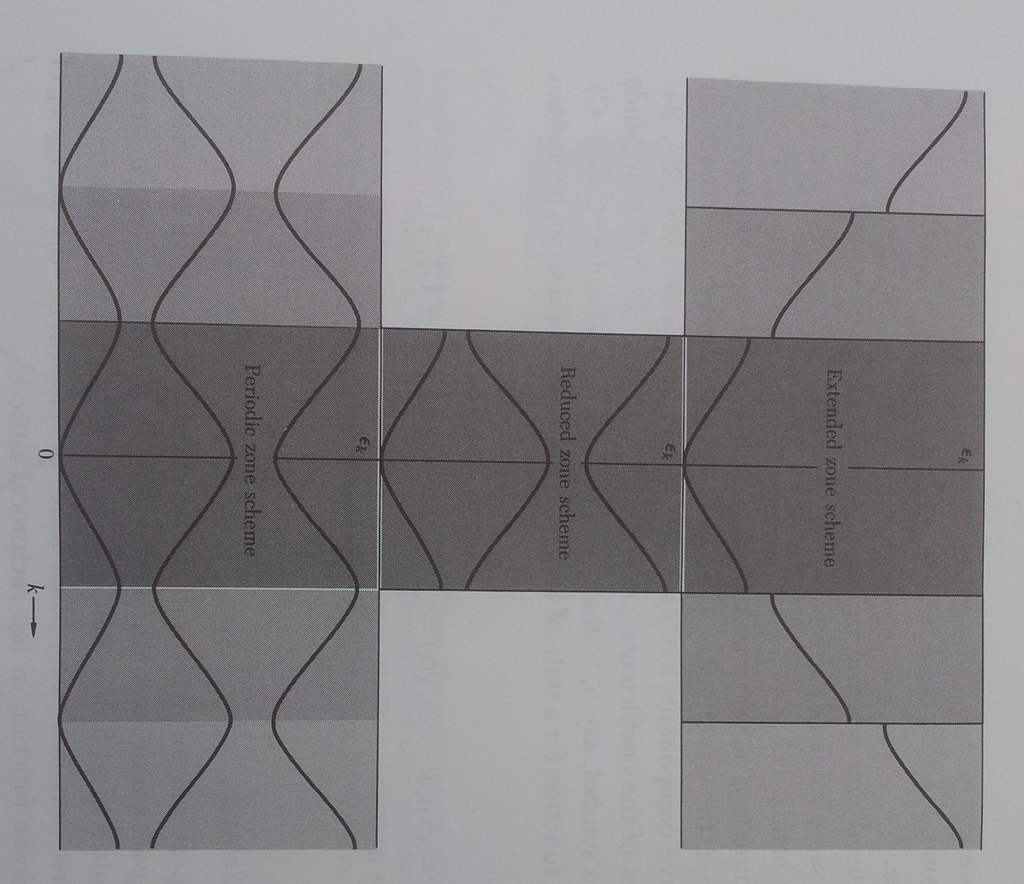
Representing bands
Three energy bands of a linear lattice. Page 238, Kittel, Introduction to Solid State Physics, Wiley 1996
Notes:
In the extended zone scheme, bandstructure looks even more like a free electron, but with these band gaps. However, k-space is periodic just like real space, so these bands get folded back into the first Brillouin zone as in this reduced zone scheme picture. Because of this, the first Brillouin zone actually contains all of the information about the bandstructure, and often people will show that like this in the reduced zone scheme.

Slide 32
Electronic Bandstructure of diamond
Electron momentum
p = ħ k, for wavevector k
W. Saslow, T. K. Bergstresser, and Marvin L. Cohen, Physical Review Letters 16, 354 (1966)
Notes:
Part of the diamond bandstructure looks like that of a free electron

Slide 33
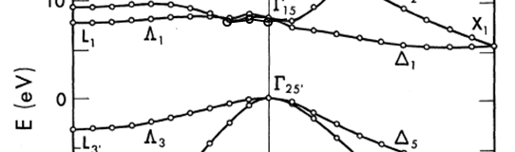
Electronic Bandstructure of diamond
Indirect bandgap
W. Saslow, T. K. Bergstresser, and Marvin L. Cohen, Physical Review Letters 16, 354 (1966)
Notes:
This is a calculation (actually it used the empirical pseudopotential method (EPM)) and Jon Goss will give you much more detail about modelling and simulations in module 4. This calculation is based on experiments like the optical experiments that Stephen Lynch will tell you about this afternoon. For optical experiments, it is important to notice that there is an indirect bandgap here. The top of the valence band is not directly below the bottom of the conduction band. Instead the bottom of the conduction band is here at a different wavenumber. An optical photon can be absorbed easily as long as it has enough energy to cross this bigger bandgap, or else if the optical photon only provides enough energy to cross this indirect bandgap then a phonon must be involved too to conserve momentum.

Slide 34
Electronic Bandstructure of diamond
Mini-Summary:
- Atomic physics → bandstructure
…by assuming the electrons in crystals are generally stuck in their atomic potentials
Electron momentum
p = ħ k
for wavevector k
W. Saslow, T. K. Bergstresser, and Marvin L. Cohen, Physical Review Letters 16, 354 (1966)
Notes:
If you look up the electronic bandstructure of diamond in the literature you get something like this. It might look a bit complex but it’s amazingly simple considering that this describes a crystal containing 10^23 atoms. The really good news is that we can ignore most of these levels most of the time. What matters most is the region around the bandgap here, because we can often ignore all of these full states down here and all of these empty states above.

Slide 35
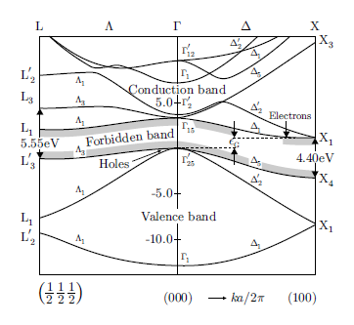
Bandstructure of Si & diamond
Based on M. Cardona and F. Pollack, Physical Review 142, 530 (1966)
Bandstructure of Si, page 50, Singleton, Band Theory and Electronic Properties of Solids, OUP 2001
Notes:
If we compare the bandstructure of silicon and diamond we see a great deal of similarities, because they have the same lattice structure and they are both from group IV. Silicon has a smaller bandgap, so it is a semiconductor rather than an insulator. We still see here this indirect bandgap. There are holes labelled here in the valence band and the conduction band is here.

Slide 36

Any questions?

Slide 37
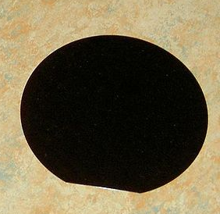
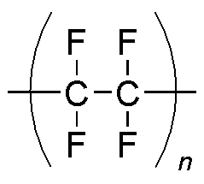
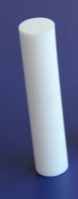
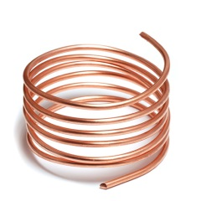
PTFE (Teflon)
ρ > 10¹⁸ Ω-cm
(room temperature)
silicon
ρ ~ 10⁴ Ω-cm
(room temperature)
Pure metal
ρ ~ 10⁻¹⁰ Ω-cm (1 K)
Tin ρ ~ 10⁻⁵ Ω-cm
(room temperature)
Superconductors ρ ~ 0
diamond ρ ~ 10¹⁶ Ω-cm
(room temperature)
10⁻¹⁰ 1 10¹⁰ 10²⁰
Resistivity (ohm-cm)
Notes:
Resistivity varies by at least 30 orders of magnitude: a huge range. Teflon is used as the insulator in coaxial cables and has a higher room-temperature resistivity than diamond. Diamond has a resistivity of around 10¹⁶ ohm-cm at room temperature. It gets even higher if you cool it down. The distinction between an insulator and a semiconductor is somewhat arbitrary but most people think of the boundary as being near <this> blue mark. Silicon is certainly a semiconductor rather than an insulator.
Pure metallic tin has a resistivity of around 10⁻⁵ ohm-cm at room temperature, and for copper this is ten times lower. The resistivity of metals goes down when you cool them: the opposite behaviour to what you find for insulators and semiconductors. The resistivity of a pure metal like copper can reach 10⁻¹⁰ ohm-cm at low temperatures, and superconductors have even lower resistivity.

Slide 38
Bandstructure
Energy
E_{g}
Metal Insulator
Semiconductor
Schematic electron occupancy for allowed energy bands. See page 174, Kittel, Introduction to Solid State Physics, Wiley 1996
Notes:
Bands explain why some crystals are insulators as you can see here. This insulator has three bands which can take electrons, and two of them are completely full. The electrons down here can’t get up here because of this energy gap labelled E_{g}, so all of the electrons are stuck where they are, like the electrons in a noble gas atom. The things we have already talked about: the discrete energy levels and Pauli exclusion mean together that electrons in a full band can’t conduct electricity or heat. The Fermi Energy is here in the gap. We call this the bandgap and it can be very important for the properties of non-metals. If this bandgap is large as with diamond then we would call it a wide-bandgap material. It would make more sense to call it a tall bandgap rather than a wide bandgap, but that’s just the terminology. In this metal though, the middle band is half full so we can give some energy to these electrons near the Fermi energy and they can move to a different wavevector and carry a current. And here is a semiconductor: there is no sharp dividing line between a semiconductor and an insulator: one just conducts electricity somewhat more than the other.
But where did the bands for a metal come from?

Slide 39
Temperature dependence
Energy
E_{g}
Metal Insulator
Intrinsic Semiconductor at room temperature
Notes:
This is a schematic drawing, and we call each of these boxes bands. They can be empty like this white one, full like this gray one, or partially full. An insulator can’t conduct electricity because all of its bands are either full or empty, so the electrons can’t move to a different quantum state. It’s similar to a noble gas atom. This is our schematic at room temperature for an intrinsic semiconductor where some thermal energy has excited electrons over the energy gap. If we cool down semiconductors their resistivity increases.

Slide 40
Cooling semiconductors down
Energy
E_{g}
Metal Insulator
Intrinsic Semiconductor at room temperature
Intrinsic Semiconductor at low temperature
Notes:
At temperatures lower than the bandgap, semiconductors and insulators behave the same: neither one conducts electricity.

Slide 41
Cooling semiconductors down
Energy
Intrinsic Extrinsic
for k_{B}T > E_{g} for E_{g} > k_{B}T > donor binding energy
Notes:
There are two ways that a semiconductor can get free charge carriers as the temperature is increased: intrinsic and extrinsic. Intrinsic means “from within” and extrinsic means ”from outside”. So the intrinsic conductivity of a semiconductor comes from thermal energy exciting electrons across the bandgap. That means that there are electrons in the conduction band next to free states which can conduct, and also the holes here in the valence band mean that there are electrons here in the valence band next to empty states and we can get conduction here too.
Extrinsic conductivity comes from doping the semiconductor: changing the crystal so that there are either extra free electrons as in this diagram, or fewer electrons. Our computers work thanks to the extrinsic doping of silicon.

Slide 42
Extrinsic charge carriers
Energy
Extrinsic (n-type) Extrinsic (p-type)
Intrinsic donor impurities acceptor impurities
Semiconductor at room temperature
Semiconductor at room temperature
Semiconductor at room temperature
Notes:
Extrinsic conductivity comes from doping the semiconductor: changing the crystal so that there are extra free electrons in this case, or less electrons in this case. If the crystal is doped with extra electrons then we say that it is negatively doped, or n-type. Similarly, p-type material is doped with positive holes. To negatively dope a semiconductor we put in some donor impurities which donate electrons to the conduction band. To make a p-type crystal we put in acceptors which grab spare electrons leaving holes behind.

Slide 43
Extrinsic charge carriers
Si:P
binding energy = 46 meV
Page 240, Eisberg and Resnick, Quantum Physics of Atoms, Molecules, Solids, Nuclei, and Particles, Wiley 1985
Notes:
If we look at the periodic table then we can see how to dope semiconductors. The modern computing industry is based on doping silicon with boron and phosphorous. Both of these atoms go in by substituting for a silicon atom to make substitutional dopants without changing the crystal structure. However, boron is missing an electron compared to silicon so it is an acceptor. Phosphorous is a donor. At low temperatures the phosphorous atom recaptures its extra electron, so it looks like a hydrogen atom with one electron bound to one net positive charge. The big difference to a real hydrogen atom is that the binding energy is much less: generally around 5 to 50meV in semiconductors like GaAs and Si as compared to 13.6eV for hydrogen. This means that at room temperature most of the electrons are ionised because k_{B}T_{295K} is around 25meV.

Slide 44
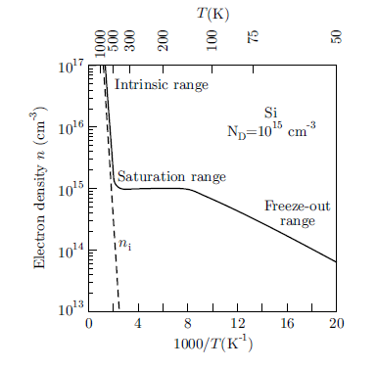
Extrinsic charge carriers
20 ppb
Dopants in diamond have larger binding energies so are not ionised at room temperature
Temperature dependence of the electron density in silicon with a net donor density N_{D}-N_{A}=10¹⁵ cm⁻³. Page 61, Singleton
Notes:
To calculate the density of extrinsic electrons and holes for a particular temperature, we can still use the law of mass action, but now instead of setting n=p we use the conservation law for electrons given a certain density of donors (N_{D}) and acceptors (N_{A}). The dashed line is from the intrinsic electrons: it is insignificant at room temperature (see red arrow) but at 500K it quickly starts to dominate. The saturation range is where the donors are all ionised: warming the sample in this range cannot provide any extra free electrons from the donors. 10¹⁵ phosphorous donors per cm^3 is quite low: it’s an impurity level of 20parts per billion. The purest silicon wafers have impurity concentrations of just parts per trillion. 50 years of materials processing have made silicon one of the purest materials we have. To make silicon more insulating without having to work so hard at removing impurities, you can carefully dope it so that the number of acceptors and donors are the same. This is called compensating.
The donors freeze out at lower temperature when their binding energy becomes strong enough compared to the thermal energy: they then capture conduction electrons giving us the hydrogenic states I just mentioned. This is why standard silicon chips designed to work at room temperature will stop working at cryogenic temperatures.
Dopants in diamond have a larger binding energy (than silicon) so that they are not ionised at room temperature. Very pure diamonds have more impurities than very pure silicon, but the fact that the dopants in diamond are not ionised is what makes diamond an excellent insulator at room temperature.

Slide 45

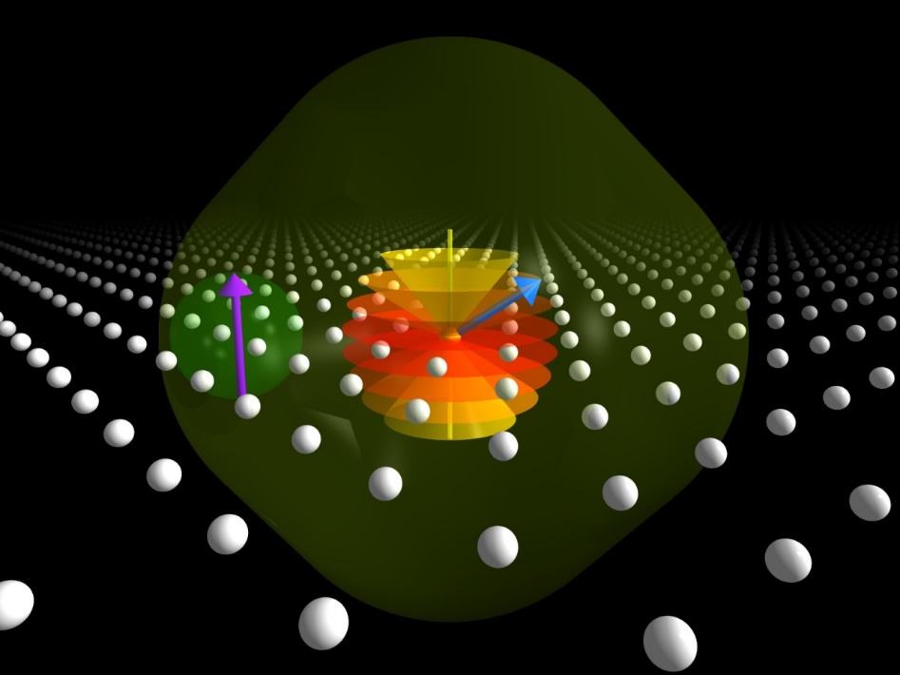
Donor Qubits in Silicon
Pictures by Manuel Voegtli
Notes:
My group does research on the electrons bound to donors in silicon at low temperatures, using its spin as a quantum bit for future quantum computers. The picture on the right is a substitutional bismuth donor in a silicon lattice and its electronic and nuclear spins make very nice qubits.

Slide 46
Electron Qubits in Diamond
Nitrogen
Vacancy
Notes:
My group also does research using electrons bound to dopants in diamond as qubits. In particular the nitrogen-vacancy centre is great for this. One of the reasons for being so keen on these qubits in diamond is that they work at room temperature. When we say that they work, we mean that we can store quantum information on the electron spin of this defect at room temperature. So clearly the electron does not escape from these defects at room temperature, even though it does for silicon. As I said before, this is the reason diamond is an insulator rather than a semiconductor: it’s because the dopants are not ionised at room temperature so there is not much extrinsic conductivity.

Slide 47
Why is diamond an insulator?
Electron energy
4
6
2
4
Interatomic spacing
Notes:
So, we explained that diamond and silicon both get bandgaps between the sp3 bonding states and their antibonding states. Then we saw that diamond has a larger bandgap than silicon. However, to understand why diamond is an insulator and silicon is a semiconductor we need to look at the extinsic conductivity: specifically dopants in diamond have larger binding energies than dopants in silicon.

Slide 48
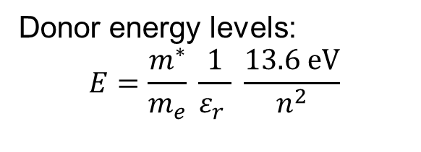

Solve Schrödinger’s equation
for an electron in a box:
Binding energies
for phosphorous
donors:
Silicon: 46 meV
Diamond: 500 meV
-
Page 240, Eisberg and Resnick, Quantum Physics of Atoms, Molecules, Solids, Nuclei, and Particles, Wiley 1985
Notes:
Here is the slide we used to get the energy levels of the actual hydrogen atom. We can use the same physics as long as we change two things: the mass of the electron in the hydrogen atom needs to be replaced by the effective mass, m* and the dielectric permittivity must be changed. For the hydrogen atom we just used the vacuum permittivity, but for an electron bound to a dopant in a semiconductor, the Coulomb potential is screened by the polarizability of the semiconductor. We sort this out by multiplying epsilon_0 in the Coulomb potential by the epsilon_r for the material. This screening means that binding energies of these hydrogenic dopants in semiconductors are smaller than for a hydrogen atom. The important term here is the epsilon_r because it is squared in the expression for the energy levels, and also because the effective masses of silicon and diamond are similar but there is significant difference between the epsilon_r for diamond and silicon. Diamond has slightly larger effective mass than silicon which increases the binding energy a little. The relative permittivity for silicon is up to twice that of diamond, so this is why diamond has larger binding energies for dopants when compared to dopants in silicon.
See:
Electron effective masses and latice scattering in natural diamond, F. Nava et al, Solid State Communications, 33, 475 (1980).
The search for donors in diamond, R. Kalish, Diamond and Related Materials 10, 1749 (2001).

Slide 49
Why is diamond an insulator rather than a semiconductor?
a) Wide band-gap means no intrinsic conductivity, deep dopants mean no extrinsic conductivity
Notes:
The binding energy of the dopants is larger: we say that they are deep dopants while silicon has shallow dopants.

Slide 50
What explains the Periodic Table?
Dmitri Mendeleev (1834 – 1907)

Slide 51
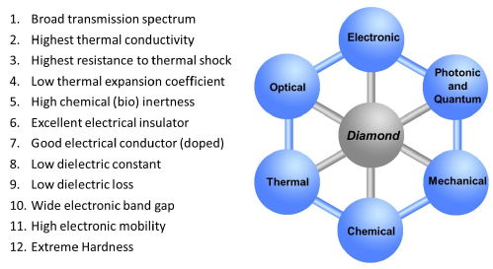
Diamond properties

Slide 52
1. Solid state physics background
Atoms
Building crystals from atoms (tight binding model)
Bandstructure
Dopants
Picture by Manuel Voegtli

