Slide 1
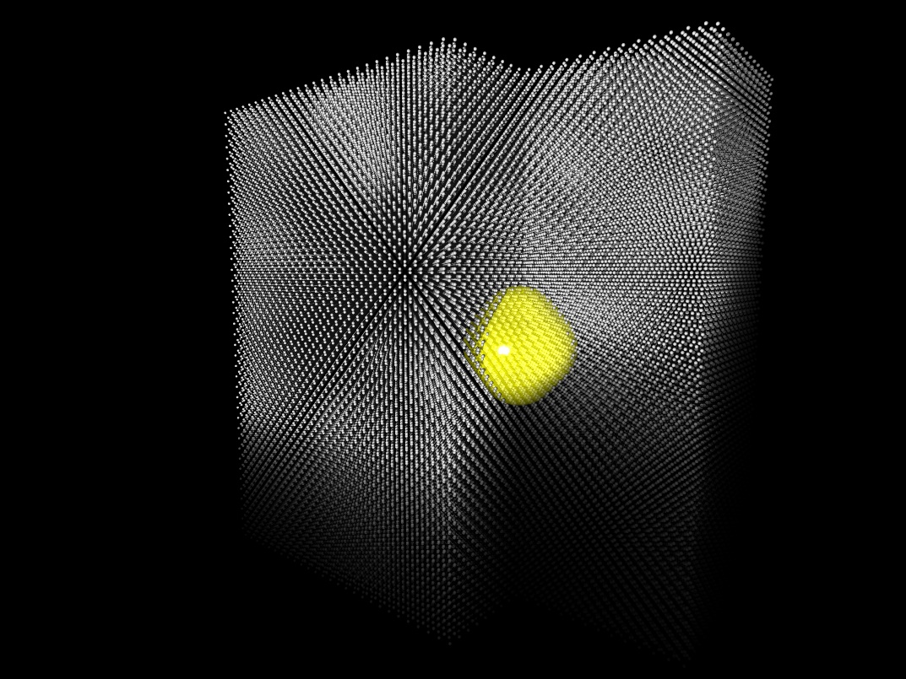
Dopants in crystals are like trapped ions
Their unpaired electron spins are qubits
Picture by Manuel Voegtli

Slide 2
Structure of these lectures
Solid state physics background (diamond and silicon)
Magnetic resonance background
Spin qubits in silicon
Spin qubits in diamond
Picture by Manuel Voegtli

Slide 3
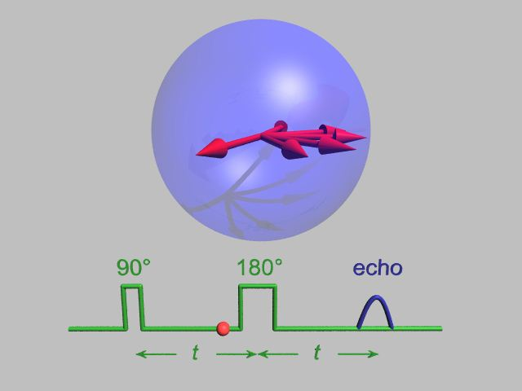
2. Magnetic resonance
- Electron paramagnetic resonance
Prepare (spin Hamiltonian)
Control (electromagnetic pulses)
Measure (spin state readout)

Slide 4

2. Magnetic resonance
a. Prepare (spin Hamiltonian)
b. Control (electromagnetic pulses)
c. Measure (spin state readout)
Notes:
Nuclear spins are all around us, with long coherence times

Slide 5
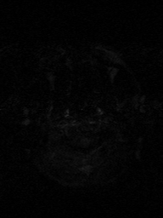
2. Magnetic resonance
a. Prepare (spin Hamiltonian)
b. Control (electromagnetic pulses)
c. Measure (spin state readout)

Slide 6
Magnetic resonance: prepare
- put a spin ½ into a magnetic field
… but first…

Slide 7
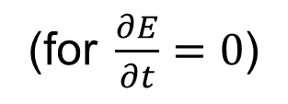
Magnetism
Current loop has
magnetic moment, µ = I A
Area, A
Maxwell 4:
∇ × B = μ₀ J
Current, I
Chapter 1, Blundell, Magnetism in Condensed Matter, OUP 2001
Notes:
Maxwell’s equations tell us that an electric charge creates a magnetic field. mu is in the same direction as A.

Slide 8
Magnetism
Current loop has
magnetic moment, µ = I A
Area, A
N
S
Current, I
Chapter 1, Blundell, Magnetism in Condensed Matter, OUP 2001
Notes:
Equivalently we can describe this as a magnetic dipole.

Slide 9
What happens if we try to cut a magnet in half?
Area, A
N
S
Current, I
Chapter 1, Blundell, Magnetism in Condensed Matter, OUP 2001
Notes:
Here is a question for you

Slide 10
What happens if we try to cut a magnet in half?
N
S
a)
b)
N
S
N
S
Chapter 1, Blundell, Magnetism in Condensed Matter, OUP 2001
Notes:
a or b?

Slide 11
Magnetism
Magnetic
Monopoles
N
S
N
S
Chapter 1, Blundell, Magnetism in Condensed Matter, OUP 2001
Notes:
You can’t cut a magnet in half and get two magnetic monopoles. If you keep on cutting then you get down to an electron which is a fundamental particle and it has a magnetic dipole. People have looked for magnetic monopoles, but never seen a free one (only quasiparticles).

Slide 12
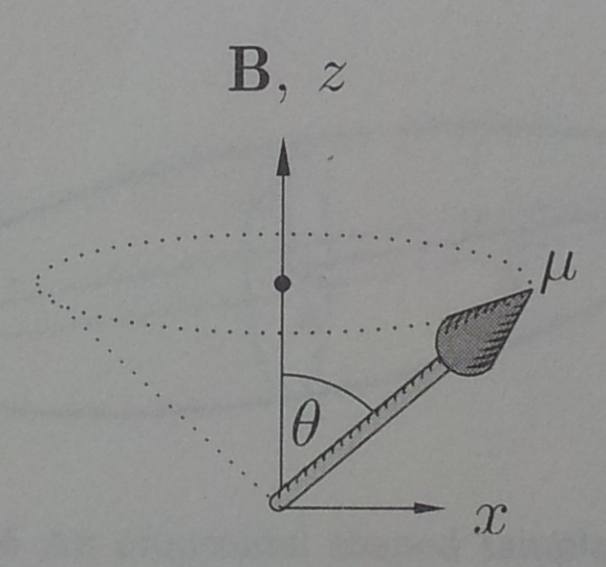
Energy of a magnetic moment
Energy of the magnetic moment in a magnetic field, B:
E = - µ • B
Area, A
Current, I
Chapter 1, Blundell, Magnetism in Condensed Matter, OUP 2001
Notes:
Why does it precess? Energy is minimised by magnetic moment pointing along B. However, the magnetic field B alone cannot rotate the magnetic moment to make it reach this minimum energy because angular momentum must be conserved (just like linear momentum). Instead, the magnetic moment precesses just like a spinning top does. However, the precessing magnetic moments can relax to the lower energy state with help from other processes.

Slide 13
Angular momentum and Magnetism
µ = γ L
(L is angular momentum
of a magnetic moment,
γ is gyromagnetic ratio)
Current loop has
magnetic moment, µ = I A
Area, A
N
S
Current, I
Chapter 1, Blundell, Magnetism in Condensed Matter, OUP 2001
Notes:
A magnetic moment is always connected with angular momentum.

Slide 14
Magnitude of magnetic moment
Electron has charge, e and mass, m, so
Current: I = -e/t as speed, v = 2 π r/t
for radius, r.
Magnetic moment,
μ = I A = I π r ² = - e ℏ/ 2m
(as electron angular momentum = mvr = ℏ)
v
e-
r
≡ -μ_{B}
Chapter 1, Blundell, Magnetism in Condensed Matter, OUP 2001

Slide 15
Angular momentum
What happens to a spinning top on the table?
It moves sideways
It falls over
It precesses
Hey, I thought you were supposed to be teaching me
See Feynman lectures, vol 1, chapter 20
Notes:
A magnetic moment is always connected with angular momentum.

Slide 16
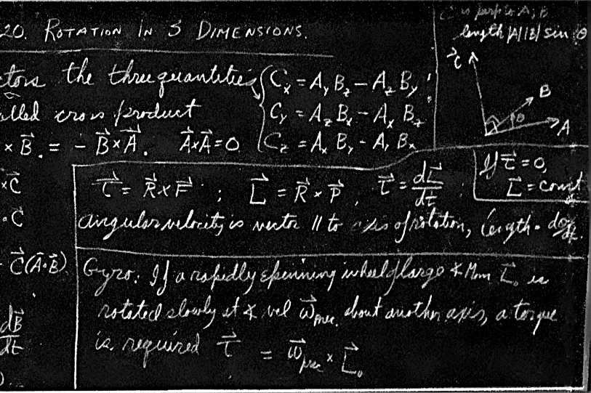
Angular momentum
What happens to a spinning top on the table?
It moves sideways
It falls over
It precesses
Hey, I thought you were supposed to be teaching me
See Feynman lectures, vol 1, chapter 20
Notes:
A magnetic moment is always connected with angular momentum.

Slide 17
Angular momentum and Magnetism
Energy of the magnetic moment in a magnetic field, B:
E = - µ • B
µ = γ L
(L is angular momentum of a magnetic moment,
γ is gyromagnetic ratio)
Area, A
N
S
Current, I
Chapter 1, Blundell, Magnetism in Condensed Matter, OUP 2001
Notes:
A magnetic moment is always connected with angular momentum.

Slide 18
What happens if you put a magnetic moment into a uniform magnetic field?
It moves
It lines up
It precesses
I’m sure you are supposed to be teaching me
N
S
Chapter 1, Blundell, Magnetism in Condensed Matter, OUP 2001

Slide 19
What happens if you put a magnetic moment into a uniform magnetic field?
It moves
It lines up
It precesses
I’m sure you are supposed to be teaching me
N
S
Chapter 1, Blundell, Magnetism in Condensed Matter, OUP 2001
Notes:
It precesses. However, it will then line up due to other “relaxation” processes (eg it could emit a photon or a phonon). If the temperature is high then it is less likely to line up.

Slide 20
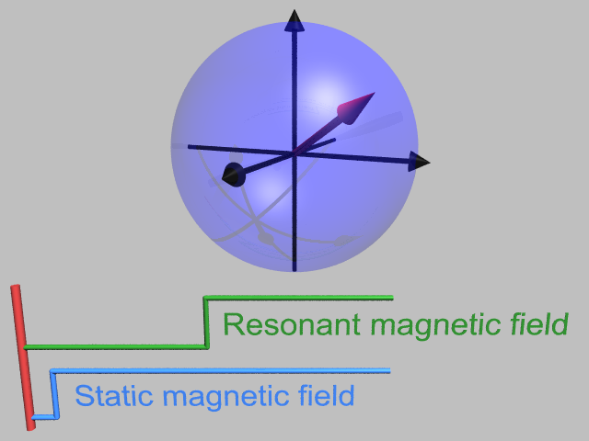
Put a magnetic moment into a vertical magnetic field
Larmor precession at angular frequency ω_{S}

Slide 21

Put a magnetic moment into a vertical magnetic field
Larmor precession at angular frequency ω_{S}

Slide 22
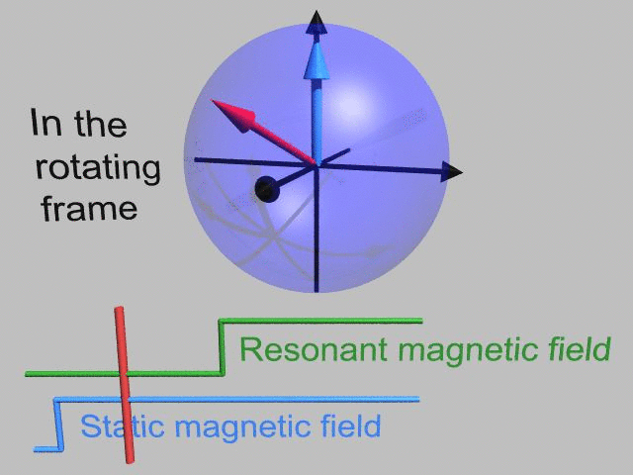
Put a magnetic moment into a vertical magnetic field
Larmor precession at angular frequency ω_{S}

Slide 23
Put a magnetic moment into a vertical magnetic field
In the rotating frame: spin vector is stationary

Slide 24
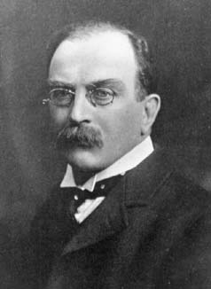
Precession of a magnetic moment
Energy of the magnetic moment in a magnetic field, B:
E = - µ • B
Larmor precession frequency = γ B
Area, A
Current, I
Joseph Larmor
(1857 – 1942)
Chapter 1, Blundell, Magnetism in Condensed Matter, OUP 2001
Notes:
Why does it precess? Energy is minimised by magnetic moment pointing along B. However, the magnetic field B alone cannot rotate the magnetic moment to make it reach this minimum energy because angular momentum must be conserved (just like linear momentum). Instead, the magnetic moment precesses just like a spinning top does. However, the precessing magnetic moments can relax to the lower energy state with help from other processes.

Slide 25
Magnetic resonance: prepare
- put a spin ½ into a magnetic field
Hamiltonian H = ω_{S}Ŝ_{z}
Electron spin: S = ½
With energy gap between up and down: ħ ω_{S} = g µ_{B} B₀
for g-factor, g ~ 2,
Bohr magneton µ_{B} = eħ/2m_{e},
Nuclear spins: µ_{N} ~ µ_{B} /1000
Energy of a spin
m_{s} = ½
m_{s} = -½
Magnetic field, B₀

Slide 26
Magnetic resonance: prepare
- put a spin ½ into a magnetic field
Larmor precession at angular frequency ω_{S}

Slide 27
Magnetic resonance: prepare
- put a spin ½ into a magnetic field
Larmor precession at angular frequency ω_{S}

Slide 28
Magnetic resonance: prepare
- put a spin ½ into a magnetic field
Larmor precession at angular frequency ω_{S}

Slide 29
Magnetic resonance: prepare
- put a spin ½ into a magnetic field
Larmor precession at angular frequency ω_{S}

Slide 30
Magnetic resonance: prepare
- put a spin ½ into a magnetic field
In the rotating frame: qubit vector is stationary

Slide 31
Magnetic resonance: control
- send in electromagnetic radiation
Energy gap is ΔE = g μ_{B} B₀,
magnetic resonance occurs when photon energy
ħ ω_{p} = ΔE
Energy of a spin
m_{s} = ½
m_{s} = -½
Photon energy ħ ω_{p}
Magnetic field, B₀
Selection rules: Δm_{s} = ±1
Circularly polarized light is absorbed

Slide 32
Magnetic resonance: control
- send in electromagnetic radiation
Notes:
Nuclear spins are all around us, with long coherence times

Slide 33
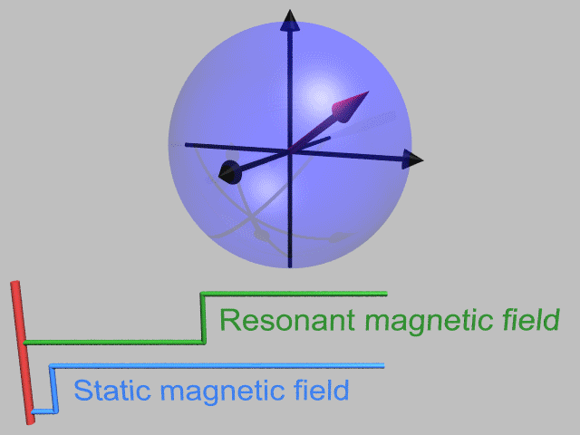
Magnetic resonance: control
- send in electromagnetic radiation
Notes:
Nuclear spins are all around us, with long coherence times

Slide 34
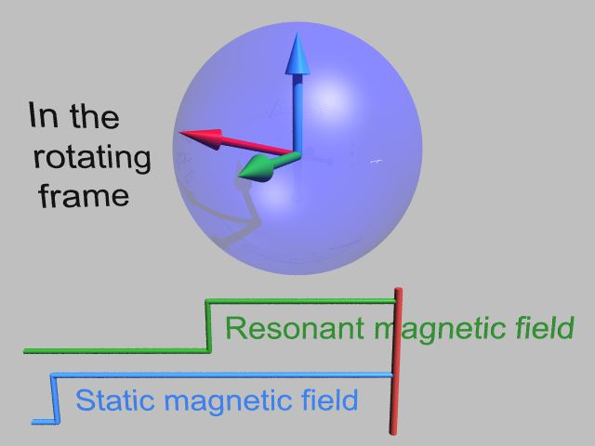
Magnetic resonance: control
- send in electromagnetic radiation
Notes:
Nuclear spins are all around us, with long coherence times

Slide 35
Magnetic resonance: control
Relaxation times
T₁ relaxation (longitudinal):
Energy relaxation
Classical information loss
Spin polarization
T₂ relaxation (transverse) is:
Phase relaxation
Quantum information loss
T₂* relaxation is:
Inhomogeneous T₂
2T₁ ≥ T₂ ≥ T₂*

Slide 36
Magnetic resonance: control
1. CW EPR spectrum (find linewidth = 1/T₂*)
2. Pulsed spectrum eg echo-detected field sweep
3. Rabi oscillations (find π pulse and Rabi decay time)
4. Phase control eg for phase cycling
5. Inversion recovery (find T₁)
6. Ramsey (find T₂*)
7. Spin echo decay (find T₂)
8. ESEEM (find nuclear precession frequency)
9. Dynamic decoupling eg CPMG, XY8 (find T₂^{CPMG},T₂^{XY8})
10. ENDOR (find T_{1n} and T_{2n})

Slide 37
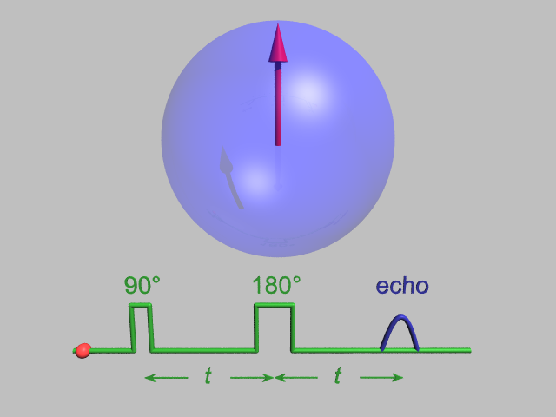
Magnetic resonance: spin echo
In rotating frame

Slide 38
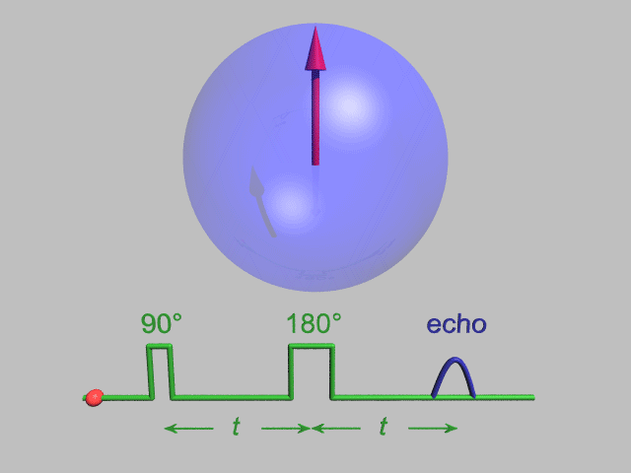
Magnetic resonance: spin echo
For ensembles of spins or repeated measurements of one spin
In rotating frame

Slide 39
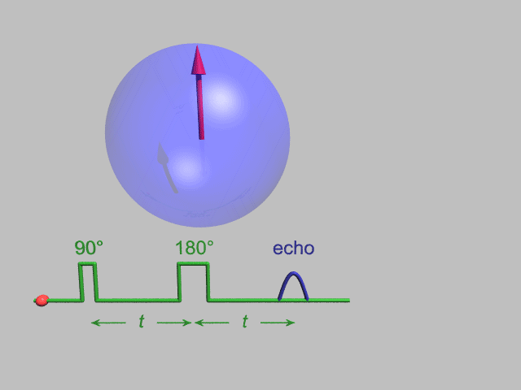
Magnetic resonance: spin echo
Spin echo decay
Dynamic decoupling: more π pulses
In rotating frame

Slide 40
Magnetic resonance: control
1. CW EPR spectrum (find linewidth = 1/T₂*)
2. Pulsed spectrum eg echo-detected field sweep
3. Rabi oscillations (find π pulse and Rabi decay time)
4. Phase control eg for phase cycling
5. Inversion recovery (find T₁)
6. Ramsey (find T₂*)
7. Spin echo decay (find T₂)
8. ESEEM (find nuclear precession frequency)
9. Dynamic decoupling eg CPMG, XY8 (find T₂^{CPMG},T₂^{XY8})
10. ENDOR (find T_{1n} and T_{2n})

Slide 41
Magnetic resonance: measure
- spin readout
Large ensembles
Precessing magnetic moments induce current in a coil (standard for NMR of >10¹⁵ nuclei)
Detect microwave power absorbed or emitted (standard for ESR of >10⁹ electron spins)
Single spins
Electrically (eg in silicon)
Optically (eg in diamond)
Footnote: the terms electron spin resonance (ESR) and
electron paramagnetic resonance (EPR) are used interchangeably
Notes:
Nuclear spins are all around us, with long coherence times

Slide 42
Magnetic resonance
Mini-summary:
1. Prepare (spin Hamiltonian)
2. Control (electromagnetic pulses)
3. Measure (spin state readout)
References:
MR for QIP theorists: MH Mohammady, PhD thesis, Chapter 3, UCL (2012)
ESR: A Schweiger & G Jeschke, Principles of Pulse Electron Paramagnetic Resonance (Oxford University Press, Oxford, 2001)
NMR: MH Levitt, Spin Dynamics (Wiley, 2001)
Notes:
Nuclear spins are all around us, with long coherence times

Slide 43
Magnetic resonance for QIP
Pioneering work: liquid-state NMR
LMK Vandersypen et al, Experimental realization of Shor's quantum factoring algorithm using nuclear magnetic resonance, Nature 414, 883 (2001)
WS Warren, The usefulness of NMR quantum computing, Science 277, 1688 (1997).

Slide 44
Magnetic resonance for QIP
Pioneering work: liquid-state NMR
Mini-summary:
1. Prepare (pseudo-pure state)
2. Control (NMR pulses)
3. Measure (spin state of large ensemble)
LMK Vandersypen et al, Experimental realization of Shor's quantum factoring algorithm using nuclear magnetic resonance, Nature 414, 883 (2001)
WS Warren, The usefulness of NMR quantum computing, Science 277, 1688 (1997).

Slide 45
Magnetic resonance for QIP
Pioneering work: liquid-state NMR
Mini-summary:
1. Prepare (pseudo-pure state)
2. Control (NMR pulses)
3. Measure (spin state of large ensemble)
n₂
ΔE
n₁
At thermal equilibrium:
n₂/n₁ = exp (- ΔE / k_{B} T)
Define polarization as:
P = (n₁-n₂) / (n₁ + n₂)

Slide 46
Magnetic resonance for QIP
Pioneering work: liquid-state NMR
… pseudo-pure states

Slide 47
Magnetic resonance for QIP
Pioneering work: liquid-state NMR
… pseudo-pure states
Notes:
Signal gets exponentially smaller as the number of qubits (q) is increased

Slide 48
Magnetic resonance for QIP
→ Use electron spins

Slide 49
Magnetic resonance for QIP
Pioneering work: GaAs quantum dots
GaAs is a semiconductor ie
”a place where electrons can be individuals”
D Loss & DP DiVincenzo, Quantum computation with quantum dots, PRA 57, 120 (1998)
R Hanson et al, Reviews of Modern Physics 79, 1217 (2007)
Notes:
Lithographically-defined quantum dots

Slide 50
Magnetic resonance for QIP
Pioneering work: GaAs quantum dots
Mini-summary:
1. Prepare (pure state)
2. Control (ESR pulses)
3. Measure (spin state of single spins)
200 µs spin coherence time:
H Bluhm et al, Nature Physics 7, 109 (2011)
R Hanson et al, Reviews of Modern Physics 79, 1217 (2007)
Notes:
Spin coherence times are not long enough due to coupling to >1000 Ga and As nuclear spins. Also spin-orbit coupling is higher than you would like

Slide 51
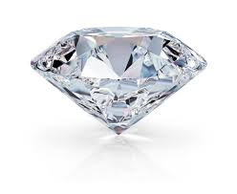
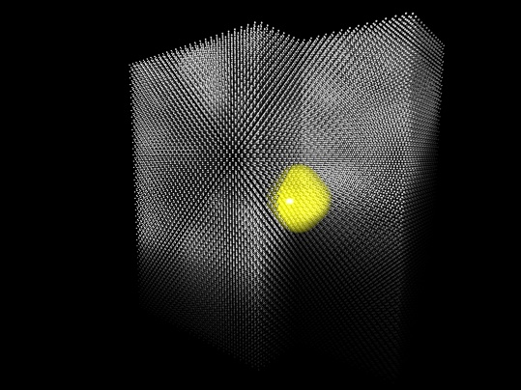
Magnetic resonance for QIP
Use electron spins in insulators/semiconductors which have a low background of nuclear spins:
Silicon and Diamond
Image by Manuel Vögtli
Notes:
Light atoms with nice low spin orbit coupling. Also silicon carbide is being considered. The white dots are silicon atoms. Substitute in a phosphorous atoms for a silicon atom and a spare electron can be bound at low temperature: that’s the lemon in the middle. This electron spin ½ is coupled to the nuclear spin ½ of the phosphorous. Called a “semiconductor vacuum” because the semiconductor does not do much.

Slide 52
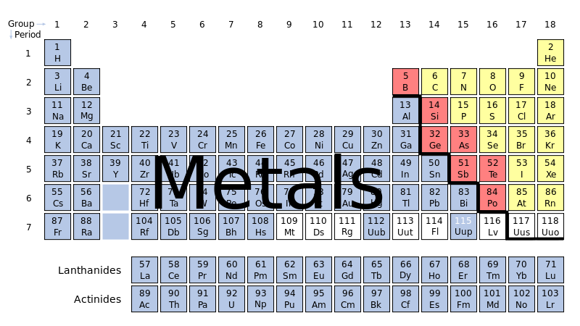

Donors in silicon

Slide 53
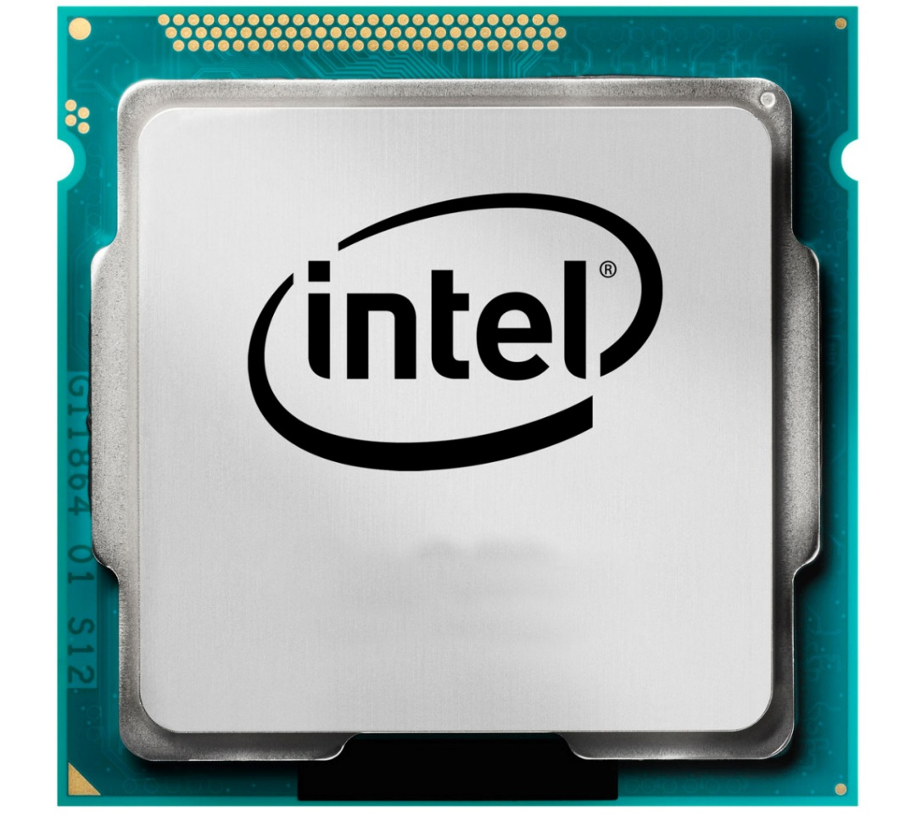
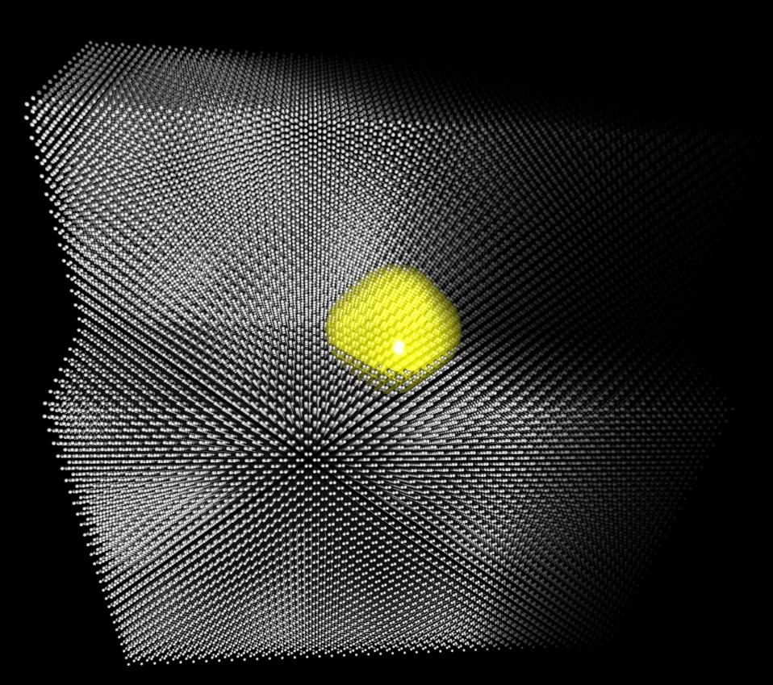
Donors in silicon

Slide 54
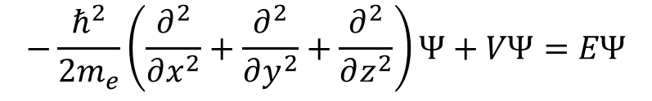
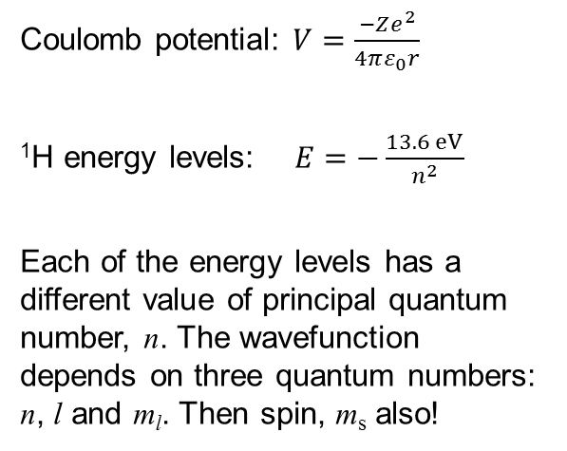
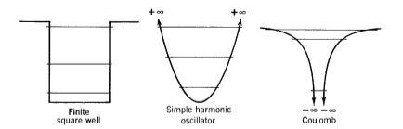
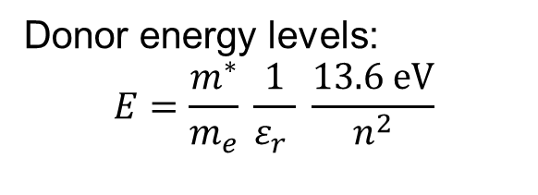

Dopants in silicon and diamond
- Hydrogenic model
Solve Schrödinger’s equation
for an electron in a box:
Relative permittivity, ε_{r}
Effective mass, m*
W Kohn, Shallow Impurity States in Silicon and Germanium, Solid State Physics 5, 257 (Academic, New York 1957)
-
Notes:
Epsilon_r used to be called the dielectric constant

Slide 55
Dopants in silicon and diamond
- Hydrogenic model
 | Relative permittivity, ε_{r} | m*/m_{e} | Binding energy for phosphorous dopant (meV)
Silicon | 11.7 | 0.98 (long.) 0.19 (trans.) | 46
Diamond | 5.7 (pure diamond) | 1.4 (long.) 0.36 (trans.) | 500
B Koiller, RB Capaz, X Hu and S Das Sarma, PRB 70, 115207 (2004)
-
Notes:
Envelope wavefunction (yellow shape) is approximately hydrogenic, but the wavefunction actually has strong oscillations due to the lattice

Slide 56


Donors in silicon
H = ω_{S}Ŝ_{z} – ω_{I}Î_{z} + A Ŝ•Î
with electron spin S = 1/2 and nuclear spin:
I = 1/2 for phosphorous (Si:P)
I = 3/2 for arsenic (Si:As)
I = 5/2 or 7/2 for antimony (Si:Sb)
I = 9/2 for bismuth (Si:Bi)
Pioneering early work:
G Feher and EA Gere, Physical Review 114, 1245 (1959)
G Feher, Physical Review 114, 1219 (1959)
JP Gordon and KD Bowers, Physical Review Letters 1, 368 (1958)
Notes:
Isotropic Hamiltonian: spatial symmetry is broken only by application of magnetic field. The anisotropy due to the lattice is small and will only become relevant later in the lecture

Slide 57
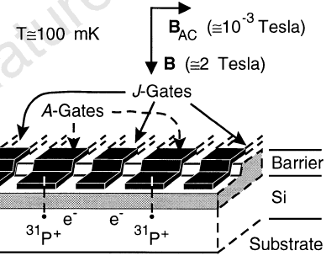

Donor qubits in silicon
Kane proposal:
BE Kane, A silicon-based nuclear spin
quantum computer, Nature 393, 133 (1998)

Slide 58
Donor qubits in silicon
Silicon QIP reviews:
DD Awschalom et al, Quantum Spintronics: Engineering and Manipulating Atom-Like Spins in Semiconductors, Science 339, 1174 (2013)
FA Zwanenburg et al, Silicon quantum electronics, Rev Mod Phys 85, 961 (2013)
GW Morley, Towards Spintronic Quantum Technologies with Dopants in Silicon, book chapter in SPR Electron Paramagnetic Resonance Volume 24, arXiv1407.6250 (2014)

Slide 59
Donor qubits in silicon
Mini-overview
Precise device fabrication
Qubit initialisation
Readout
Control
Coherence times

Slide 60
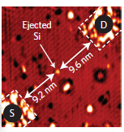

Precise fabrication
Fabrication Initialisation Readout Control Coherence
Using scanning tunnelling microscopy (STM)
JL O’Brien et al., PRB 64, 161401 (2001)
SR Schofield et al., PRL 91, 136104 (2003)
M Fuechsle et al., Nat Nano 7, 242 (2012)
B Weber et al., Science 335, 64 (2012)
Notes:
Hydrogen lithography with STM. Being set up in UCL by Neil Curson and Steven Schofield

Slide 61
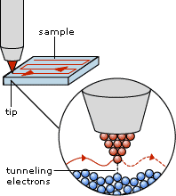
Scanning tunnelling microscopy (STM)
Fabrication Initialisation Readout Control Coherence
www.nobelprize.org/educational/physics/microscopes/scanning

Slide 62
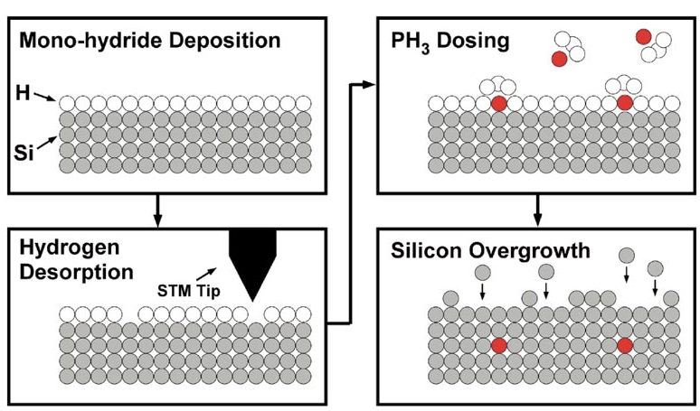
Fabrication Initialisation Readout Control Coherence
Precise fabrication
Using STM and hydrogen lithography

Slide 63
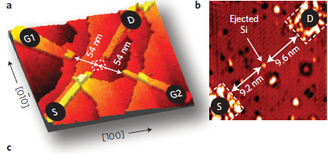
Fabrication Initialisation Readout Control Coherence
Precise fabrication
Using STM and hydrogen lithography
A Single Atom Transistor
M Fuechsle et al., Nat Nano 7, 242 (2012)

Slide 64
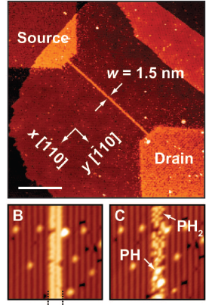
Fabrication Initialisation Readout Control Coherence
Precise fabrication
Using STM and hydrogen lithography
Ohm’s law Survives to the Atomic Scale
B Weber et al., Science
335, 64 (2012)

Slide 65
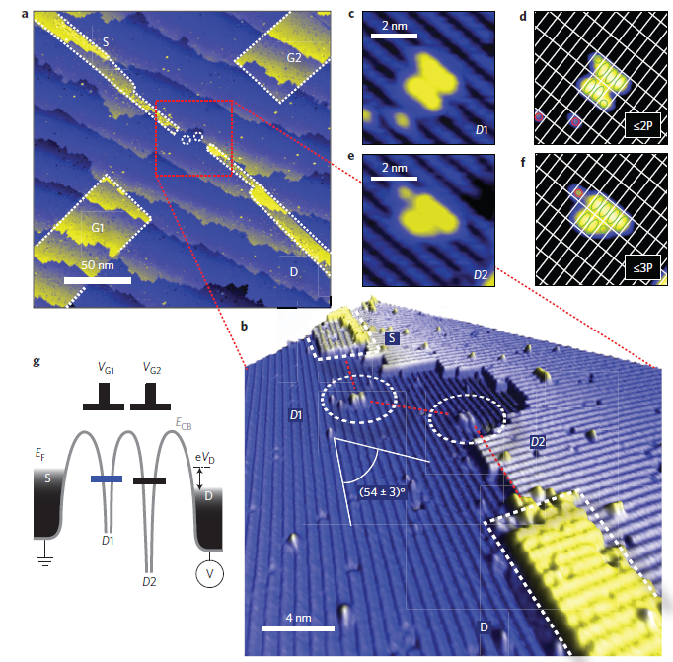
Fabrication Initialisation Readout Control Coherence
Precise fabrication
Using STM and hydrogen lithography
Spin blockade and exchange in Coulomb-confined
silicon double quantum dots
B Weber et al., Nature Nano
9, 430 (2014)

Slide 66
Initialisation by spin polarization
Fabrication Initialisation Readout Control Coherence
Thermal (Boltzmann) equilibrium:
n₂ / n₁ = exp(-ΔE / k_{B}T)
Define polarization as:
P = (n₁ - n₂) / (n₁ + n₂)
n₂
ΔE
n₁
DR McCamey, J van Tol, GW Morley and C Boehme, Fast Nuclear Hyperpolarization of Phosphorus in Silicon, Physical Review Letters, 102, 027601 (2009)
Electron spin: P_{Boltzmann} = 99.9%, Nuclear spin: P_{measured} = 68%

Slide 67
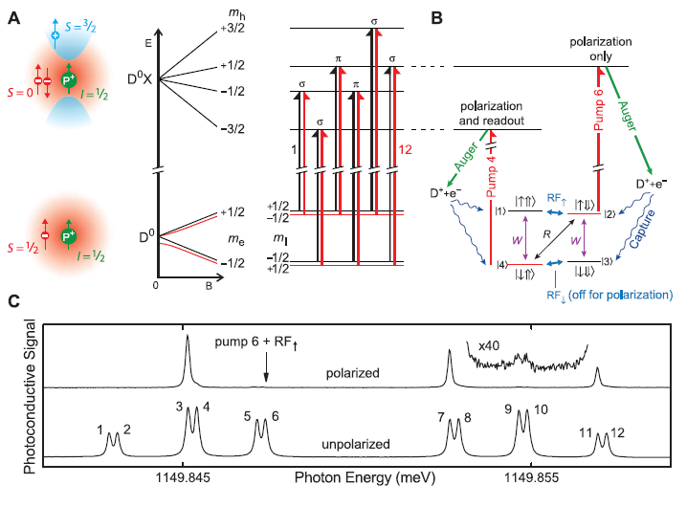
Qubit initialisation with lasers
Fabrication Initialisation Readout Control Coherence
A Yang et al., Simultaneous subsecond Hyperpolarization of the Nuclear and Electron Spins of Phosphorus in Silicon by Optical Pumping of Exciton Transitions, Physical Review Letters 102, 257401 (2009)
M Steger et al., Quantum Information Storage for over 180s Using Donor Spins in a ²⁸Si “Semiconductor Vacuum”, Science 336, 1280 (2012)
Electron spin: P_{bound exciton} = 97%
Nuclear spin: P_{bound exciton} = 90%

Slide 68
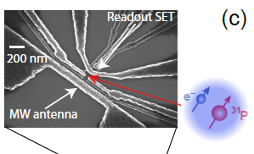
Initialisation by spin polarization
Fabrication Initialisation Readout Control Coherence
JT Muhonen et al., Storing quantum information for 30 seconds in a nanoelectronic device, Nature Nanotechnology, 9, 986 (2014)
Electron spin: P_{Boltzmann} = 99.9999999%

Slide 69
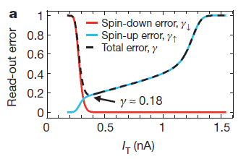
Initialisation using a readout
Fabrication Initialisation Readout Control Coherence
JJ Pla et al., A single-atom electron spin qubit in silicon, Nature 489, 541 (2012)
Electron spin readout error ~18%
Fast initialisation (spin-down) error ~1%

Slide 70
Single-shot single-spin SET readout
Fabrication Initialisation Readout Control Coherence
A Morello et al., Single-shot readout of an electron spin in silicon, Nature 467, 687 (2010)
JJ Pla et al., A single-atom electron spin qubit in silicon, Nature 489, 541 (2012)
Energy of a spin
Magnetic field

Slide 71
Fabrication Initialisation Readout Control Coherence
Single-shot single-spin SET readout
A Morello et al., Single-shot readout of an electron spin in silicon, Nature 467, 687 (2010)
JJ Pla et al., A single-atom electron spin qubit in silicon, Nature 489, 541 (2012)
Energy
metal island
donor

Slide 72
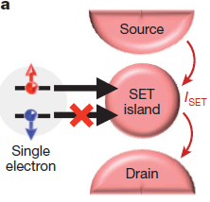
Fabrication Initialisation Readout Control Coherence
Single-shot single-spin SET readout
A Morello et al., Single-shot readout of an electron spin in silicon, Nature 467, 687 (2010)
JJ Pla et al., A single-atom electron spin qubit in silicon, Nature 489, 541 (2012)
Energy
metal island
donor

Slide 73
Fabrication Initialisation Readout Control Coherence
Single-shot single-spin SET readout
JT Muhonen et al., Quantifying the quantum gate fidelity of single-atom spin qubits in silicon by randomized benchmarking, J Phys: Condens Matter 27, 154205 (2015)
Readout error ~5% (electron spin)
Readout error ~10⁻⁷ (nuclear spin)

Slide 75
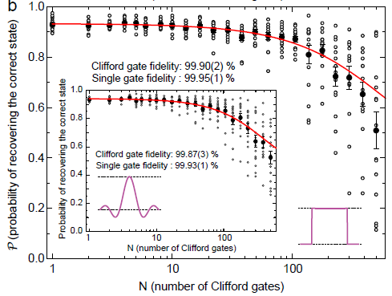
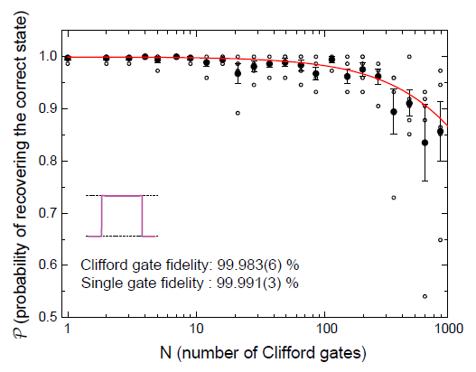
Qubit control
Fabrication Initialisation Readout Control Coherence
JT Muhonen et al., Quantifying the quantum gate fidelity of single-atom spin qubits in silicon by randomized benchmarking, J Phys: Condens Matter 27, 154205 (2015)
Average gate fidelities with ²⁸Si:
99.95% for electron
99.99% for nucleus

Slide 76
Spin echo
Fabrication Initialisation Readout Control Coherence
In rotating frame

Slide 77
Fabrication Initialisation Readout Control Coherence
Spin echo
For ensembles of spins or repeated measurements of a single spin
In rotating frame

Slide 78
Fabrication Initialisation Readout Control Coherence
Spin echo decay
Dynamic decoupling: more π pulses
In rotating frame

Slide 79
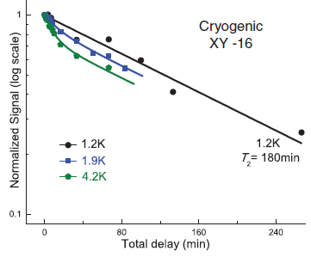
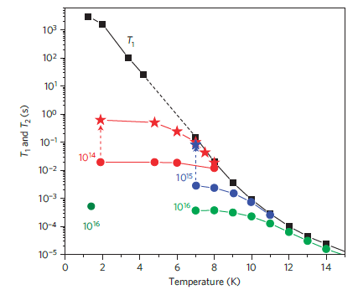
Coherence: donor qubit ensembles
Fabrication Initialisation Readout Control Coherence
Silicon:
Low impurity density
Low density of nuclear spins
Can use enriched ²⁸Si
Low spin orbit coupling
Nuclear T₂ = 3 hours
K Saeedi et al., Science 342, 830 (2013)
Electron T₂ > 1 second
AM Tyryshkin et al., Electron spin coherence exceeding seconds in high-purity silicon, Nature Materials 11, 143 (2012)
Notes:
99.9% electron polarization

Slide 80
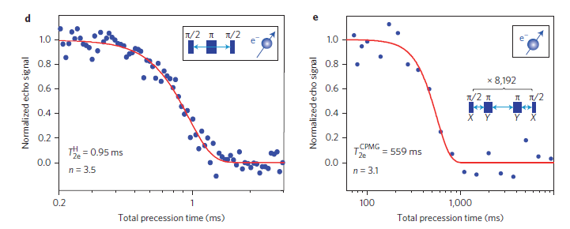
Fabrication Initialisation Readout Control Coherence
Coherence: single electron spin
Use ²⁸Si:
JT Muhonen et al., Storing quantum information for 30 seconds in a nanoelectronic device, Nature Nano 9, 986 (2014)
Notes:
99.9% electron polarization

Slide 81
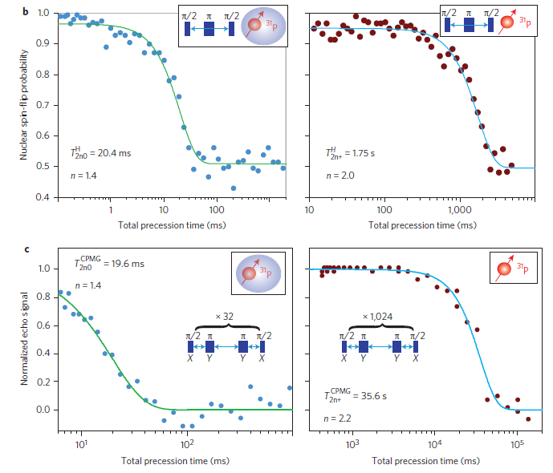
Fabrication Initialisation Readout Control Coherence
Coherence: single nuclear spin
Use ²⁸Si:
JT Muhonen et al., Storing quantum information for 30 seconds in a nanoelectronic device, Nature Nano 9, 986 (2014)
Notes:
99.9% electron polarization

Slide 82

Fabrication Initialisation Readout Control Coherence
Simulating coherence
Central spin problem: one electron spin in a bath of >1000 nuclear spins.
Intractable to do a full quantum simulation with a classical computer.
- WM Witzel & S Das Sarma, PRB 74, 035322 (2006)
- W Yang & R-B Liu, PRB 78, 085315 (2008)
Notes:
Coherence of a nuclear spin is longer than for an electron spin because the nuclear magnetic moment is ~1000 times smaller.

Slide 83
Conclusions and perspective
Fabrication Initialisation Readout Control Coherence
Need to couple up two donors
Notes:
99.9% electron polarization

Slide 84
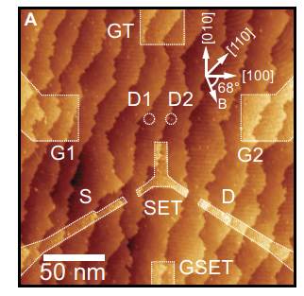
Fabrication Initialisation Readout Control Coherence
How to couple up two donors?
TF Watson, B Weber, Y-L Hsueh, LCL Hollenberg, R Rahman, MY Simmons, Atomically engineered electron spin lifetimes of 30 s in silicon, Sci Adv 3, e1602811 (2017)
Notes:
99.9% electron polarization

Slide 85
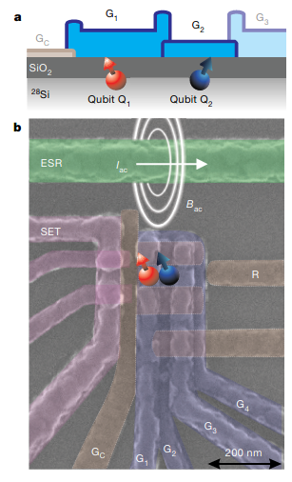
Fabrication Initialisation Readout Control Coherence
Lithographically-defined quantum dots in silicon
T₂ = 28 ms
T₂* = 120 µs
2 qubit gate in 500 ns
M Veldhorst, CH Yang, JCC Hwang, W Huang, JP Dehollain, JT Muhonen, S Simmons,
A Laucht, FE Hudson, KM Itoh, A Morello & AS Dzurak,
A two-qubit logic gate in silicon, Nature 526, 410 (2015)
M Veldhorst et al,
An addressable quantum dot qubit with fault-tolerant fidelity.
Nature Nano 9, 981 (2014)
Notes:
99.9% electron polarization

Slide 86
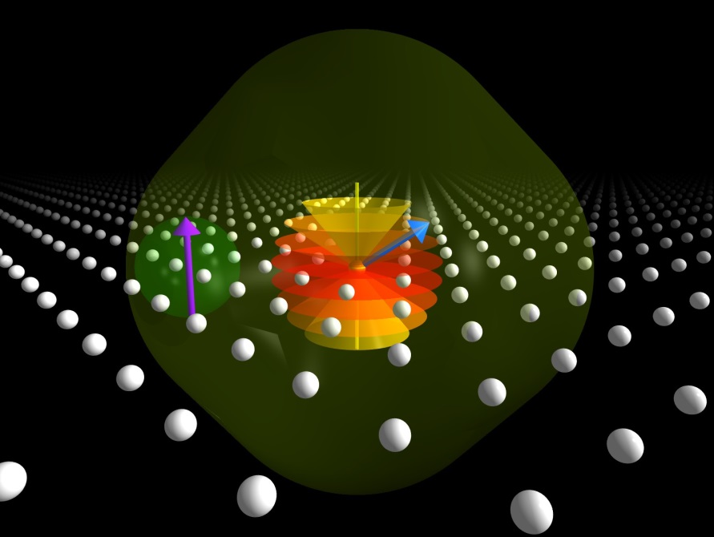
Bismuth donors in silicon
Image by Manuel Vögtli
T Sekiguchi et al., PRL 104, 137402 (2010)
GW Morley et al., Nature Materials 9, 725 (2010)
MH Mohammady, GW Morley & TS Monteiro, PRL 105, 067602 (2010)
RE George et al., PRL 105, 067601 (2010)
GW Morley et al., Nature Materials 12, 103 (2013)
G Wolfowicz et al., Nature Nano 8, 561 (2013)

Slide 87

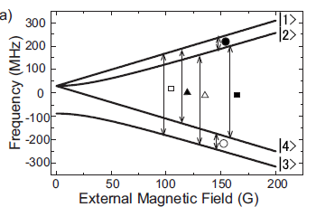
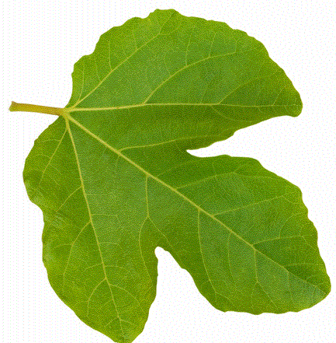
Phosphorus qubits in silicon

Slide 88

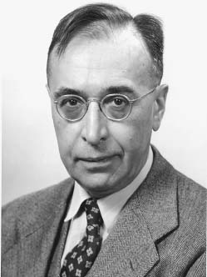
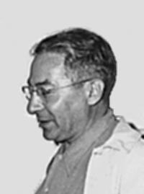
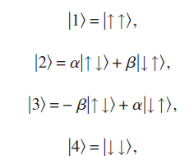
Phosphorus qubits in silicon
Gregory Breit (1899-1981)
Isidor Isaac Rabi (1898 – 1988)

Slide 89
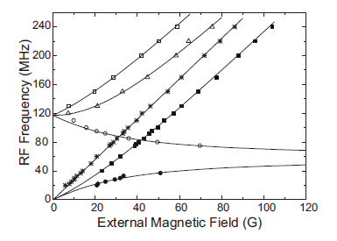
Phosphorus qubits in silicon
H. Morishita, L. S. Vlasenko, H. Tanaka, K. Semba, K. Sawano, Y. Shiraki, M. Eto & K. M. Itoh, Physical Review B 80, 205206 (2009).

Slide 90


Bismuth qubits in silicon

Slide 91
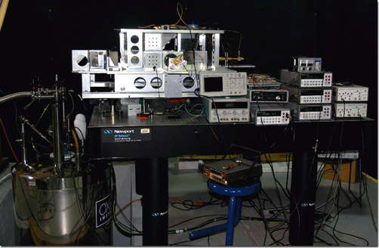

Pulsed electron spin resonance (ESR) at 110 – 336 GHz, 12.5 T
GWM, L-C Brunel & J van Tol, Rev Sci Instrum 79, 064703 (2008)
CW & transient EPR: J van Tol, L-C Brunel & R J Wylde, Rev Sci Instrum 76, 074101 (2005)
99.9% electron spin polarization

Slide 92

Bismuth donors in silicon
ESR of Si:Bi at 240 GHz
GWM, M Warner, AM Stoneham, PT Greenland, J van Tol, CWM Kay & G Aeppli, Nature Materials 9, 725 (2010)
^{A}/_{2π} = 1.5 GHz
9/2 7/2 5/2 3/2 1/2 -1/2 -3/2 -5/2 -7/2 -9/2
Si:P and Si:Bi resonances are resolved
Notes:
In high-field regime. You can see the 10 different states of the nuclear spin

Slide 93
Bismuth donors in silicon
Electron-nuclear double resonance (ENDOR) of Si:Bi at 240 GHz
GWM, M Warner, AM Stoneham, PT Greenland, J van Tol, CWM Kay & G Aeppli, Nature Materials 9, 725 (2010)

Slide 94
Bismuth donors in silicon
ESR of Si:Bi at 9.7 GHz
GWM, M Warner, AM Stoneham, PT Greenland, J van Tol, CWM Kay & G Aeppli, Nature Materials 9, 725 (2010)
Notes:
Not in high-field regime

Slide 95
Bismuth donors in silicon
Pulsed ESR of Si:Bi at 9.7 GHz
GWM, M Warner, A M Stoneham, P T Greenland, J van Tol, C W M Kay, G Aeppli, Nature Materials 9, 725 (2010)
G Wolfowicz et al., Nature Nano 8, 561 (2013)
Notes:
T2 for Si:Bi is over 1ms: as long as Si:P and limited by 29Si. T1 rate is Orbach term (deltaE=500K) + T7 Raman term

Slide 96
Bismuth donors in silicon
Pulsed ESR of Si:Bi at 9.7 GHz
G Wolfowicz, S Simmons, AM Tyryshkin, RE George, H Riemann, NV Abrosimov, P Becker, H-J Pohl, SA Lyon, MLW Thewalt & JJL Morton, Physical Review B 86, 245301 (2012)
Extrapolated to zero instantaneous diffusion

Slide 97

Bismuth donors in silicon
Magnetic resonance of Si:Bi
MH Mohammady, GWM & TS Monteiro, PRL 105, 067602 (2010)

Slide 98
Bismuth donors in silicon
Magnetic resonance of Si:Bi
G Wolfowicz, AM Tyryshkin, RE George, H Riemann, NV Abrosimov, P Becker, H-J Pohl, MLW Thewalt, SA Lyon & JJL Morton, Nature Nano 8, 561 (2013)
Magnitude detection to remove experimental phase noise

Slide 99
Bismuth donors in silicon
Magnetic resonance of Si:Bi
MH Mohammady, GWM & TS Monteiro, PRL 105, 067602 (2010)
10 ➔ 9 is an NMR transition at high field

Slide 100


Bismuth donors in silicon
Nuclear-electronic magnetic resonance of Si:Bi at 4 GHz
10 ➔ 9 is an NMR transition at high field
GWM, P Lueders, MH Mohammady, SJ Balian, G Aeppli, CWM Kay, WM Witzel, G Jeschke, TS Monteiro, Nature Materials 12, 103 (2013)

Slide 101

Bismuth donors in silicon
Quantum control of a hybrid nuclear-electronic spin system
GWM, P Lueders, MH Mohammady, SJ Balian, G Aeppli, CWM Kay, WM Witzel, G Jeschke, TS Monteiro, Nature Materials 12, 103 (2013)

Slide 102

Bismuth donors in silicon
Hybrid MR of Si:Bi at 4 GHz
GWM, P Lueders, MH Mohammady, SJ Balian, G Aeppli, CWM Kay, WM Witzel, G Jeschke, TS Monteiro, Nature Materials 12, 103 (2013)

Slide 103

Bismuth donors in silicon
Hybrid MR of Si:Bi at 4 GHz
GWM, P Lueders, MH Mohammady, SJ Balian, G Aeppli, CWM Kay, WM Witzel, G Jeschke, TS Monteiro, Nature Materials 12, 103 (2013)

Slide 104

Bismuth donors in silicon
Hybrid MR of Si:Bi at 4 GHz
GWM, P Lueders, MH Mohammady, SJ Balian, G Aeppli, CWM Kay, WM Witzel, G Jeschke, TS Monteiro, Nature Materials 12, 103 (2013)
Notes:
Points where decoherence is reduced and nuclear spin can be manipulated fast

Slide 105
Bismuth donors in silicon
Si:Bi magnetic resonance
- T Sekiguchi et al., PRL 104, 137402 (2010)
- M Belli et al., PRB 83, 235204 (2011)
- S J Balian et al., PRB 86, 104428 (2012)
- M H Mohammady et al., PRB 85, 094404 (2012)
- C D Weis et al., APL 100, 172104 (2012)
- G Wolfowicz et al., PRB 86, 245301 (2012)
- P Studer et al., ACS Nano 6, 10456 (2012)
- P A Mortemousque et al., APL 101, 082409 (2012)
- G Wolfowicz et al., Nature Nano 8, 561 (2013)
- S J Balian et al., PRB 89, 045403 (2014)

Slide 106
Donor qubits in silicon: conclusions
Precise device fabrication
Qubit initialisation
Readout
Control
Coherence times
Using Si:Bi offers extra benefits
Need to couple up two donors

Slide 107

Energy levels of P and As in Si
N Q Vinh et al., PNAS 105, 10649 (2008)
Notes:
Si:Bi ionisation energy is 68meV and Si:P has 45meV, Si:As has 54meV

