Slide 1
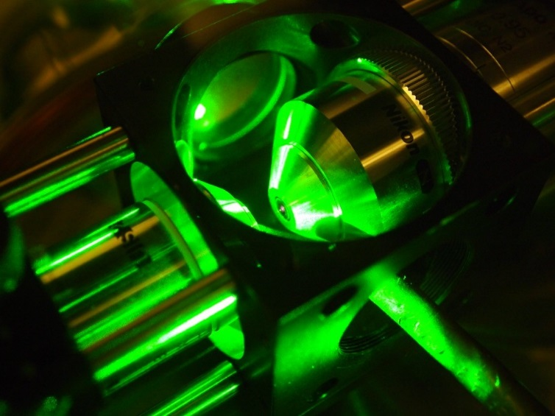
Experiments with spin qubits in diamond

Slide 2

Experiments with spin qubits in diamond: overview
Diamond
Nitrogen-vacancy (NV⁻) centre
1. Properties
2. Applications
a) magnetometry
b) thermometry
c) electrometry
d) in a tractor beam?
e) violating Bell’s inequality
Silicon-vacancy (SiV) centre

Slide 3

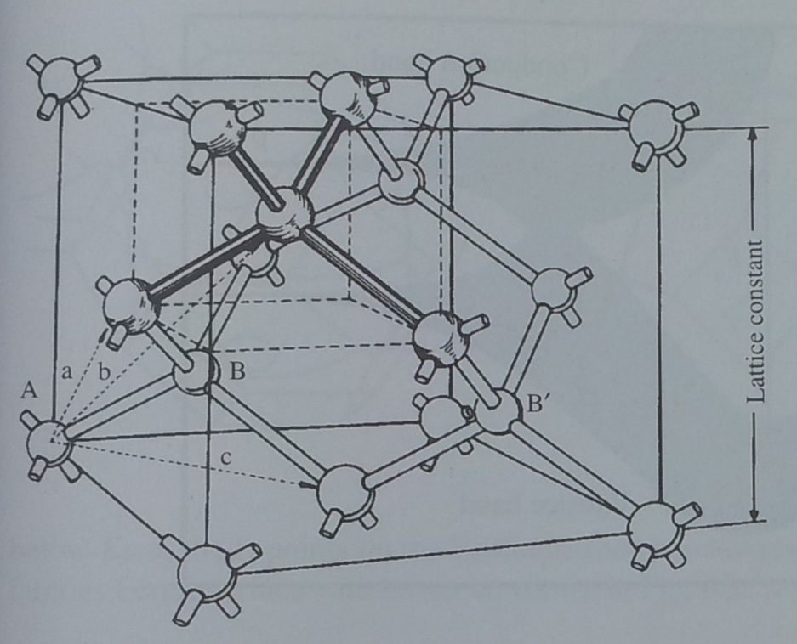
Diamond
Face-centred cubic (FCC)
with two atom basis
EPSRC CDT:
Warwick (host)
Oxford
Imperial
Bristol
Cardiff
Strathclyde
Newcastle Aberystwyth
Diamond crystal structure. Page 37, Singleton, Band Theory and Electronic Properties of Solids, OUP 2001

Slide 4
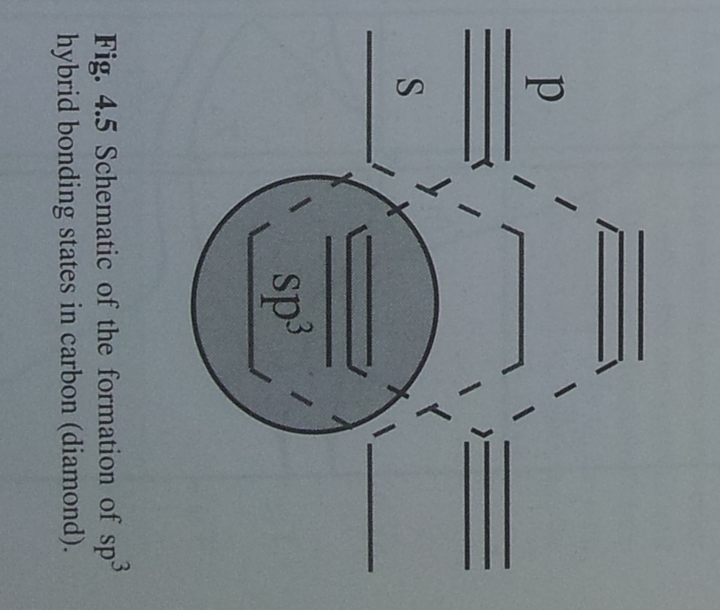
Diamond
- tight-binding model
Carbon:
1s² 2s² 2p²
Schematic of the formation of sp³ hybrid bonding states in diamond. Page 37, Singleton, Band Theory and Electronic Properties of Solids, OUP 2001

Slide 5
Diamond
- tight-binding model
Carbon:
1s² 2s² 2p²
5.5 eV band gap
Diamond is an insulator:
”a place where electrons can be hermits”
Schematic of the formation of sp³ hybrid bonding states in diamond. Page 37, Singleton, Band Theory and Electronic Properties of Solids, OUP 2001

Slide 6
Diamond defects
F Bridges, G Davies, J Robertson and AM Stoneham, Journal of Physics-Condensed Matter 2, 2875 (1990)

Slide 7
Diamond defects
F Bridges, G Davies, J Robertson and AM Stoneham, Journal of Physics-Condensed Matter 2, 2875 (1990)

Slide 8
Diamond defects
F Bridges, G Davies, J Robertson and AM Stoneham, Journal of Physics-Condensed Matter 2, 2875 (1990)

Slide 9
Diamond defects
F Bridges, G Davies, J Robertson and AM Stoneham, Journal of Physics-Condensed Matter 2, 2875 (1990)

Slide 10
The nitrogen-vacancy (NV) centre in diamond
Confocal microscope image
MW Doherty, NB Manson, P Delaney, F Jelezko, J Wrachtrup, LCL Hollenberg, Phys Rep 528, 1 (2013)

Slide 11
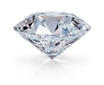
Single nitrogen-vacancy centres
Hanbury Brown and Twiss (HBT) experiment
Correlation?
Detector 1
Detector 2
Green excitation
MW Doherty, NB Manson, P Delaney, F Jelezko, J Wrachtrup, LCL Hollenberg, Phys Rep 528, 1 (2013)

Slide 12
Single nitrogen-vacancy centres
NV⁻ optical spectroscopy
Green excitation in, red florescence out
See also: M Fox, Optical Properties of Solids, Second Edition, OUP 2013, Section 8.2, page 218-224.
A Gruber, A Drabenstedt, C Tietz, L Fleury, J Wrachtrup*, C. von Borczyskowski, Science 276, 2012 (1997).
MW Doherty, NB Manson, P Delaney, F Jelezko, J Wrachtrup, LCL Hollenberg, Phys Rep 528, 1 (2013).

Slide 13
Single nitrogen-vacancy centres
NV⁻ electron spin resonance spectroscopy
Optically-detected magnetic resonance (ODMR)
MW Doherty, NB Manson, P Delaney, F Jelezko, J Wrachtrup, LCL Hollenberg, Phys Rep 528, 1 (2013)

Slide 14
Single nitrogen-vacancy centres
NV⁻ energy levels
JHN Loubser
& JA van Wyk, Rep Progr Phys 41 1202 (1978)
MW Doherty, NB Manson, P Delaney, F Jelezko, J Wrachtrup, LCL Hollenberg, Phys Rep 528, 1 (2013)

Slide 15
Single nitrogen-vacancy centres
NV⁻ energy levels
±1
³E
±0
¹A₁
¹E
Black numbers are spin state (in zero magnetic field)
±1
³A₂
Red names come from the C_{3v} point group: see appendix of Doherty et al
±0
MW Doherty, NB Manson, P Delaney, F Jelezko, J Wrachtrup, LCL Hollenberg, Phys Rep 528, 1 (2013)

Slide 16
Single nitrogen-vacancy centres
NV⁻ energy levels
±1
³E
±0
Green excitation
¹A₁
¹E
±1
³A₂
±0
MW Doherty, NB Manson, P Delaney, F Jelezko, J Wrachtrup, LCL Hollenberg, Phys Rep 528, 1 (2013)

Slide 17
Single nitrogen-vacancy centres
NV⁻ energy levels
±1
³E
±0
¹A₁
Red Emission
Decay time ~10ns
¹E
±1
³A₂
±0
MW Doherty, NB Manson, P Delaney, F Jelezko, J Wrachtrup, LCL Hollenberg, Phys Rep 528, 1 (2013)

Slide 18
Single nitrogen-vacancy centres
NV⁻ energy levels
±1
³E
±0
¹A₁
¹E
±1
³A₂
Microwave excitation (2.9 GHz)
±0
MW Doherty, NB Manson, P Delaney, F Jelezko, J Wrachtrup, LCL Hollenberg, Phys Rep 528, 1 (2013)

Slide 19
Single nitrogen-vacancy centres
NV⁻ energy levels
±1
³E
±0
Green excitation
¹A₁
¹E
±1
³A₂
±0
MW Doherty, NB Manson, P Delaney, F Jelezko, J Wrachtrup, LCL Hollenberg, Phys Rep 528, 1 (2013)

Slide 20
Single nitrogen-vacancy centres
NV⁻ energy levels
±1
³E
±0
¹A₁
¹E
±1
³A₂
No florescence, ~300 ns decay time
±0
MW Doherty, NB Manson, P Delaney, F Jelezko, J Wrachtrup, LCL Hollenberg, Phys Rep 528, 1 (2013)

Slide 21
Single nitrogen-vacancy centres
NV⁻ energy levels
Green excitation light polarizes the NV- electron spin far beyond Boltzmann polarization
Florescence intensity depends on spin state
MW Doherty, NB Manson, P Delaney, F Jelezko, J Wrachtrup, LCL Hollenberg, Phys Rep 528, 1 (2013)

Slide 22
Single nitrogen-vacancy centres
NV⁻ optically-detected magnetic resonance
Green excitation light polarizes the NV- electron spin far beyond Boltzmann polarization
Florescence intensity depends on spin state
MW Doherty, NB Manson, P Delaney, F Jelezko, J Wrachtrup, LCL Hollenberg, Phys Rep 528, 1 (2013)

Slide 23
Single nitrogen-vacancy centres
NV⁻ summary
Mini-overview
NV fabrication
Qubit initialisation
Readout
Control
Coherence times
MW Doherty, NB Manson, P Delaney, F Jelezko, J Wrachtrup, LCL Hollenberg, Phys Rep 528, 1 (2013)

Slide 24
Single nitrogen-vacancy centres
Initialize nuclear spins as well as electrons
Mini-overview
NV fabrication
Qubit initialisation
Readout
Control
Coherence times
V Jacques et al, Physical Review Letters 102, 057403 (2009)

Slide 25
Single nitrogen-vacancy centres
Single shot readout using nuclear spins
Mini-overview
NV fabrication
Qubit initialisation
Readout
Control
Coherence times
L. Jiang et al, Science 326, 267 (2009)
P Neumann et al, Science 329, 542 (2010)
E Togan et al, Nature 478, 497 (2011)
MW Doherty, NB Manson, P Delaney, F Jelezko, J Wrachtrup, LCL Hollenberg, Phys Rep 528, 1 (2013)

Slide 26
Single nitrogen-vacancy centres
Quantum control of electron and nuclear spins
Mini-overview
NV fabrication
Qubit initialisation
Readout
Control
Coherence times
Microwaves to control electron spin and
radiowaves to control nuclear spins
eg three spin quantum error correction:
G Waldherr et al, Nature 506, 204 (2014)
MW Doherty, NB Manson, P Delaney, F Jelezko, J Wrachtrup, LCL Hollenberg, Phys Rep 528, 1 (2013)

Slide 27
Single nitrogen-vacancy centres
Ion implantation for fabrication
Mini-overview
NV fabrication
Qubit initialisation
Readout
Control
Coherence times
Very imperfect arrays:
up to 50% yield for NV- after nitrogen ion implantation
Worse for shallow NV-
~50 nm precision
Repeat-until-success?
DM Toyli et al, Nano Lett 10, 3168 (2010)

Slide 28
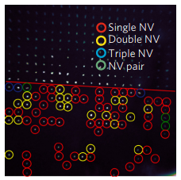
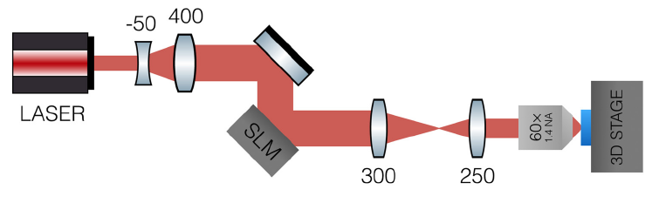
Single nitrogen-vacancy centres
Laser-writing for fabrication
Courvoisier, Booth, and Salter, APL 109, 031109 (2016)
Chen, Salter, Knauer, Weng, Frangeskou, Stephen, Ishmael, Dolan, Johnson, Green, Morley, Newton, Rarity, Booth, Smith, Nat Photon 11, 77 (2017)
Very imperfect arrays:
up to 50% yield for NV-
Worse for shallow NV-
~200 nm precision
Repeat-until-success?

Slide 29
Single nitrogen-vacancy centres
Spin coherence times
Mini-overview
NV fabrication
Qubit initialisation
Readout
Control
Coherence times
 | Electron spin in ¹²C | Nuclear spin
Room temperature T₂ | 1.8 ms | 1 s
Cryogenic T₂ | 0.6 s (77 K with dynamic decoupling) | 10 s (at 8 K)
1.8 ms: G Balasubramanian et al, Nature Materials 8, 383 (2009)
0.6 s: N Bar-Gill et al, Nat Commun 4, 1743 (2013)
1 s: PC Maurer et al, Science 336, 1283 (2012)
10s: S Yang et al, Nat Photon 10, 507 (2016)

Slide 30
Single nitrogen-vacancy centres
Properties
Mini-overview
NV fabrication
Qubit initialisation
Readout
Control
Coherence times
MW Doherty, NB Manson, P Delaney, F Jelezko, J Wrachtrup, LCL Hollenberg, Phys Rep 528, 1 (2013)

Slide 31
Nitrogen-vacancy centres: Applications
Magnetometer, Electrometer, Thermometer…
MW Doherty, NB Manson, P Delaney, F Jelezko, J Wrachtrup, LCL Hollenberg, Phys Rep 528, 1 (2013)

Slide 32
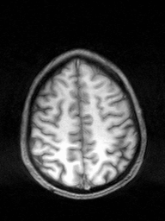
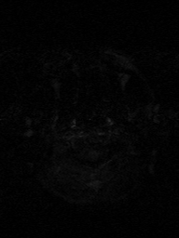
Sensing
Notes:
Signal, SNR, resolution (temporal and spatial)

Slide 33

Sensing
Notes:
Signal, SNR, resolution (temporal and spatial)

Slide 34
Sensing
Notes:
Signal, SNR, resolution (temporal and spatial)

Slide 35

Sensing
Notes:
Signal, SNR, resolution (temporal and spatial)

Slide 36

Sensing
Notes:
Signal, SNR, resolution (temporal and spatial)

Slide 37
Sensing
Notes:
Signal, SNR, resolution (temporal and spatial)

Slide 38
Sensing
Notes:
Signal, SNR, resolution (temporal and spatial)

Slide 39
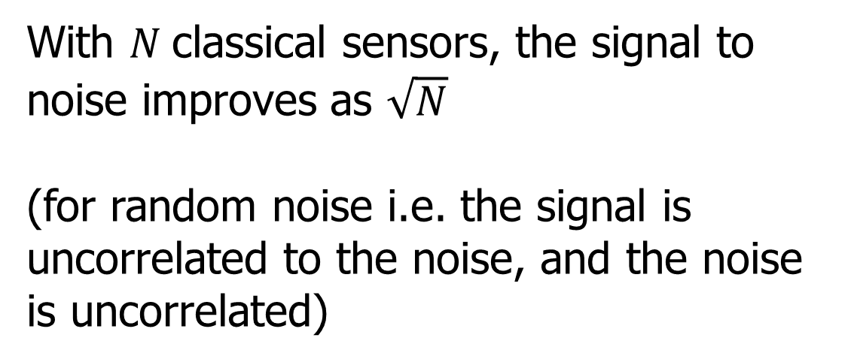
Classical Sensing
With $N$classical sensors, the signal to noise improves as $\sqrt{N}$
(for random noise i.e. the signal is uncorrelated to the noise, and the noise is uncorrelated)
Notes:
Signal, SNR, resolution (temporal and spatial)

Slide 40
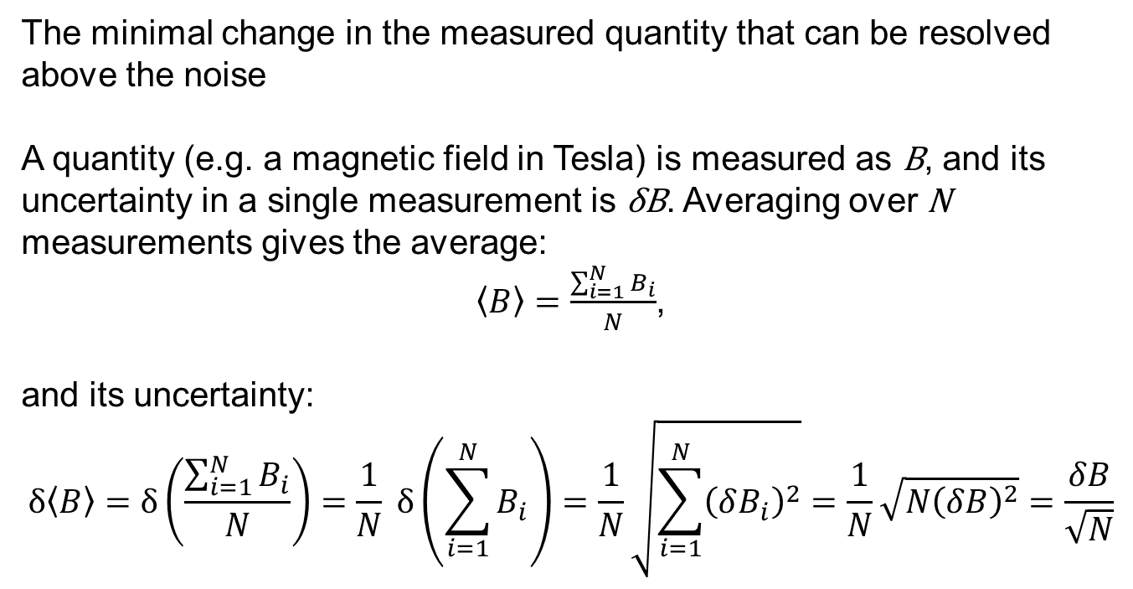
Sensitivity
The minimal change in the measured quantity that can be resolved above the noise
A quantity (e.g. a magnetic field in Tesla) is measured as B, and its uncertainty in a single measurement is δB. Averaging over N measurements gives the average:
$\left\langle B\right\rangle =\frac{\sum_{i=1}^{N}{B_{i}}}{N}$,
and its uncertainty:
$$δ\left\langle B\right\rangle =δ\left(\frac{\sum_{i=1}^{N}{B_{i}}}{N}\right)=\frac{1}{N} δ\left(\sum_{i=1}^{N}{B_{i}}\right)=\frac{1}{N}\sqrt{\sum_{i=1}^{N}{{\left(δB_{i}\right)}^{2}}}=\frac{1}{N}\sqrt{{N\left(δB\right)}^{2}}=\frac{δB}{\sqrt{N}}$$

Slide 41

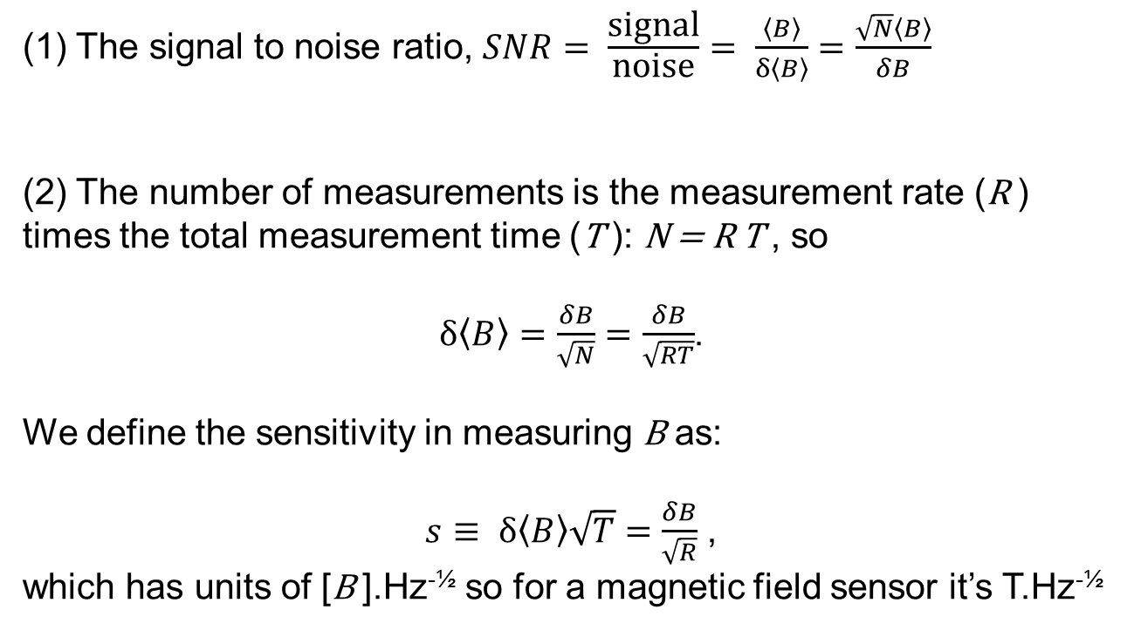
Sensitivity (cont.)
$$δ\left\langle B\right\rangle =\frac{δB}{\sqrt{N}}$$
(1) The signal to noise ratio, $SNR= \frac{\text{signal}}{\text{noise}}= \frac{\left\langle B\right\rangle }{δ\left\langle B\right\rangle }=\frac{\sqrt{N}\left\langle B\right\rangle }{δB}$
(2) The number of measurements is the measurement rate (R ) times the total measurement time (T ): N = R T , so
$δ\left\langle B\right\rangle =\frac{δB}{\sqrt{N}}=\frac{δB}{\sqrt{RT}}$.
We define the sensitivity in measuring B as:
$s≡ δ\left\langle B\right\rangle \sqrt{T}=\frac{δB}{\sqrt{R}}$ ,
which has units of [B ].Hz^{-½} so for a magnetic field sensor it’s T.Hz^{-½}

Slide 42
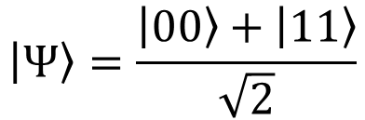
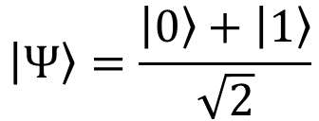
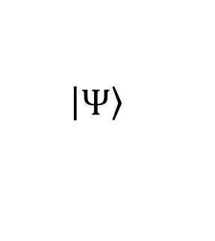
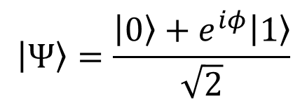
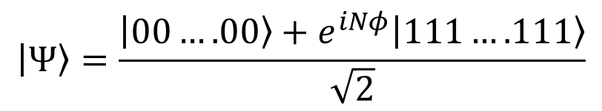

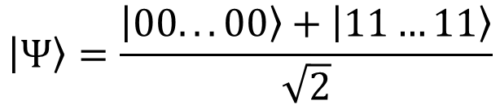

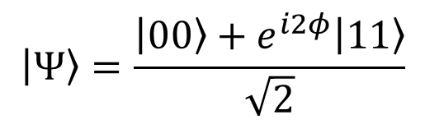
Quantum Sensing
$$U_{φ}= e^{−iφZ}$$
$Z=\left(\begin{matrix}1 & 0 \\ 0 & −1\end{matrix}\right)$
$$U_{φ}$$
$$\left|\left.Ψ\right\rangle \right.$$
U_{Φ}
U_{Φ}
$$\left|\left.Ψ\right\rangle \right.=\frac{\left.\left|0\right.\right\rangle +\left|\left.1\right\rangle \right.}{\sqrt{2}}$$
$$\left|\left.Ψ\right\rangle \right.=\frac{\left.\left|0\right.\right\rangle +e^{iφ}\left|\left.1\right\rangle \right.}{\sqrt{2}}$$
Use superposition
$$\left|\left.Ψ\right\rangle \right.=\frac{\left.\left|00\right.\right\rangle +\left|\left.11\right\rangle \right.}{\sqrt{2}}$$
$$\left|\left.Ψ\right\rangle \right.=\frac{\left.\left|00\right.\right\rangle +e^{i2φ}\left|\left.11\right\rangle \right.}{\sqrt{2}}$$
Use entanglement
$$\left|\left.Ψ\right\rangle \right.=\frac{\left.\left|00...00\right.\right\rangle +\left|\left.11…11\right\rangle \right.}{\sqrt{2}}$$
$$\left|\left.Ψ\right\rangle \right.=\frac{\left.\left|00….00\right.\right\rangle +e^{iNφ}\left|\left.111….111\right\rangle \right.}{\sqrt{2}}$$
Notes:
Signal, SNR, resolution (temporal and spatial)

Slide 43
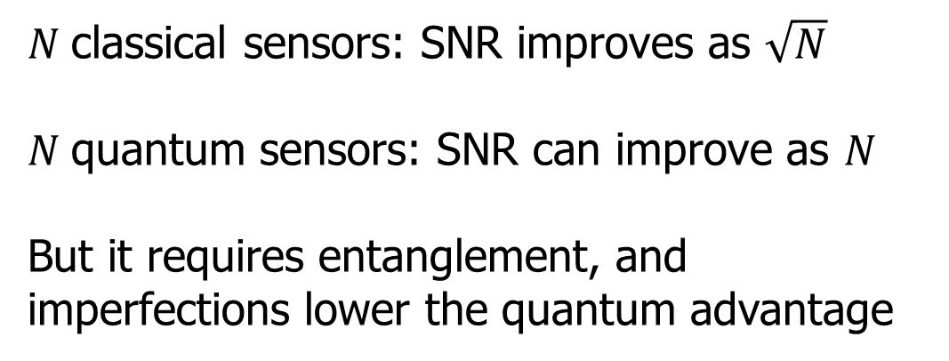
Quantum Sensing
$N$classical sensors: SNR improves as $\sqrt{N}$
$N$quantum sensors: SNR can improve as $N$
But it requires entanglement, and imperfections lower the quantum advantage
$$\left|\left.Ψ\right\rangle \right.=\frac{\left.\left|00...00\right.\right\rangle +\left|\left.11…11\right\rangle \right.}{\sqrt{2}}$$
$$\left|\left.Ψ\right\rangle \right.=\frac{\left.\left|00….00\right.\right\rangle +e^{iNφ}\left|\left.111….111\right\rangle \right.}{\sqrt{2}}$$
Notes:
Signal, SNR, resolution (temporal and spatial)

Slide 44
Practical Quantum Sensing
Don’t use maximally entangled states because of decoherence
Quantum sensing is useful when averaging is limited e.g. by size, time, fragile samples
$$\left|\left.Ψ\right\rangle \right.=\frac{\left.\left|00...00\right.\right\rangle +\left|\left.11…11\right\rangle \right.}{\sqrt{2}}$$
$$\left|\left.Ψ\right\rangle \right.=\frac{\left.\left|00….00\right.\right\rangle +e^{iNφ}\left|\left.111….111\right\rangle \right.}{\sqrt{2}}$$
Notes:
Signal, SNR, resolution (temporal and spatial)

Slide 45




Practical Quantum Sensing
Magnetometry
Thermometry
Accelerometers
Gravimetry
Microscopy
Imaging
Notes:
Signal, SNR, resolution (temporal and spatial)

Slide 46
Nitrogen-vacancy centres: Applications
Magnetometer, Electrometer, Thermometer…
MW Doherty, NB Manson, P Delaney, F Jelezko, J Wrachtrup, LCL Hollenberg, Phys Rep 528, 1 (2013)

Slide 47
Nitrogen-vacancy centres: Applications
DC Magnetometer
m_{s} = +1
m_{s} = -1
m_{s} = 0
Energy of NV- with spin 1
2.88 GHz
Magnetic field, B₀
Review:
L Rondin et al., Magnetometry with nitrogen-vacancy defects in diamond, Rep Prog Phys 77, 056503 (2014)

Slide 48
Nitrogen-vacancy centres: Applications
DC Magnetometer
m_{s} = +1
m_{s} = -1
m_{s} = 0
15 pT.Hz^{-½} sensitivity at 80 - 2000 Hz from (13 x 200 x 2000) µm³ diamond: JF Barry et al., PNAS 2016
Energy of NV- with spin 1
Magnetic field, B₀
- lock-in detection
- large ensemble of NV- (sacrificing nanoscale spatial resolution)
- multiple passes of light though the diamond

Slide 49
Bulk, DC, lock-in
Lock-in detection
Signal
Lock-in signal
Magnetic field modulation
(~1 to 100 kHz)
Advantage: noise only at
modulation frequency
Magnetic field, B

Slide 50
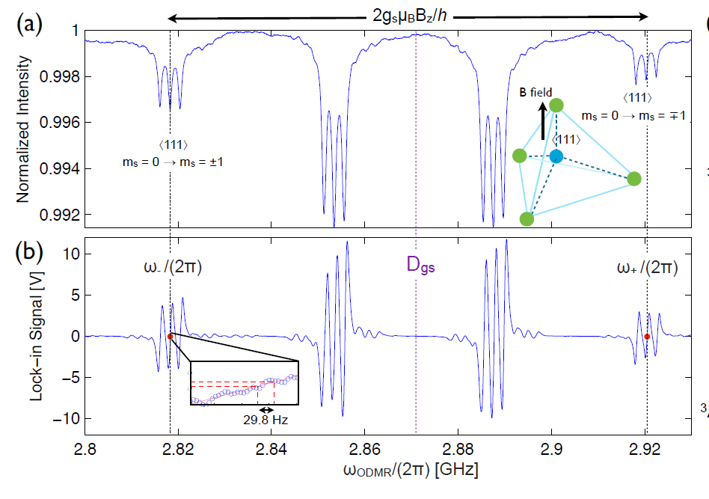
Bulk, DC, lock-in
Nitrogen-vacancy centres: Applications
DC Magnetometer: lock-in detection
H Clevenson et al, Nat Phys 11, 393 (2015)

Slide 51
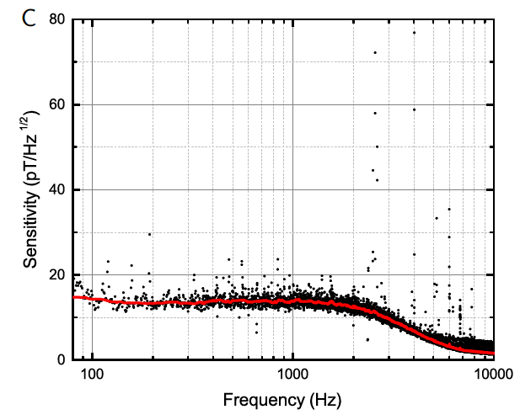
Bulk, DC, lock-in
Nitrogen-vacancy centres: Applications
DC Magnetometer
15 pT.Hz^{-½} sensitivity at 80 - 2000 Hz from (13 x 200 x 2000) µm³ diamond: JF Barry et al., PNAS 2016

Slide 52
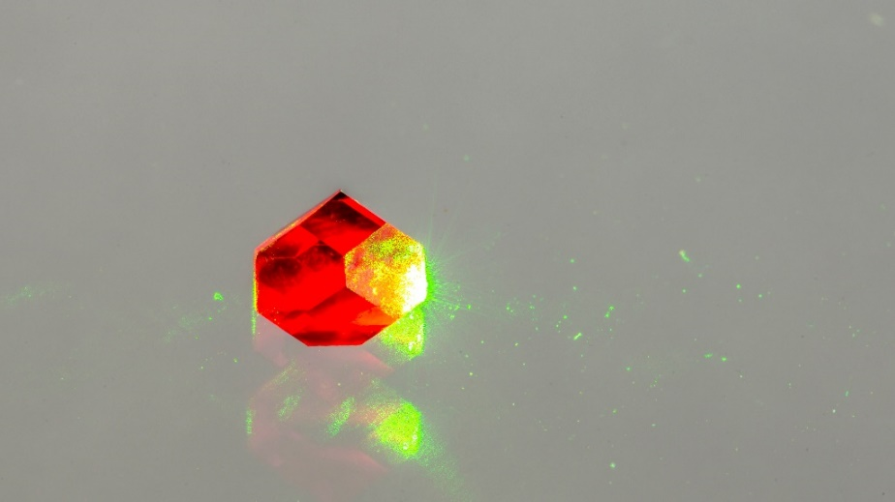
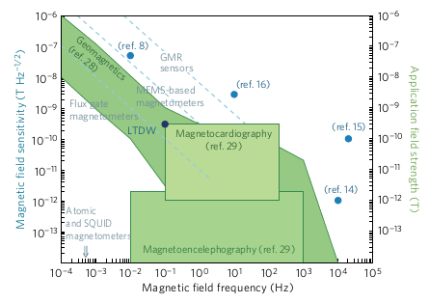
Nitrogen-vacancy centres: Applications
DC Magnetometer
Barry et al
300 pT/√Hz sensitivity at 1 Hz:
H Clevenson et al, Nat Phys 11, 393 (2015)
15 pT/√Hz sensitivity at 80 - 2000 Hz:
JF Barry et al, PNAS 113, 14133 (2016)
Comercial viability:
MW Dale & GWM, arXiv:1705.01994 (2017)
- lock-in detection
- ensemble of ~10¹³ NV- (sacrificing nanoscale spatial resolution)

Slide 53
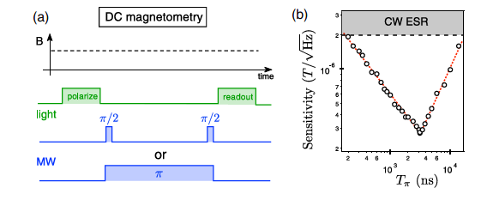
Bulk, DC, beyond lock-in
Single nitrogen-vacancy centres
Ramsey interferometry
Review:
L Rondin et al., Magnetometry with nitrogen-vacancy defects in diamond, Rep Prog Phys 77, 056503 (2014)

Slide 54
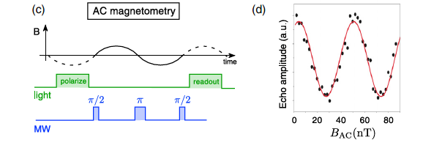
AC, pulsed readout
Single nitrogen-vacancy centres
AC magnetometry
Review:
L Rondin et al., Magnetometry with nitrogen-vacancy defects in diamond, Rep Prog Phys 77, 056503 (2014)

Slide 55
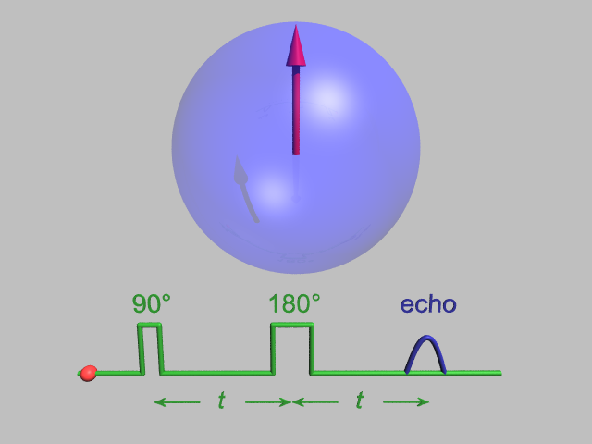
AC, pulsed readout
Spin echo
Spin echo
In rotating frame
Notes:
Hahn echo

Slide 56
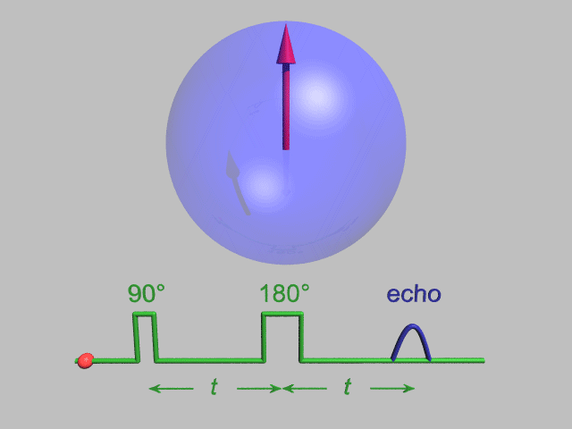
AC, pulsed readout
Spin echo
Spin echo
In rotating frame
Notes:
Hahn echo

Slide 57
Nitrogen-vacancy centres: Applications
AC Magnetometer
0.9 pT/√Hz sensitivity at 10 kHz:
T Wolf et al, PRX 5, 041001 (2015)
- Spin echo on the NV- centre allows through chosen frequency of interest
- Control noise in laser and microwave sources
- Ensemble of ~10¹¹ NV-

Slide 58
AC, pulsed readout
Single nitrogen-vacancy centres
Spin coherence times
 | Electron spin in ¹²C | Nuclear spin
Room temperature T₂ | 1.8 ms | 1 s
cryogenic T₂ | 0.6 s (77 K with decoupling) | 10 s (at 8 K)
1.8 ms: G Balasubramanian et al, Nature Materials 8, 383 (2009)
0.6 s: N Bar-Gill et al, Nat Commun 4, 1743 (2013)
1 s: PC Maurer et al, Science 336, 1283 (2012)
10 s: S Yang et al, Nature Photonics 10, 507 (2016)

Slide 59
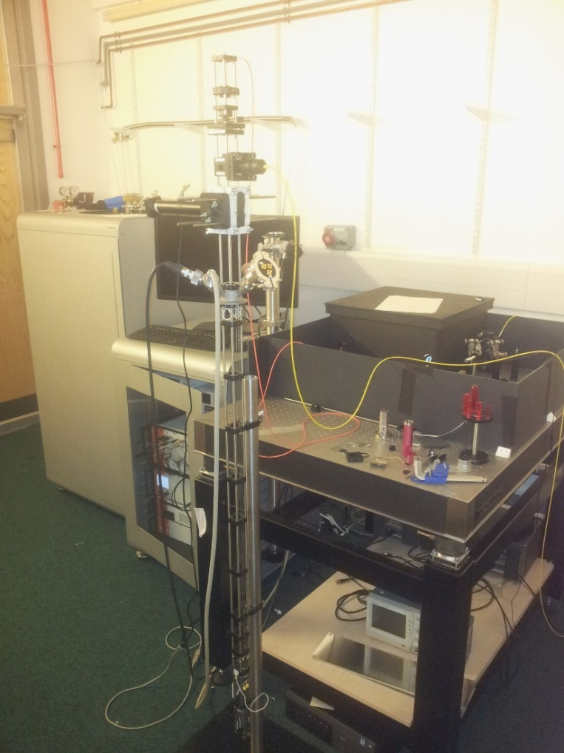
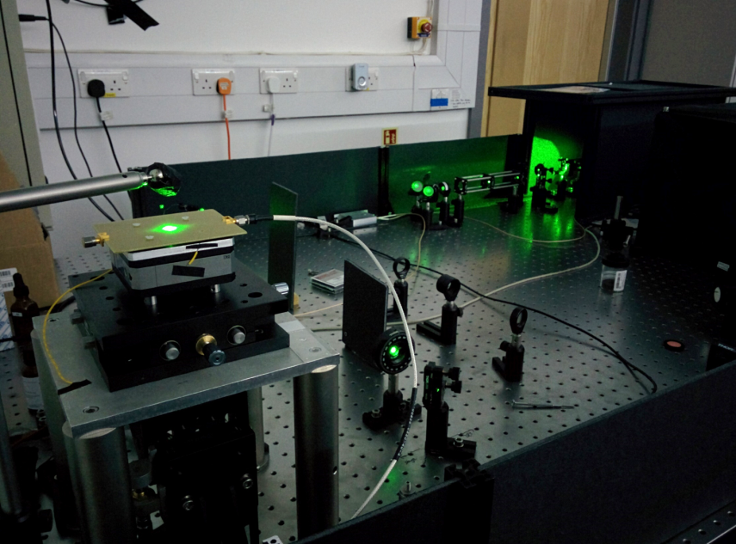
Single NV, AC, pulsed readout
Nitrogen-vacancy centres: Applications
Warwick: single spin magnetometry

Slide 60
Nitrogen-vacancy centres: Applications
Nanoscale AC magnetometer for single spin NMR
Single proton spin on surface of diamond:
AO Sushkov et al, Phys Rev Lett 113, 197601 (2014)
- Spin echo on the NV- centre allows through chosen frequency of interest
- Single NV- detects a reporter spin

Slide 61
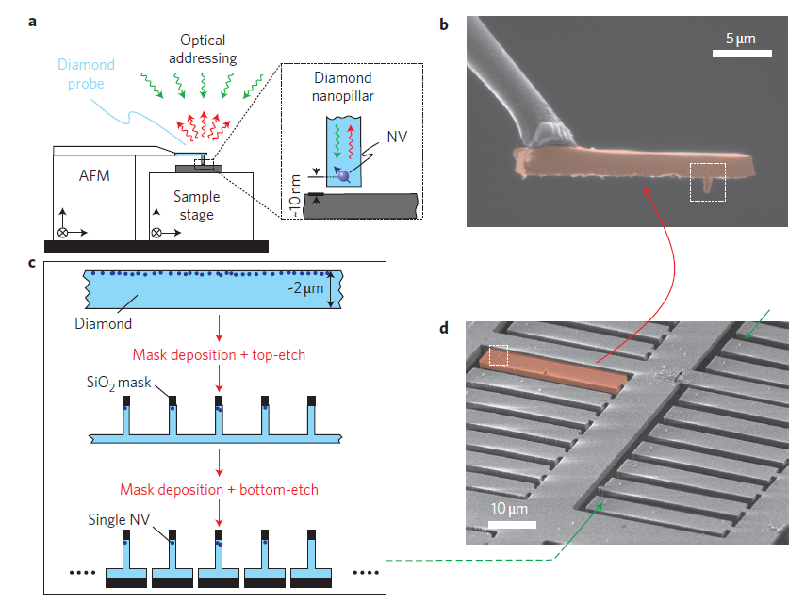
Single NV, AC, pulsed readout
Nitrogen-vacancy centres: Applications
Nanoscale magnetometer for scanning over a sample
P. Maletinsky et al., Nature Nano. 7, 320 (2012)

Slide 62
Nitrogen-vacancy centres: Applications
Nanoscale AC magnetometer for scanning over a sample
Detect a single electron spin 50 nm away from NV- sensor:
MS Grinolds et al, Nat Phys 9, 215 (2013)
- Dynamic decoupling allows through chosen frequency of interest
- The electron spin being detected was another NV-

Slide 63
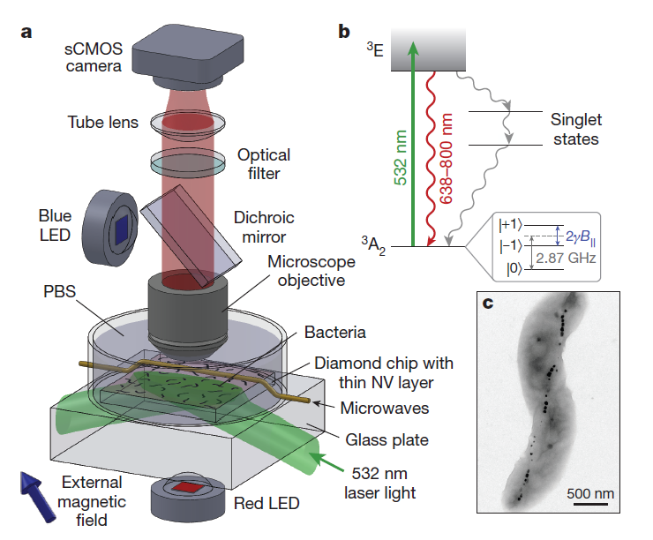
Nitrogen-vacancy centres: Applications
Wide-field magnetometry
Optical magnetic imaging of living cells, D Le Sage et al, Nature 496, 486 (2013)
Diamond is bio-compatible

Slide 64
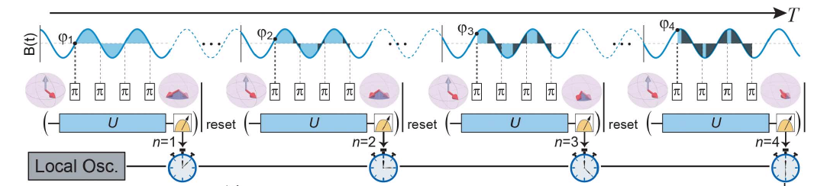
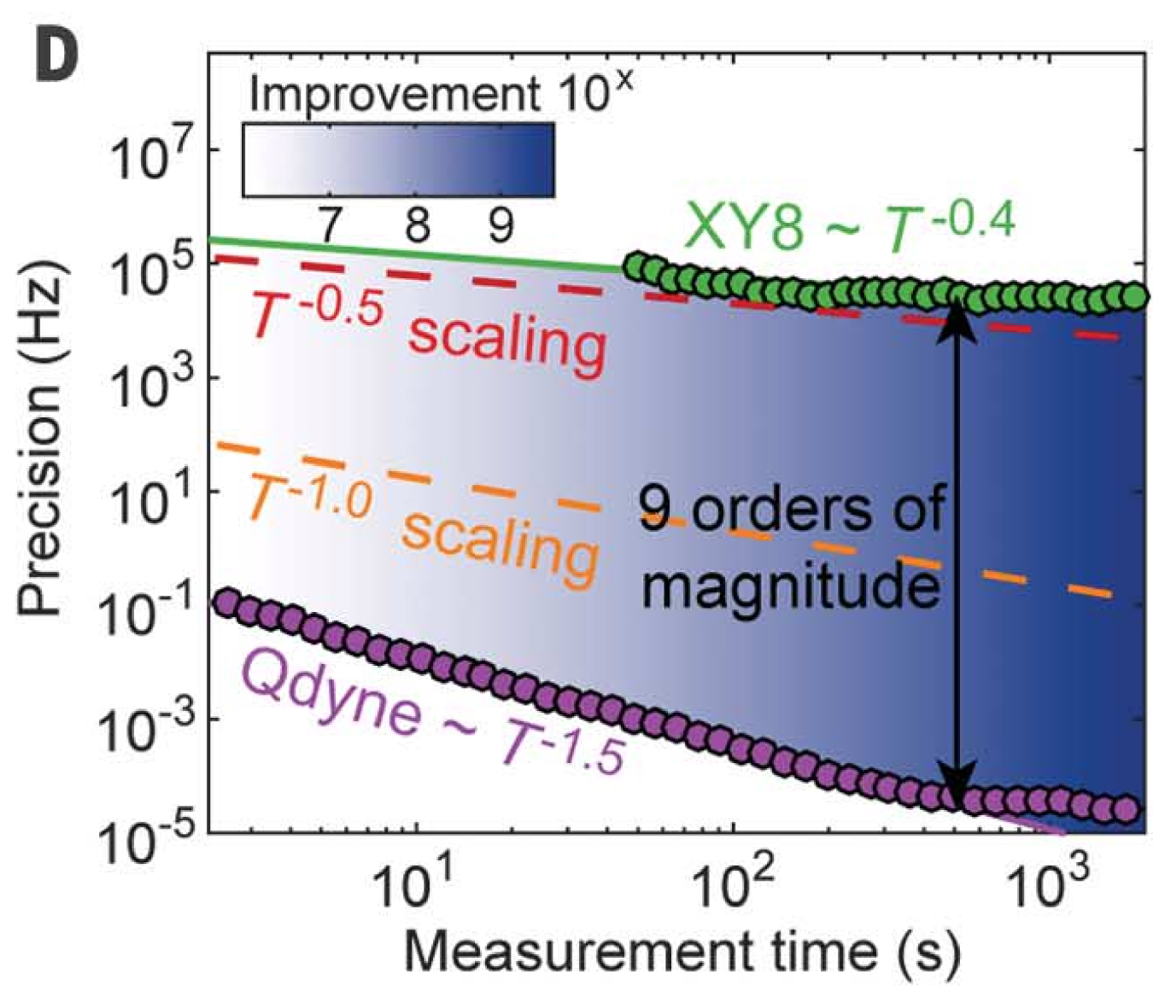
Nitrogen-vacancy centres: Applications
High resolution: Qdyne
S Schmitt et al, Science 356, 832 (2017)
JM Boss et al, Science 356, 837 (2017)

Slide 65
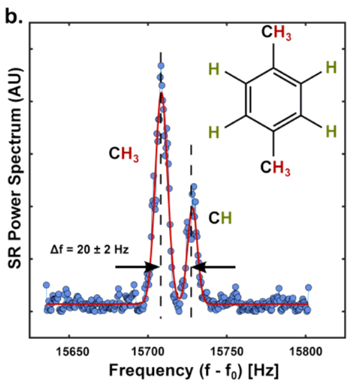
Nitrogen-vacancy centres: Applications
High resolution: Qdyne
DB Bucher et al, arXiv:1705.08887 (2017)

Slide 66
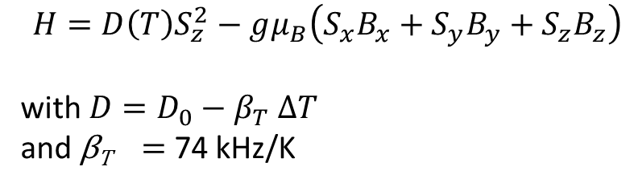
Nitrogen-vacancy centres: Applications
Nanoscale thermometry for inside living cells & computer chips
G Kucsko et al, Nature 500, 54 (2013)
P Neumann et al, Nano Lett 13, 2738 (2013)
DM Toyli et al, PNAS 110, 8417 (2013)
$$H=D\left(T\right)S_{z}^{2}−gμ_{B}\left(S_{x}B_{x}+S_{y}B_{y}+S_{z}B_{z}\right)$$
with ${D=D}_{0}−β_{T} ∆T$
and β_{T} = 74 kHz/K

Slide 67
Nitrogen-vacancy centres: Applications
Electrometry: Stark shift
F Dolde et al, Nat Phys 7, 459 (2011)

Slide 68
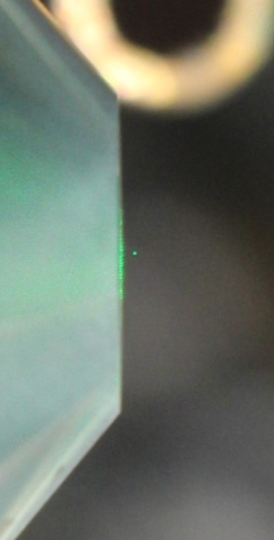
Nitrogen-vacancy centres: Applications
In a tractor beam
Proposals:
- M Scala et al, PRL 111, 180403 (2013)
- Z-q Yin et al, PRA 88, 033614 (2013)
- C Wan et al, PRL 117, 143003 (2016)
Experiments:
- LP Neukirch et al, Nat Photon 9, 653 (2015)
- AC Frangeskou et al., arXiv:1608.04724 (2016)

Slide 69
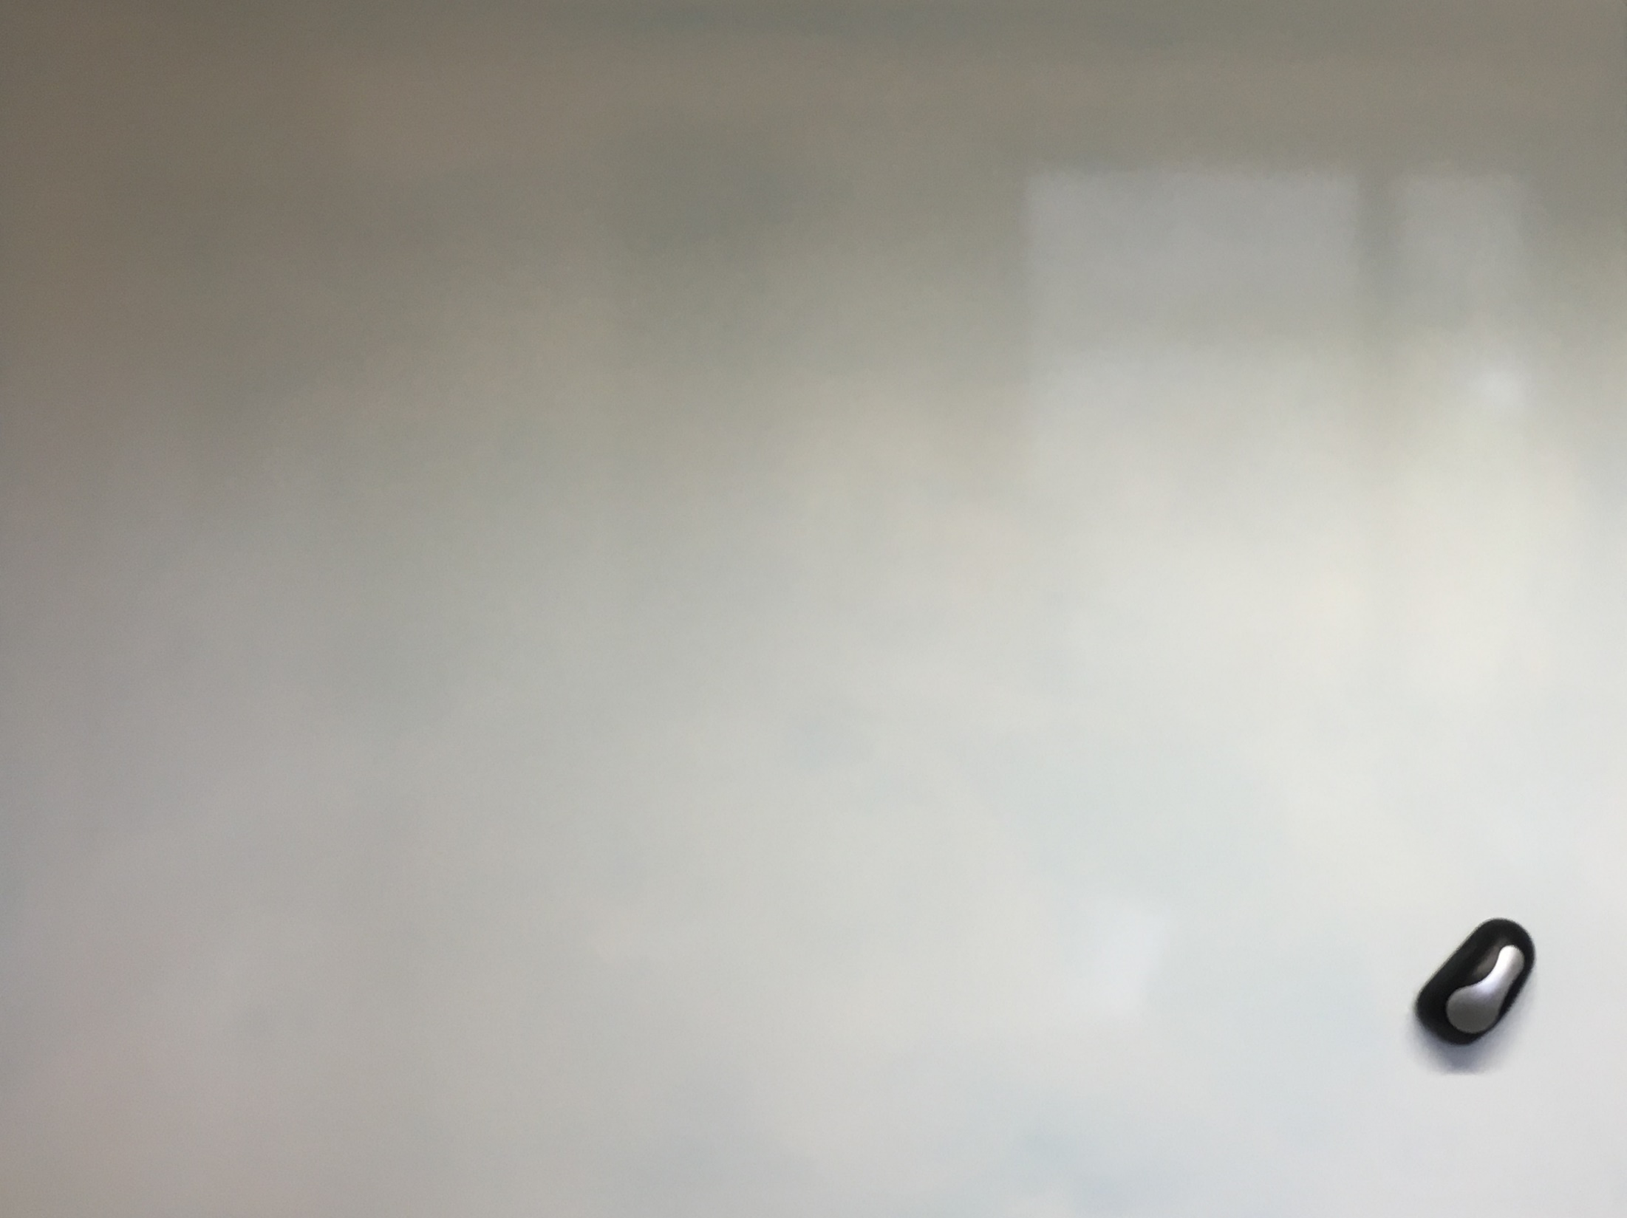

Slide 70
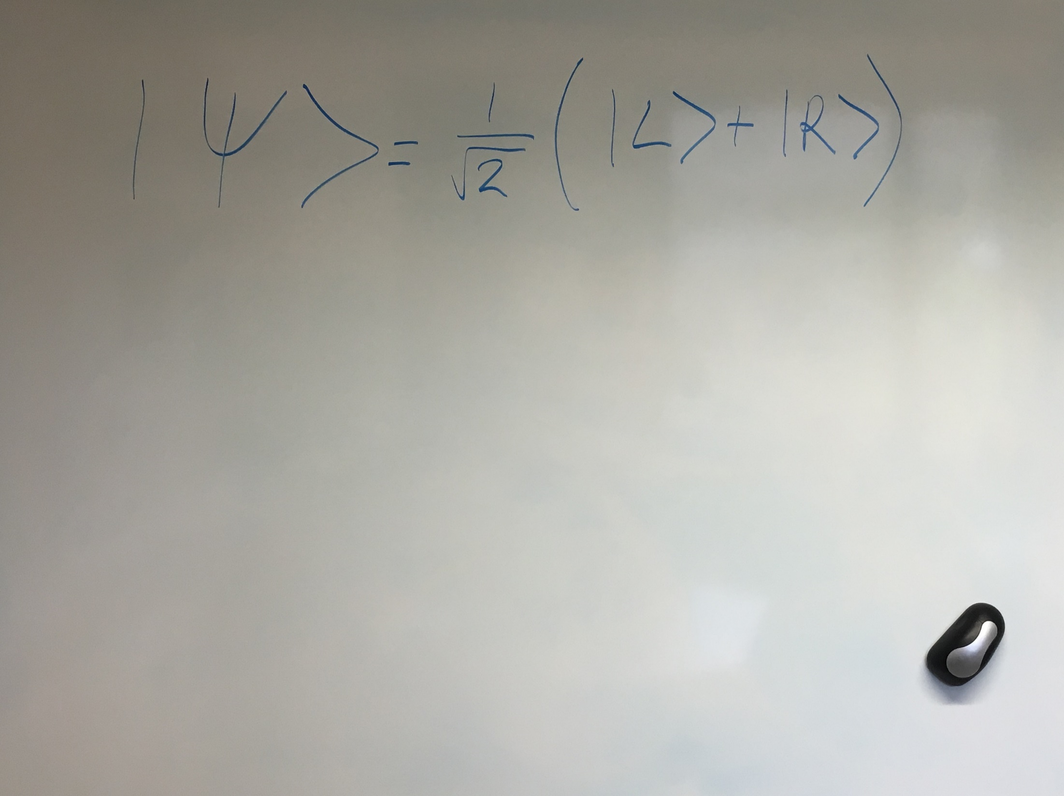

Slide 71
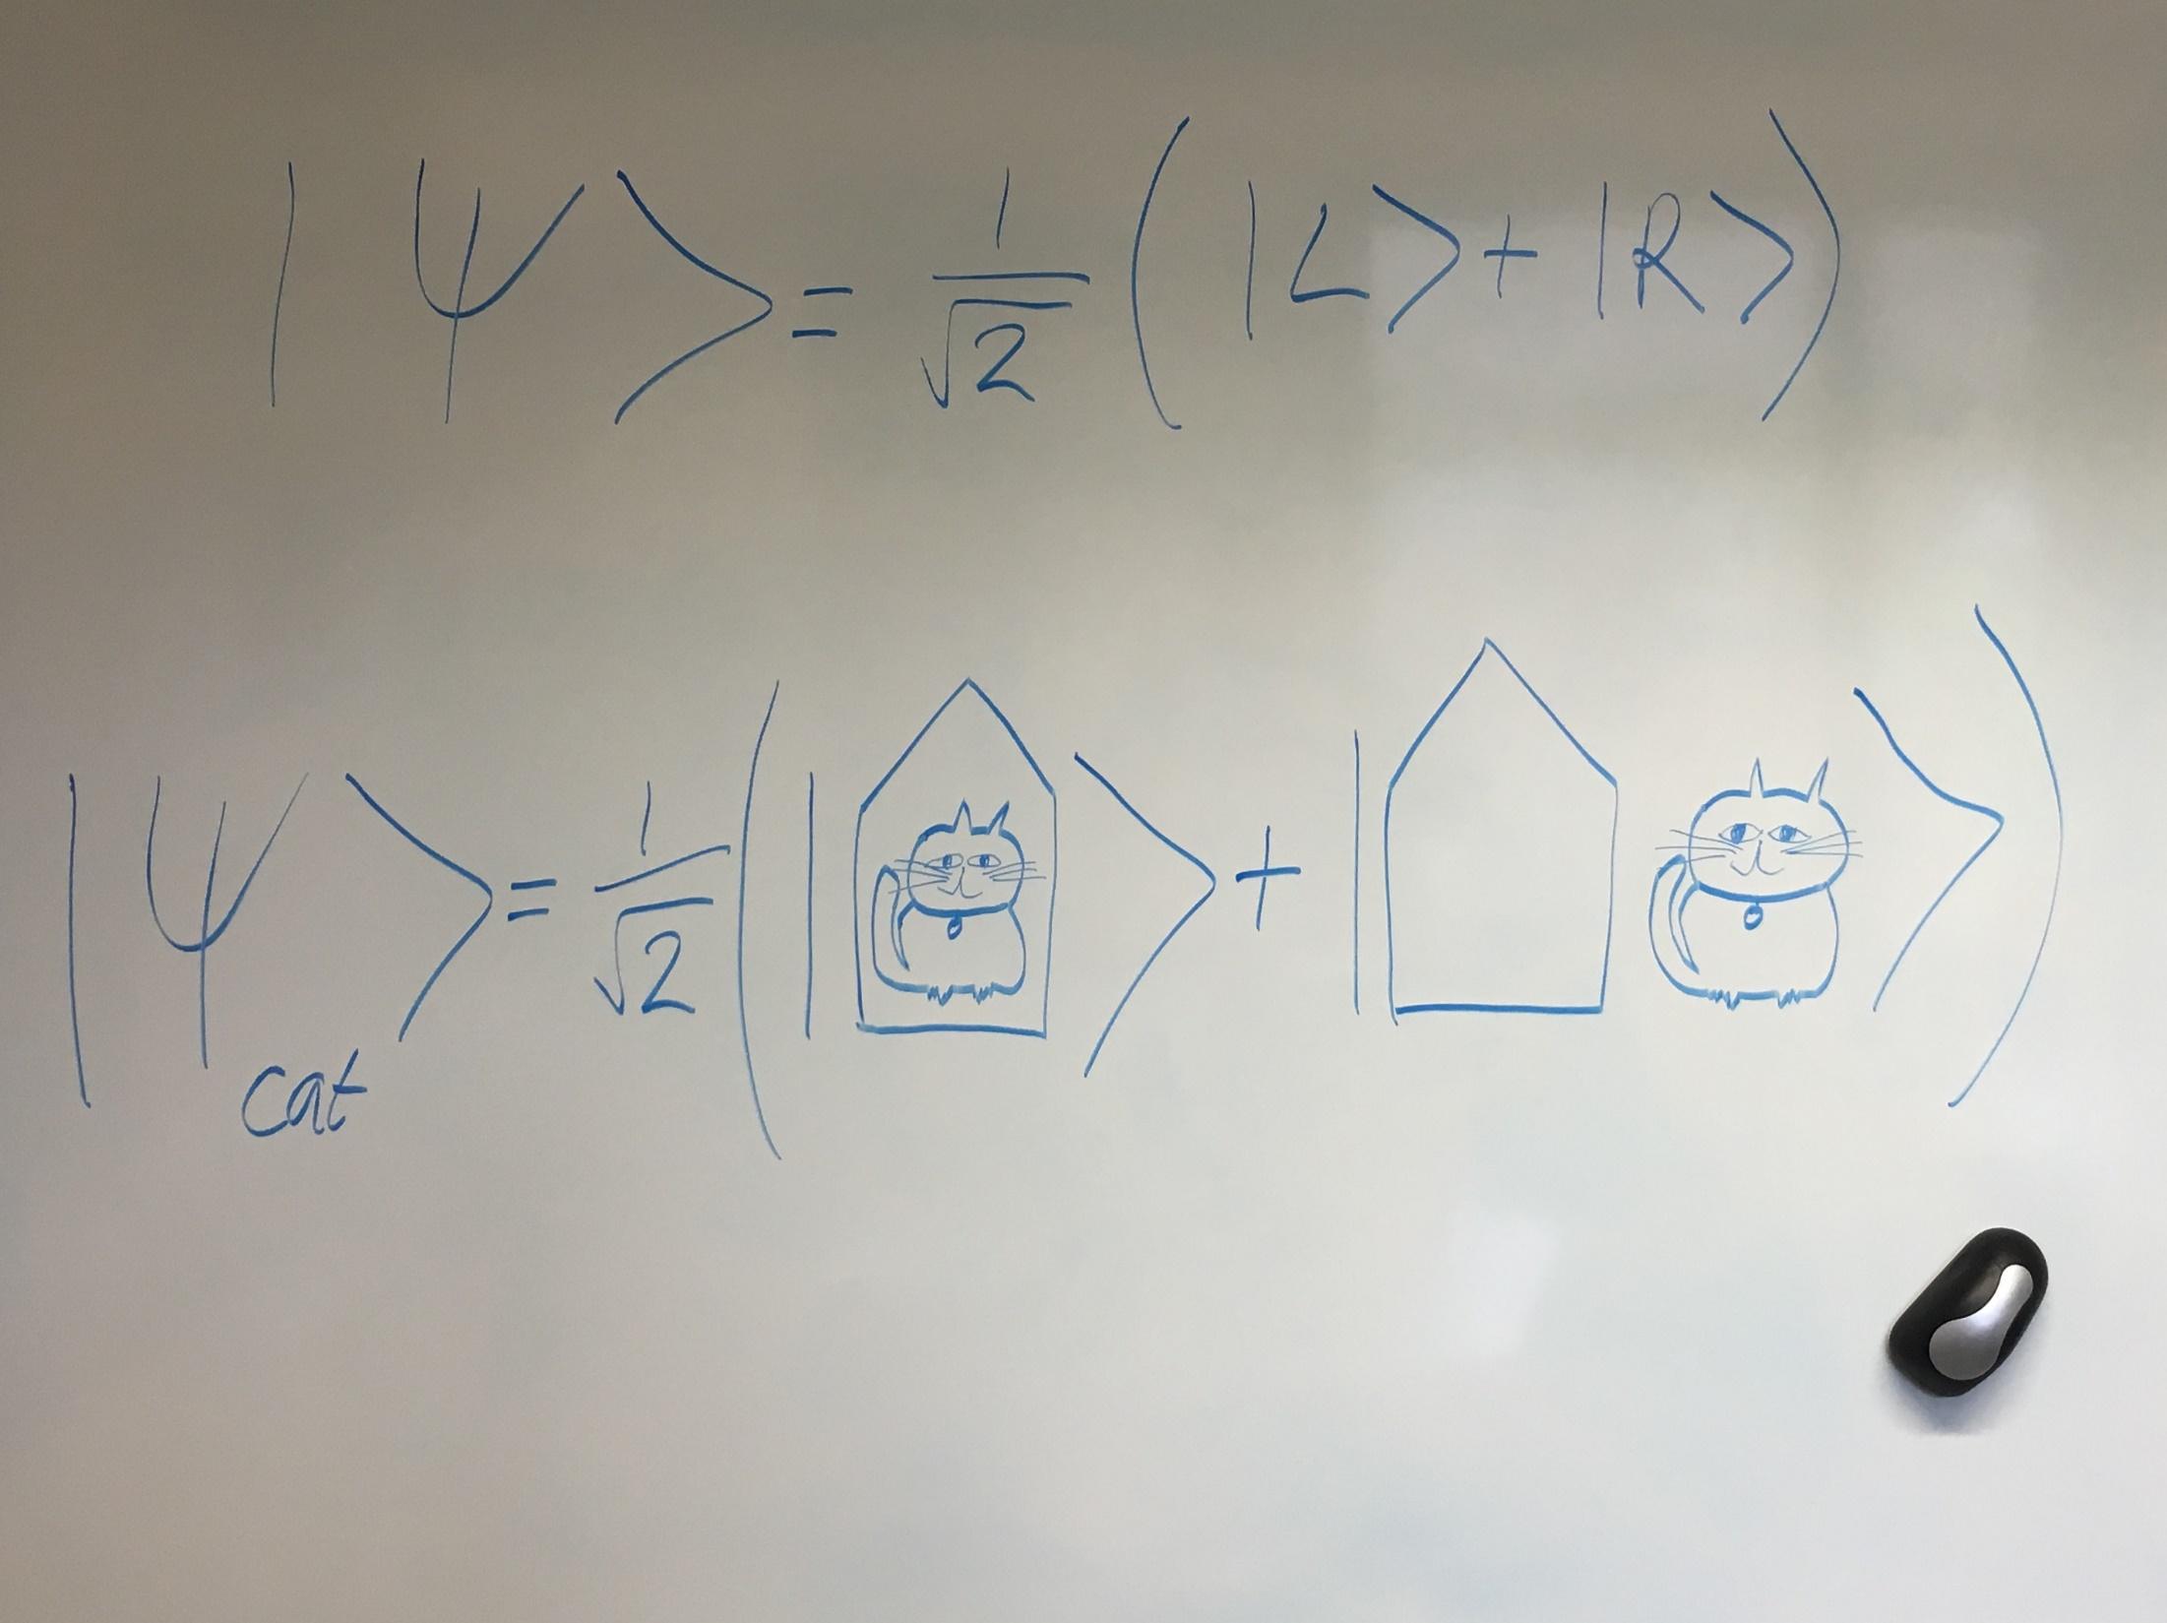

Slide 72
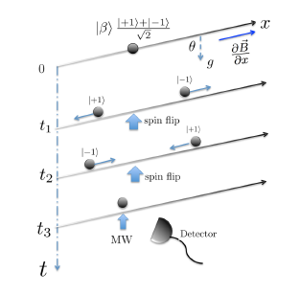
Our proposal:
drop a nanodiamond containing a spin
From our collaboration:
- M Scala et al., PRL 111, 180403 (2013)
- C Wan et al., PRA 93, 043852 (2016)
- C Wan et al., PRL 117, 143003 (2016)
From other groups:
- Z-q Yin, T Li, X Zhang & LM Duan,
PRA 88, 033614 (2013)

Slide 73

Our proposal:
drop a nanodiamond containing a spin
From our collaboration:
- M Scala et al., PRL 111, 180403 (2013)
- C Wan et al., PRA 93, 043852 (2016)
- C Wan et al., PRL 117, 143003 (2016)

Slide 74
Our proposal:
drop a nanodiamond containing a spin
From our collaboration:
- M Scala et al., PRL 111, 180403 (2013)
- C Wan et al., PRA 93, 043852 (2016)
- C Wan et al., PRL 117, 143003 (2016)

Slide 75
Our proposal:
drop a nanodiamond containing a spin
From our collaboration:
- M Scala et al., PRL 111, 180403 (2013)
- C Wan et al., PRA 93, 043852 (2016)
- C Wan et al., PRL 117, 143003 (2016)

Slide 76
Our proposal:
drop a nanodiamond containing a spin
From our collaboration:
- M Scala et al., PRL 111, 180403 (2013)
- C Wan et al., PRA 93, 043852 (2016)
- C Wan et al., PRL 117, 143003 (2016)

Slide 77
Our proposal:
drop a nanodiamond containing a spin
From our collaboration:
- M Scala et al., PRL 111, 180403 (2013)
- C Wan et al., PRA 93, 043852 (2016)
- C Wan et al., PRL 117, 143003 (2016)

Slide 78


Our proposal:
drop a nanodiamond containing a spin
From our collaboration:
- M Scala et al., PRL 111, 180403 (2013)
- C Wan et al., PRA 93, 043852 (2016)
- C Wan et al., PRL 117, 143003 (2016)

Slide 79
Levitating nanodiamonds in air
- Berlin: atmospheric pressure, NV⁻ florescence,
A Kuhlicke, AW Schell, J Zoll & O Benson, APL 105, 073101 (2014)
- Paris: atmospheric pressure, Optically-detected magnetic resonance,
T Delord, L Nicolas, L Schwab & G Hétet, NJP 19, 033031 (2017)
- University College London: Peter Barker‘s group
- Pittsburgh: 6.7 x 10⁻³ mbar, NV⁻ florescence,
J-F Hsu, P Ji, CW Lewandowski & B D’Urso, Sci Rep 6, 30125 (2016)
- Rochester: 1064 nm, >5 mbar,
LP Neukirch, E von Haartman, JM Rosenholm & AN Vamivakas,
Nat Photon 9, 653 (2015)
- Purdue: 1550 nm, >10 mbar
TM Hoang, J Ahn, J Bang & T Li, Nat Comms 7, 12250 (2016)
Ion traps
Magneto-gravitational trap
Optical traps

Slide 80
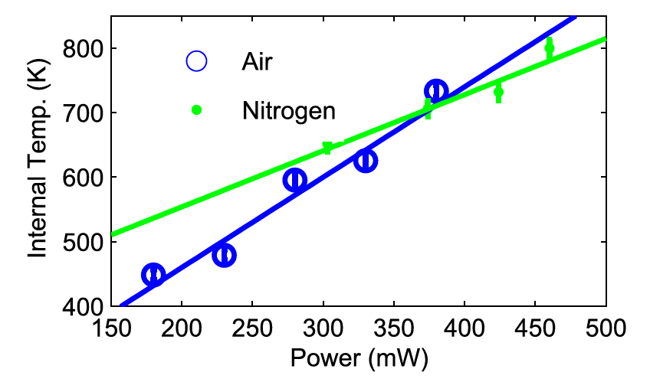
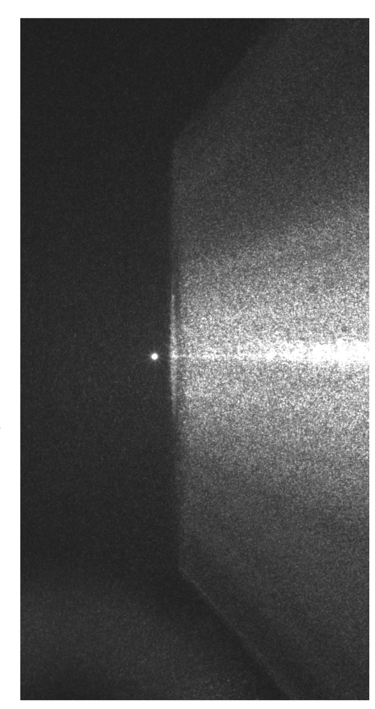
Levitating nanodiamonds in air
20 mbar
ATMA Rahman et al., Scientific Reports 6, 21633 (2016)
AC Frangeskou et al., arXiv:1608.04724 (2016)

Slide 81
Nitrogen-vacancy centres: Applications
Violating Bell’s inequality
The first experiment in which the “detection” and “locality” loopholes have both been closed
B Henson et al, Nature 526, 682 (2015)
Proposal for entangling remote NV-
SD Barrett and P Kok, Physical Review A 71, 060310 (2005)

Slide 82
Silicon-vacancy centres
Better optical properties, worse spin properties (spin T₂* ~ 45 ns)
70% of the florescence from the SiV- is in the zero phonon line (ZPL), compared with 4% for NV- at low temperature
Spin control with coherent population trapping:
B Pingault et al, Physical Review Letters 113, 263601 (2014)
LJ Rogers et al, Physical Review Letters 113, 263602 (2014)

Slide 83
Experiments with spin qubits in diamond: overview
Diamond
Nitrogen-vacancy (NV) centre
1. Properties
2. Applications
a) magnetometry
b) thermometry
c) electrometry
d) in a tractor beam
e) violating Bell’s inequality
Silicon-vacancy (SiV) centre

Slide 84
Quantum technology with diamond & silicon
Solid state physics background (diamond and silicon)
Magnetic resonance background
Spin qubits in silicon
Spin qubits in diamond

Slide 85
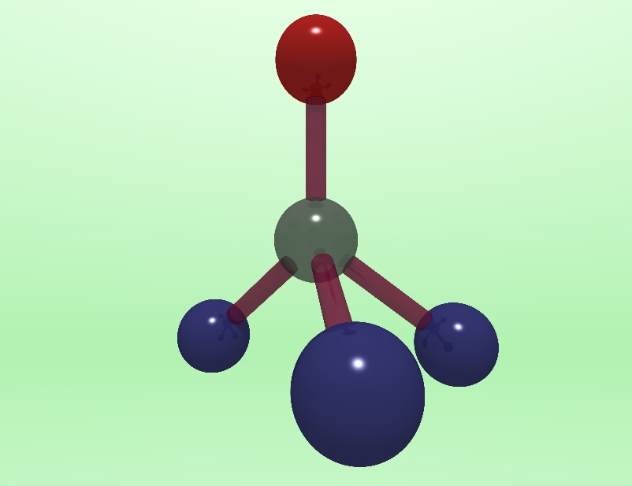
Quantum technology with diamond & silicon
Nitrogen
Vacancy

