Slide 1
Gavin W Morley Department of Physics University of Warwick
Diamond Science & Technology
Centre for Doctoral Training, MSc course
Module 8 – Photonics and Quantum Technologies
Module 2 – (PX907)
Lectures 13 and 14 – Diamond Sensors based on nitrogen vacancy centres

Slide 2
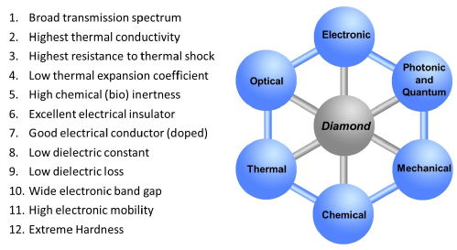
Diamond properties

Slide 3
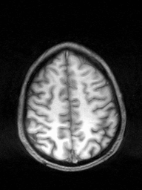
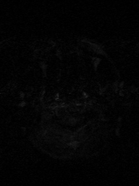
Sensing
Notes:
Signal, SNR, resolution (temporal and spatial)

Slide 4

Sensing
Notes:
Signal, SNR, resolution (temporal and spatial)

Slide 5
Sensing
Notes:
Signal, SNR, resolution (temporal and spatial)

Slide 6

Sensing
Notes:
Signal, SNR, resolution (temporal and spatial)

Slide 7

Sensing
Notes:
Signal, SNR, resolution (temporal and spatial)

Slide 8
Sensing
Notes:
Signal, SNR, resolution (temporal and spatial)

Slide 9
Sensing
Notes:
Signal, SNR, resolution (temporal and spatial)

Slide 10
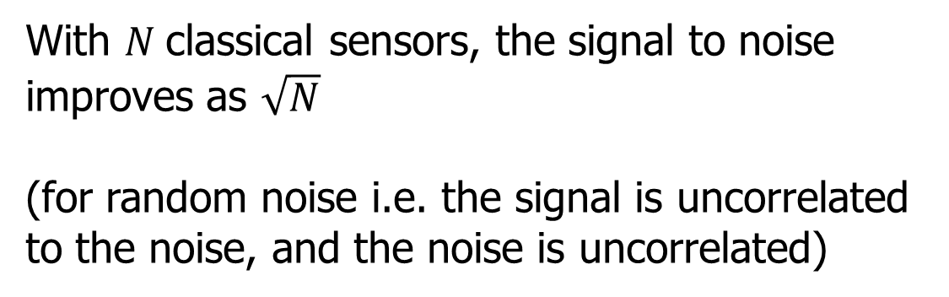
Classical Sensing
With $N$classical sensors, the signal to noise improves as $\sqrt{N}$
(for random noise i.e. the signal is uncorrelated to the noise, and the noise is uncorrelated)
Notes:
Signal, SNR, resolution (temporal and spatial)

Slide 11
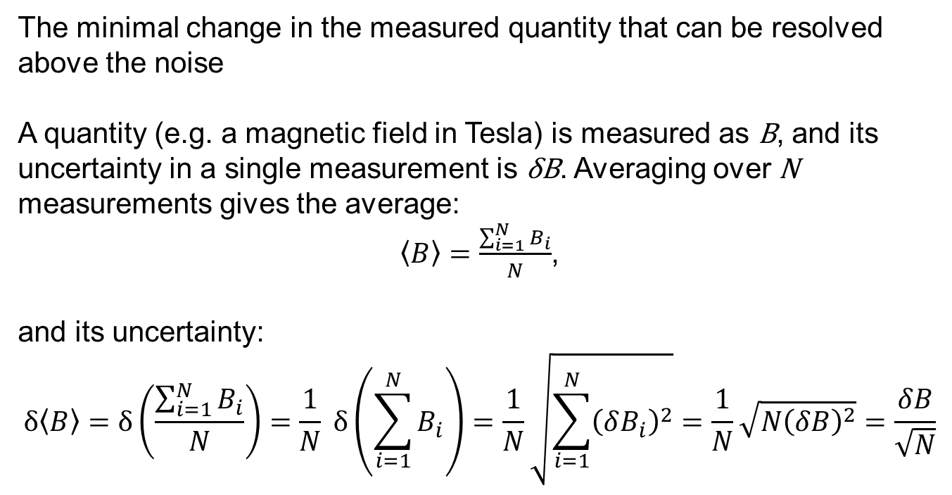
Sensitivity
The minimal change in the measured quantity that can be resolved above the noise
A quantity (e.g. a magnetic field in Tesla) is measured as B, and its uncertainty in a single measurement is δB. Averaging over N measurements gives the average:
$\left\langle B\right\rangle =\frac{\sum_{i=1}^{N}{B_{i}}}{N}$,
and its uncertainty:
$$δ\left\langle B\right\rangle =δ\left(\frac{\sum_{i=1}^{N}{B_{i}}}{N}\right)=\frac{1}{N} δ\left(\sum_{i=1}^{N}{B_{i}}\right)=\frac{1}{N}\sqrt{\sum_{i=1}^{N}{{\left(δB_{i}\right)}^{2}}}=\frac{1}{N}\sqrt{{N\left(δB\right)}^{2}}=\frac{δB}{\sqrt{N}}$$

Slide 12

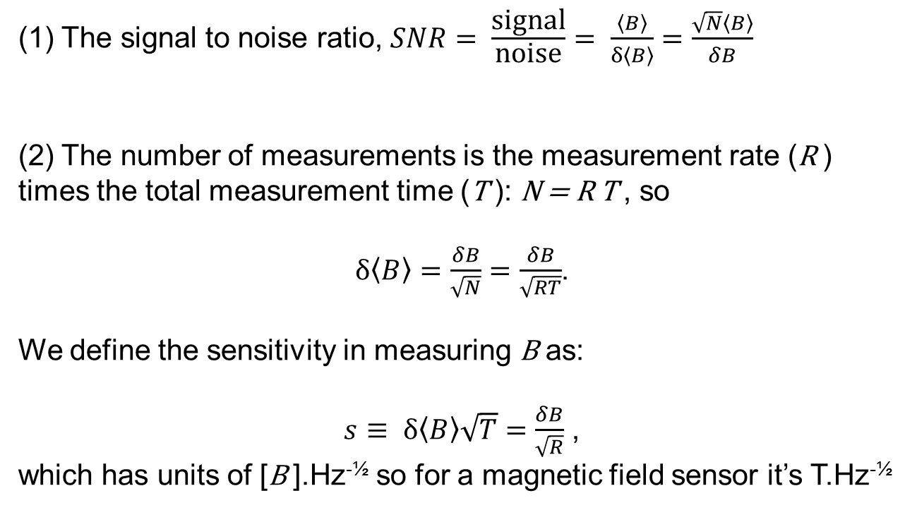
Sensitivity (cont.)
$$δ\left\langle B\right\rangle =\frac{δB}{\sqrt{N}}$$
(1) The signal to noise ratio, $SNR= \frac{\text{signal}}{\text{noise}}= \frac{\left\langle B\right\rangle }{δ\left\langle B\right\rangle }=\frac{\sqrt{N}\left\langle B\right\rangle }{δB}$
(2) The number of measurements is the measurement rate (R ) times the total measurement time (T ): N = R T , so
$δ\left\langle B\right\rangle =\frac{δB}{\sqrt{N}}=\frac{δB}{\sqrt{RT}}$.
We define the sensitivity in measuring B as:
$s≡ δ\left\langle B\right\rangle \sqrt{T}=\frac{δB}{\sqrt{R}}$ ,
which has units of [B ].Hz^{-½} so for a magnetic field sensor it’s T.Hz^{-½}

Slide 13
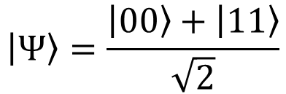
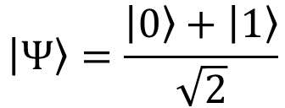
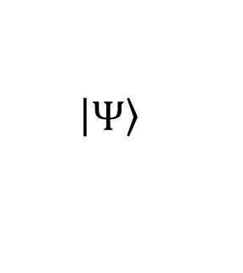
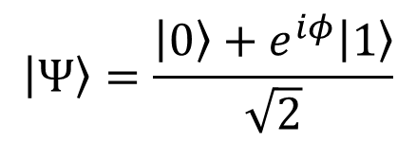
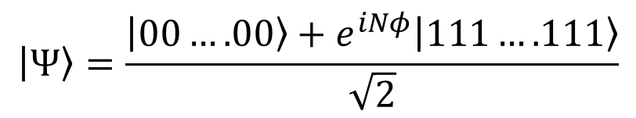

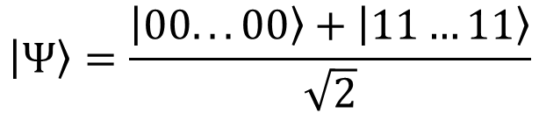

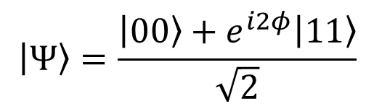
Quantum Sensing
$$U_{φ}= e^{−iφZ}$$
$Z=\left(\begin{matrix}1 & 0 \\ 0 & −1\end{matrix}\right)$
$$U_{φ}$$
$$\left|\left.Ψ\right\rangle \right.$$
U_{Φ}
U_{Φ}
$$\left|\left.Ψ\right\rangle \right.=\frac{\left.\left|0\right.\right\rangle +\left|\left.1\right\rangle \right.}{\sqrt{2}}$$
$$\left|\left.Ψ\right\rangle \right.=\frac{\left.\left|0\right.\right\rangle +e^{iφ}\left|\left.1\right\rangle \right.}{\sqrt{2}}$$
Use superposition
$$\left|\left.Ψ\right\rangle \right.=\frac{\left.\left|00\right.\right\rangle +\left|\left.11\right\rangle \right.}{\sqrt{2}}$$
$$\left|\left.Ψ\right\rangle \right.=\frac{\left.\left|00\right.\right\rangle +e^{i2φ}\left|\left.11\right\rangle \right.}{\sqrt{2}}$$
Use entanglement
$$\left|\left.Ψ\right\rangle \right.=\frac{\left.\left|00...00\right.\right\rangle +\left|\left.11…11\right\rangle \right.}{\sqrt{2}}$$
$$\left|\left.Ψ\right\rangle \right.=\frac{\left.\left|00….00\right.\right\rangle +e^{iNφ}\left|\left.111….111\right\rangle \right.}{\sqrt{2}}$$
Notes:
Signal, SNR, resolution (temporal and spatial)

Slide 14
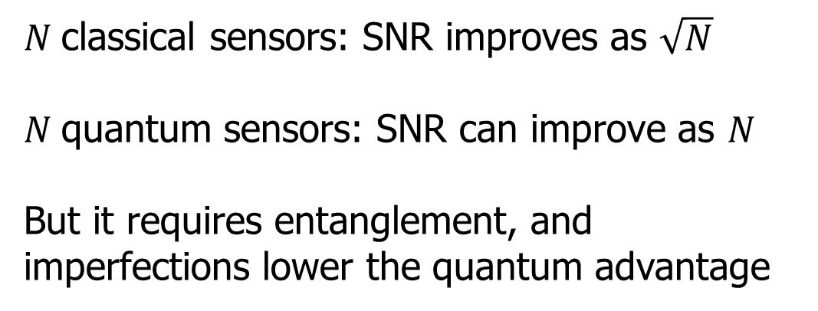
Quantum Sensing
$N$classical sensors: SNR improves as $\sqrt{N}$
$N$quantum sensors: SNR can improve as $N$
But it requires entanglement, and imperfections lower the quantum advantage
$$\left|\left.Ψ\right\rangle \right.=\frac{\left.\left|00...00\right.\right\rangle +\left|\left.11…11\right\rangle \right.}{\sqrt{2}}$$
$$\left|\left.Ψ\right\rangle \right.=\frac{\left.\left|00….00\right.\right\rangle +e^{iNφ}\left|\left.111….111\right\rangle \right.}{\sqrt{2}}$$
Notes:
Signal, SNR, resolution (temporal and spatial)

Slide 15
Practical Quantum Sensing
Don’t use maximally entangled states because of decoherence
Quantum sensing is useful when averaging is limited e.g. by size, time, fragile samples
$$\left|\left.Ψ\right\rangle \right.=\frac{\left.\left|00...00\right.\right\rangle +\left|\left.11…11\right\rangle \right.}{\sqrt{2}}$$
$$\left|\left.Ψ\right\rangle \right.=\frac{\left.\left|00….00\right.\right\rangle +e^{iNφ}\left|\left.111….111\right\rangle \right.}{\sqrt{2}}$$
Notes:
Signal, SNR, resolution (temporal and spatial)

Slide 16




Practical Quantum Sensing
  Magnetometry
  Thermometry
  Accelerometers
  Gravimetry
  Microscopy
  Imaging
Notes:
Signal, SNR, resolution (temporal and spatial)

Slide 17


Quantum Sensors
Cold atom interferometers
  Gravity, magnetic field, time, rotation
Ion trap
  Magnetic field, time
Atomic vapour cell
  Magnetic field
Nitrogen vacancy centres in diamond
  Magnetic field, electric field, temperature
Optical spectroscopy of atoms
Optical spectroscopy of atoms
Optical spectroscopy of atoms
Optical spectroscopy of atoms

Slide 18
Quantum Sensors
Cold atom interferometers
  Gravity, magnetic field, time, rotation
Ion trap
  Magnetic field, time
Atomic vapour cell
  Magnetic field
Nitrogen vacancy centres in diamond
  Magnetic field, electric field, temperature
Single atom or many?

Slide 19
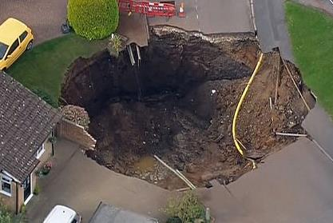

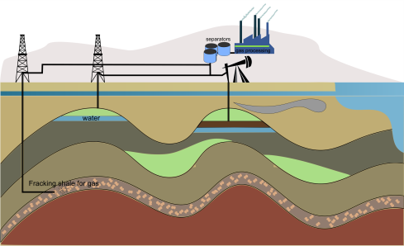
Quantum Sensors
for gravity
(also time, rotation and magnetic fields)
UK cost of digging up the roads : £5bn/yr

Slide 20
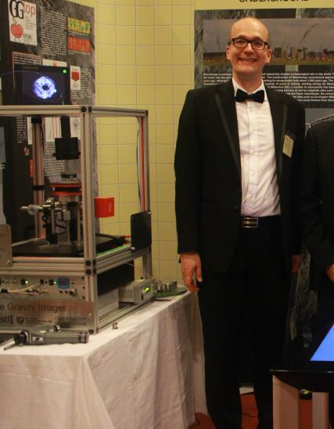
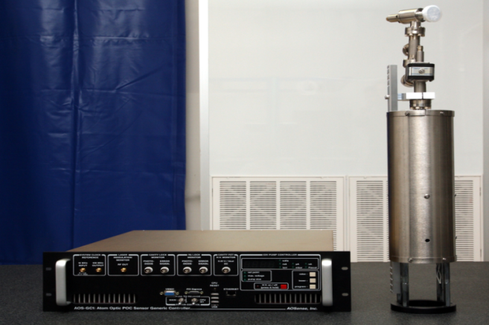
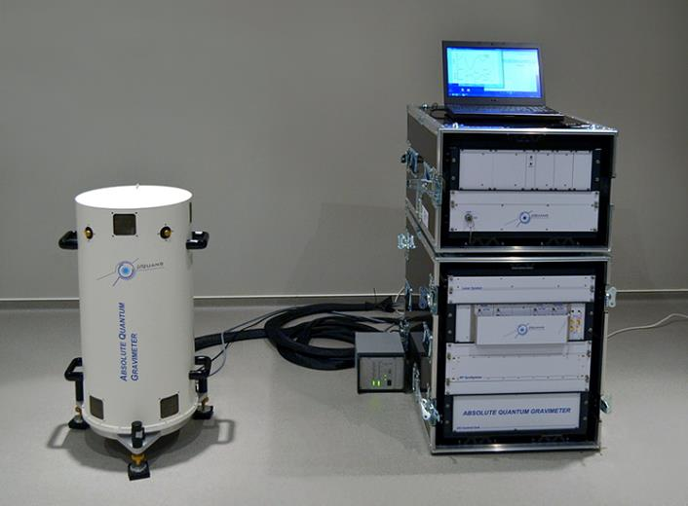
Quantum Sensors
for gravity
(also time, rotation and magnetic fields)
Kai Bongs, Birmingham Hub, 2015
AOSense (from Mark Kasevich lab, Stanford, California, 2010)
Muquans, Paris, 2016

Slide 21


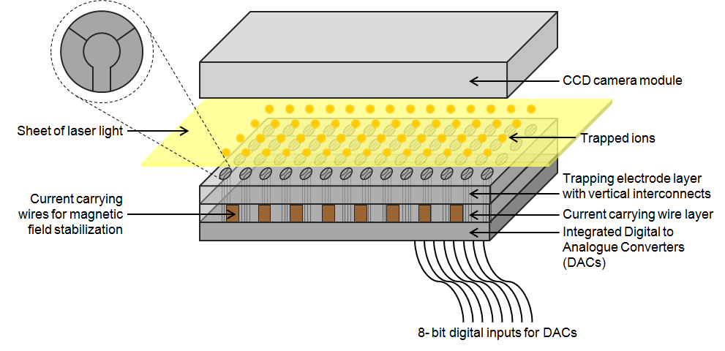
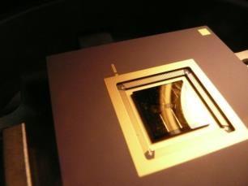
Ion magnetometer
N-ion array chip fabricated by B. Lekitsch, Sussex

Slide 22
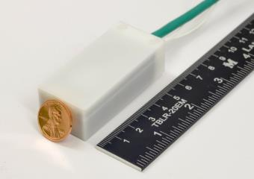

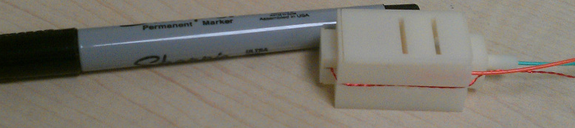
Atomic vapour cells for sensing
magnetic fields
Twinleaf:
QuSpin:
Very good sensitivity in zero magnetic field (with magnetic shielding)

Slide 23
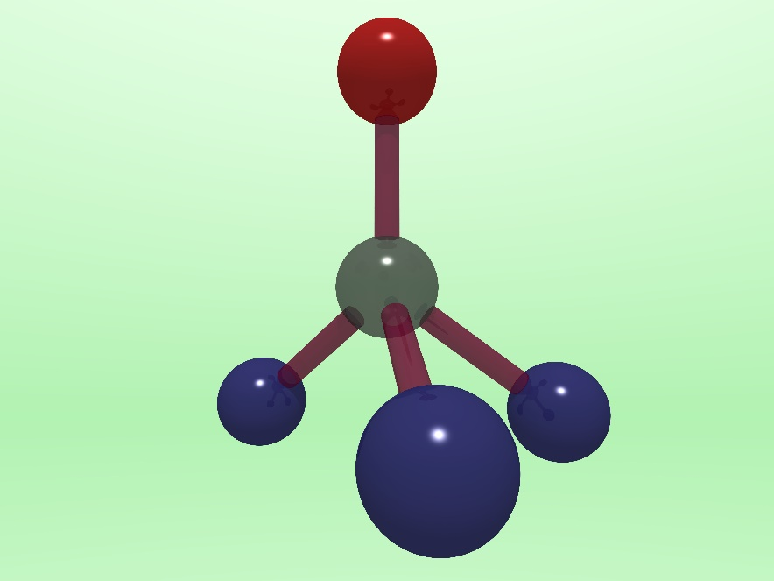
Nitrogen-Vacancy Centres
    1. Properties
      Geometric structure
      Optical properties
      Spin properties
      Energy levels and transitions
    2. Magnetometry
Nitrogen-vacancy (NV⁻) centre

Slide 24
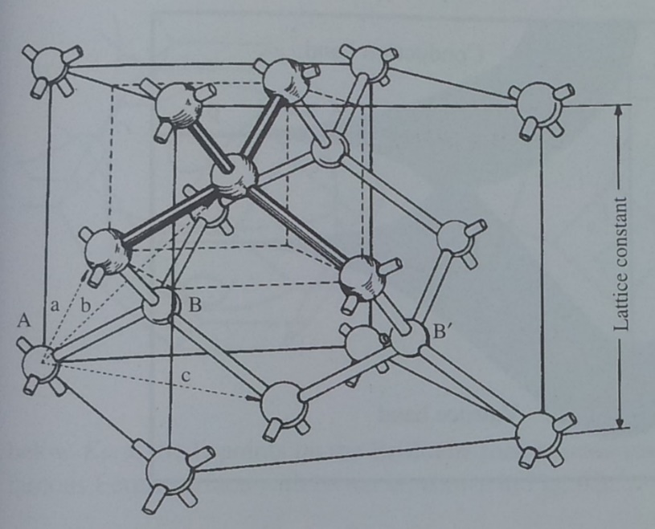
Geometric structure
Nitrogen-vacancy (NV⁻) centre
Missing carbon
Nitrogen atom
Diamond, from John Singleton
NV⁻ Review paper: MW Doherty, NB Manson, P Delaney, F Jelezko, J Wrachtrup, LCL Hollenberg, Phys Rep 528, 1 (2013)
Carbon atoms

Slide 25
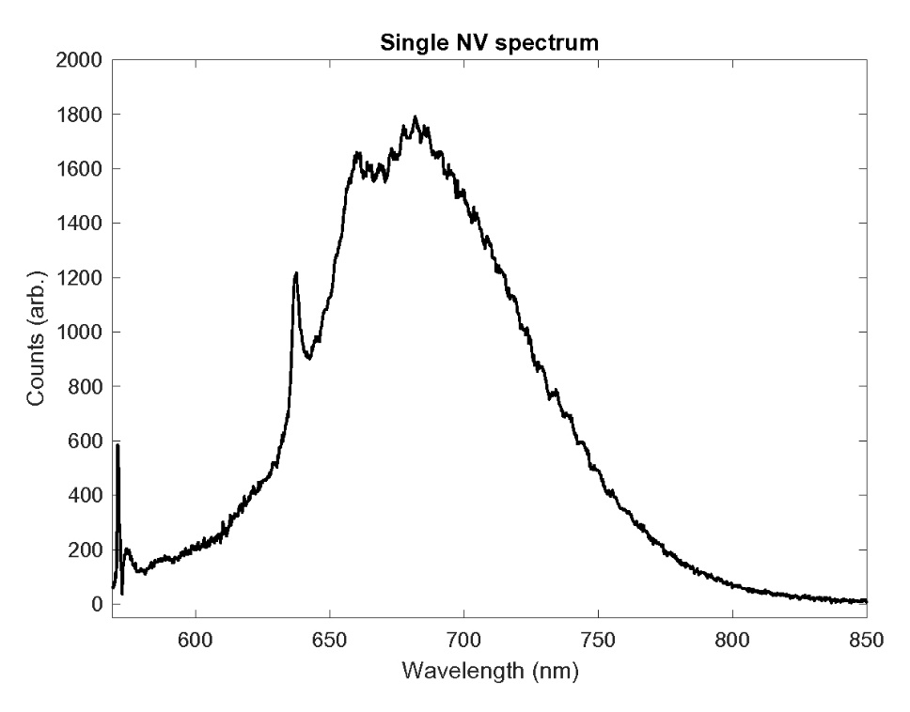
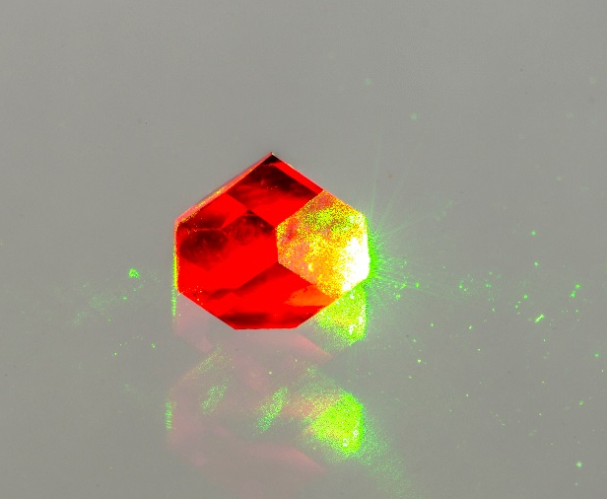
Optical properties of NV⁻ centres
Photograph by Jon Newland (Warwick)

Slide 26
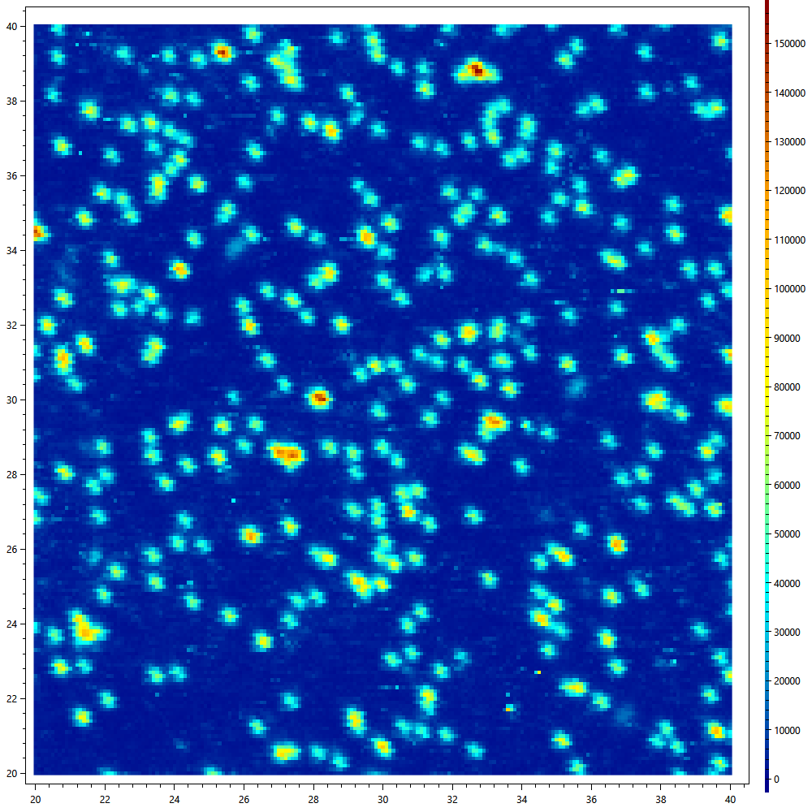
Optical properties of NV⁻ centres
Confocal microscope image
Photograph by Jon Newland (Warwick)

Slide 27
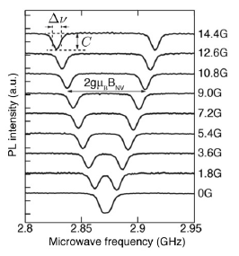
Spin properties of NV⁻ centres
Green excitation →
1. Spin polarization
2. Spin-dependent florescence
Review:
L Rondin et al., Magnetometry with nitrogen-vacancy defects in diamond, Rep Prog Phys 77, 056503 (2014)

Slide 28
Nitrogen-vacancy (NV⁻) energy levels
±1
³E
±0
¹A₁
¹E
Black numbers are spin state (in zero magnetic field)
±1
³A₂
Red names come from the C_{3v} point group: see appendix of Doherty et al
±0

Slide 29
Nitrogen-vacancy (NV⁻) energy levels
±1
³E
±0
Green excitation
¹A₁
¹E
±1
³A₂
±0

Slide 30
Nitrogen-vacancy (NV⁻) energy levels
±1
³E
±0
¹A₁
Red Emission
Decay time ~12ns
¹E
±1
³A₂
±0

Slide 31
Nitrogen-vacancy (NV⁻) energy levels
±1
³E
±0
¹A₁
¹E
±1
³A₂
Microwave excitation (2.9 GHz)
±0

Slide 32
Nitrogen-vacancy (NV⁻) energy levels
±1
³E
±0
Green excitation
¹A₁
¹E
±1
³A₂
±0

Slide 33
Nitrogen-vacancy (NV⁻) energy levels
±1
³E
±0
¹A₁
¹E
±1
³A₂
No red florescence (only IR), decay time >300 ns
±0

Slide 34
Nitrogen-vacancy (NV⁻) energy levels
Green excitation →
1. Spin polarization
2. Spin-dependent florescence

Slide 35
Nitrogen-vacancy centres: Applications
DC Magnetometer
Energy of NV-
m_{s} = +1
m_{s} = -1
m_{s} = 0
2.88 GHz
Magnetic field, B₀
Review:
L Rondin et al., Magnetometry with nitrogen-vacancy defects in diamond, Rep Prog Phys 77, 056503 (2014)

Slide 36
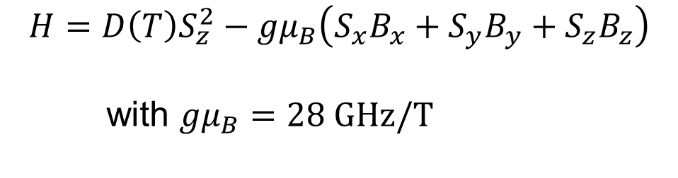
Nitrogen-vacancy centres: Applications
DC Magnetometer
Energy of NV-
m_{s} = +1
m_{s} = -1
m_{s} = 0
D = 2.88 GHz
Magnetic field, B₀
$$H=D\left(T\right)S_{z}^{2}−gμ_{B}\left(S_{x}B_{x}+S_{y}B_{y}+S_{z}B_{z}\right)$$
with $gμ_{B}=28 \text{GHz}\text{/}\text{T}$

Slide 37
Bulk, DC, lock-in
Nitrogen-vacancy centres: Applications
DC Magnetometer
Energy of NV-
m_{s} = +1
m_{s} = -1
m_{s} = 0
15 pT.Hz^{-½} sensitivity at 80 - 2000 Hz from (13 x 200 x 2000) µm³ diamond: JF Barry et al., PNAS 2016
Magnetic field, B₀

Slide 38
Bulk, DC, lock-in
Lock-in detection
Signal
Lock-in signal
Magnetic field modulation
(~1 to 100 kHz)
Advantage: noise only at
modulation frequency
Magnetic field, B

Slide 39
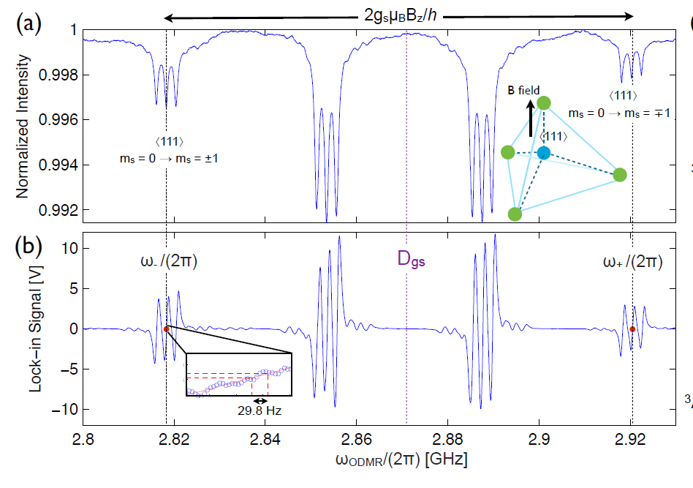
Bulk, DC, lock-in
Nitrogen-vacancy centres: Applications
DC Magnetometer: lock-in detection
H Clevenson et al, Nat Phys 11, 393 (2015)

Slide 40
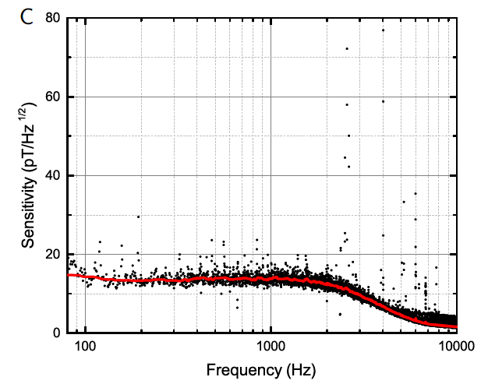
Bulk, DC, lock-in
Nitrogen-vacancy centres: Applications
DC Magnetometer
15 pT.Hz^{-½} sensitivity at 80 - 2000 Hz from (13 x 200 x 2000) µm³ diamond: JF Barry et al., PNAS 2016

Slide 41
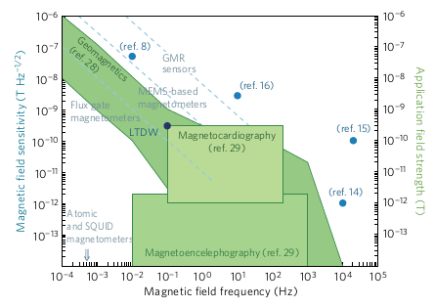
Bulk, DC, lock-in
Nitrogen-vacancy centres: Applications
DC Magnetometer
JF Barry et al., PNAS 2016
Barry et al
H Clevenson et al, Nat Phys 11, 393 (2015)

Slide 42
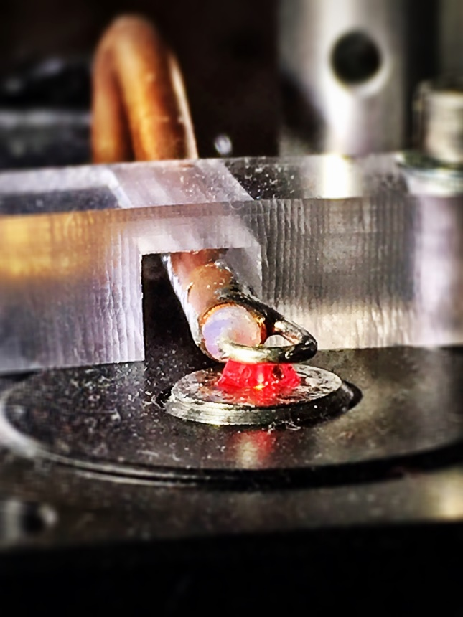
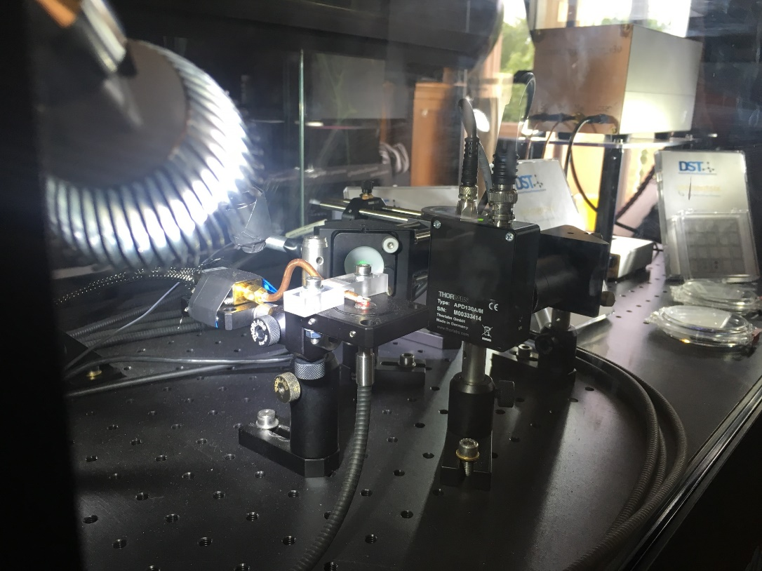
Bulk, DC, lock-in
Nitrogen-vacancy centres: Applications
Warwick: bulk magnetometry towards medical imaging

Slide 43
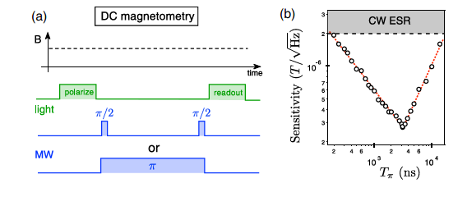
Bulk, DC, beyond lock-in
Single nitrogen-vacancy centres
Ramsey interferometry
Review:
L Rondin et al., Magnetometry with nitrogen-vacancy defects in diamond, Rep Prog Phys 77, 056503 (2014)

Slide 44
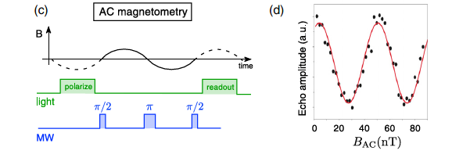
AC, pulsed readout
Single nitrogen-vacancy centres
AC magnetometry
Review:
L Rondin et al., Magnetometry with nitrogen-vacancy defects in diamond, Rep Prog Phys 77, 056503 (2014)

Slide 45
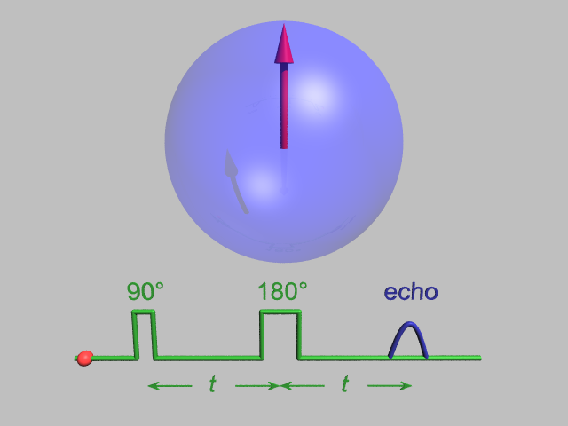
AC, pulsed readout
Spin echo
Spin echo
In rotating frame
Notes:
Hahn echo

Slide 46
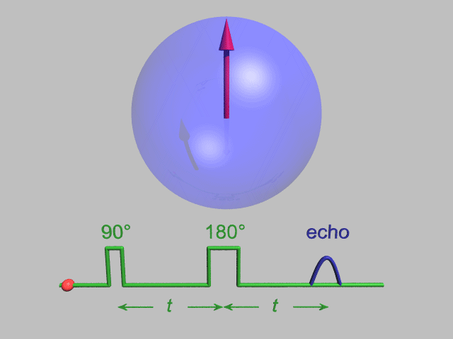
AC, pulsed readout
Spin echo
Spin echo
In rotating frame
Notes:
Hahn echo

Slide 47
AC, pulsed readout
Single nitrogen-vacancy centres
Spin coherence times
 | Electron spin in ¹²C | Nuclear spin
Room temperature T₂ | 1.8 ms | 1 s
cryogenic T₂ | 0.6 s (with decoupling) | 10 s
1.8 ms: G Balasubramanian et al, Nature Materials 8, 383 (2009)
0.6 s: N Bar-Gill et al, Nat Commun 4, 1743 (2013)
1 s: PC Maurer et al, Science 336, 1283 (2012)
10 s: S Yang et al, Nature Photonics 10, 507 (2016)

Slide 48
Bulk AC, pulsed readout
Nitrogen-vacancy centres: Applications
Bulk AC Magnetometer
1 pT/√Hz sensitivity at 10 kHz:
T Wolf et al, Phys. Rev. X 5, 041001 (2015)
- Spin echo on the NV- centre allows through chosen frequency of interest
- Ensemble of ~10¹¹ NV-

Slide 49
Single NV, AC, pulsed readout
Nitrogen-vacancy centres: Applications
Nanoscale magnetometer for NMR
AC detection of single proton spin on surface of diamond in ambient conditions:
AO Sushkov et al, Phys Rev Lett 113, 197601 (2014)
also
6 nT Hz^{-½} DC (20 Hz) with wide dynamic range of 1.7 mT:
C Bonato et al, Nature Nanotechnology 11, 247 (2015)
AC detection at ~200 kHz:
T Staudacher et al, Science 339, 561 (2013)

Slide 50
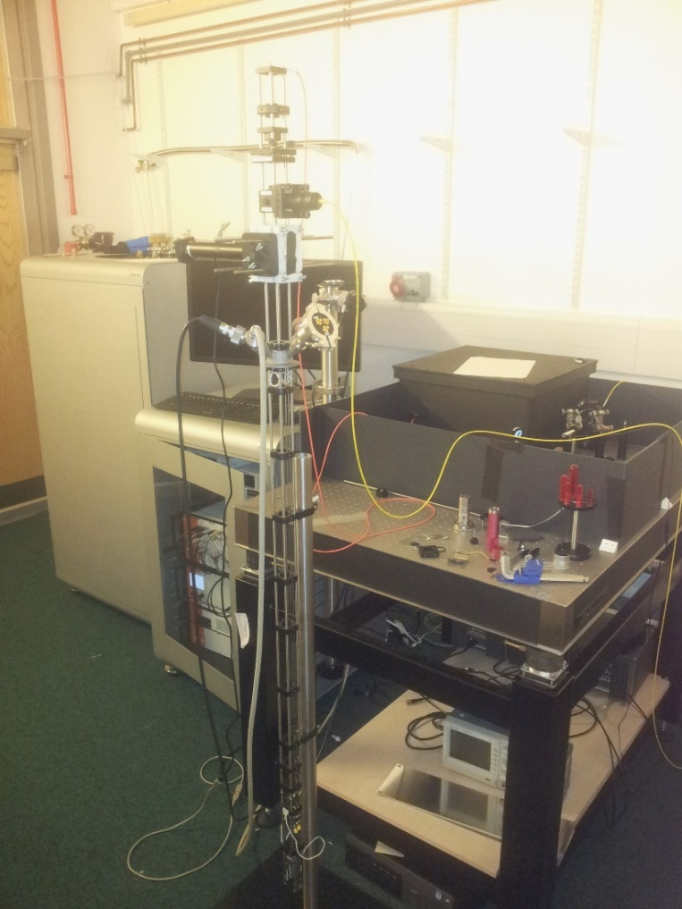
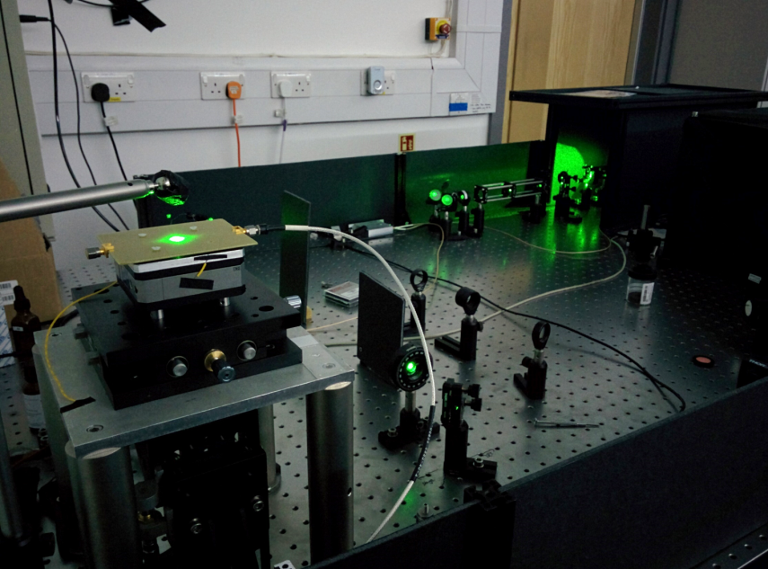
Single NV, AC, pulsed readout
Nitrogen-vacancy centres: Applications
Warwick: single spin magnetometry

Slide 51
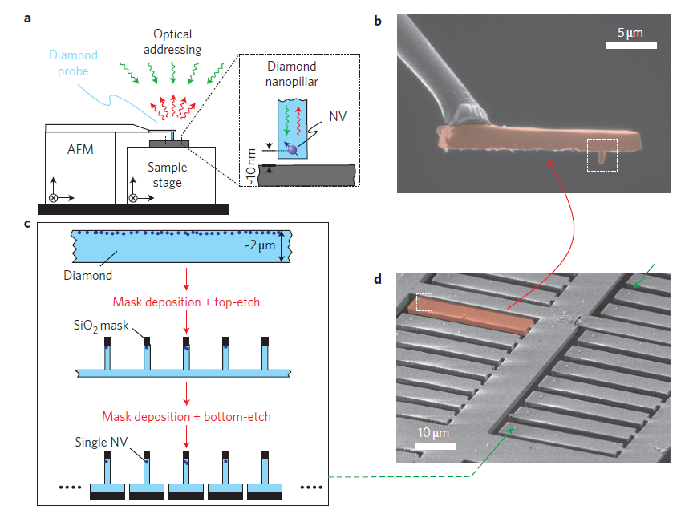
Single NV, AC, pulsed readout
Nitrogen-vacancy centres: Applications
Nanoscale magnetometer for scanning over a sample
P. Maletinsky et al., Nature Nano. 7, 320 (2012)

Slide 52
Single NV, AC, pulsed readout
Nitrogen-vacancy centres: Applications
Nanoscale AC magnetometer for scanning over a sample
Detect a single electron spin 50 nm away from NV- sensor:
MS Grinolds et al, Nat Phys 9, 215 (2013)
- Dynamic decoupling allows through chosen frequency of interest

Slide 53
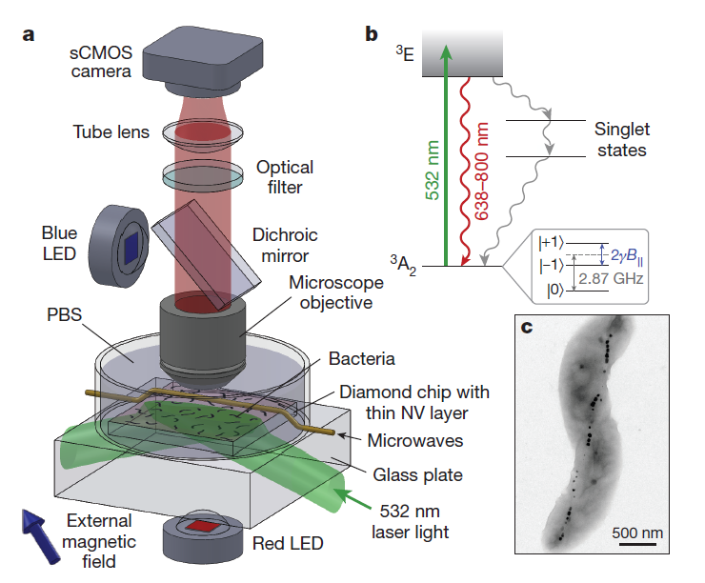
Nitrogen-vacancy centres: Applications
Wide-field magnetometry
Optical magnetic imaging of living cells, D Le Sage et al, Nature 496, 486 (2013)
Diamond is bio-compatible

Slide 54
Nitrogen-vacancy centres: Summary
    1. Properties
      Geometric structure
      Optical properties
      Spin properties
      Energy levels and transitions
    2. Applications
      Magnetometry
        DC vs AC
        Bulk vs nanoscale
        Room temperature vs cryogenic
        Scanning vs widefield

Slide 55
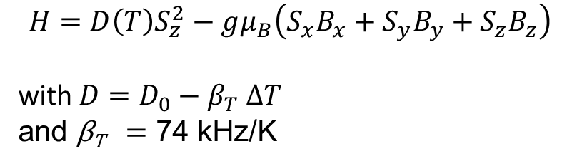
Nitrogen-vacancy centres: Applications
Nanoscale thermometry for inside living cells & computer chips
G Kucsko et al, Nature 500, 54 (2013)
P Neumann et al, Nano Lett 13, 2738 (2013)
DM Toyli et al, PNAS 110, 8417 (2013)
$$H=D\left(T\right)S_{z}^{2}−gμ_{B}\left(S_{x}B_{x}+S_{y}B_{y}+S_{z}B_{z}\right)$$
with ${D=D}_{0}−β_{T} ∆T$
and β_{T} = 74 kHz/K

Slide 56
Nitrogen-vacancy centres: Applications
Electrometry: Stark shift
F Dolde et al, Nat Phys 7, 459 (2011)

Slide 57
Nitrogen-vacancy centres: Applications
Violating Bell’s inequalities
The first experiment in which the “detection” and “locality” loopholes have both been closed
B Henson et al, Nature 526, 682 (2015)
Proposal for entangling remote NV-
SD Barrett and P Kok, Physical Review A 71, 060310 (2005)

Slide 58
Conclusions: Quantum Sensors
Cold atom interferometers
  Gravity, magnetic field, time, rotation
Ion trap
  Magnetic field, time
Atomic vapour cell
  Magnetic field
Nitrogen vacancy centres in diamond
  Magnetic field, electric field, temperature
  Optical spectroscopy of atoms
  Single atom vs many

