Slide 1
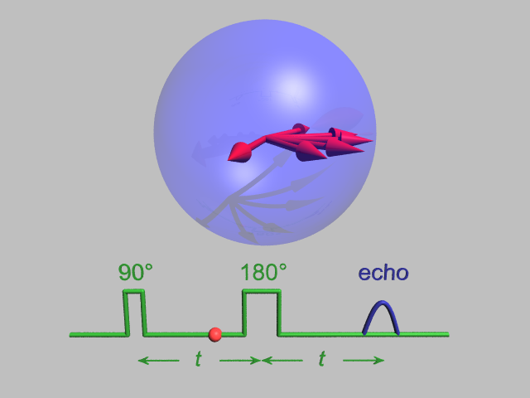
Electron Paramagnetic Resonance and Dynamic Nuclear Polarisation CH916
Gavin W Morley,
Department of Physics,
University of Warwick

Slide 2
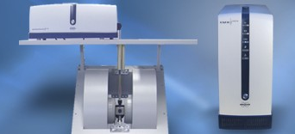
Overview
Electron paramagnetic resonance
What it is
Why it’s useful
Dynamic nuclear polarization
Why it’s useful
What it is

Slide 3
Overview
Electron paramagnetic resonance
What it is
Why it’s useful
Dynamic nuclear polarization
Why it’s useful
What it is

Slide 4
Overview
Electron paramagnetic resonance
What it is
…NMR for electrons

Slide 5

Electron paramagnetic resonance (EPR)
… or electron spin resonance (ESR)
… or electron magnetic resonance (EMR)
… or ferromagnetic resonance (FMR)

Slide 6
Magnetism
Electron spins tend to:
Paramagnetism: follow
Diamagnetism: oppose
Ferromagnetism: ignore
…an applied magnetic field

Slide 7
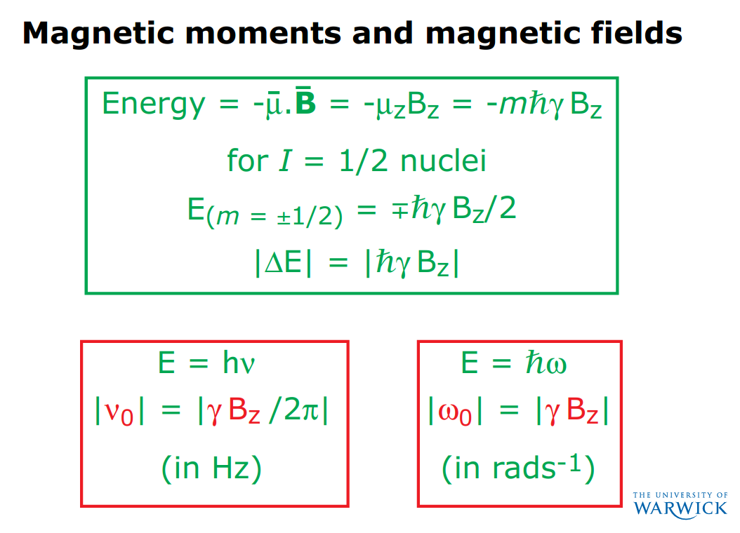
From Steven Brown’s NMR lecture:

Slide 8
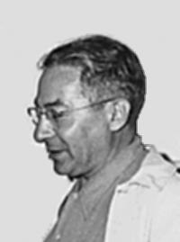
Magnetic resonance
An isolated spin I = ½ has m = ±½
Isidor Isaac Rabi (1898 – 1988)
Energy of a spin ½
m = -½
Photon energy
m = +½
Magnetic field

Slide 9
Magnetic resonance
Isidor Isaac Rabi (1898 – 1988)
Energy of a spin ½
m = -½
Photon energy
m = +½
Magnetic field

Slide 10
Magnetic resonance
Photons reflected
Magnetic field
Isidor Isaac Rabi (1898 – 1988)
Energy of a spin ½
m = -½
Photon energy
m = +½
Magnetic field

Slide 11
Magnetic resonance
Photons reflected
Magnetic field
Isidor Isaac Rabi (1898 – 1988)
Energy of a spin ½
m = -½
Photon energy
m = +½
Magnetic field

Slide 12
Magnetic resonance
Photons reflected
Magnetic field
Isidor Isaac Rabi (1898 – 1988)
Energy of a spin ½
m = -½
Photon energy
m = +½
Magnetic field

Slide 13
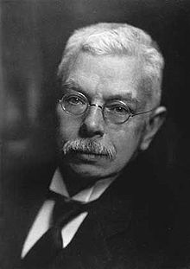
Magnetic resonance
Photons reflected
Magnetic field, B_{z}
Pieter Zeeman (1865 - 1943)
Energy of a spin S = ½
Energy gap |ΔE| = g μ_{B} B_{z}
g is the EPR equivalent of chemical shielding in NMR,
µ_{B} is the Bohr magneton
Magnetic field, B_{z}
Notes:
Zeeman effect

Slide 14
Magnetic resonance condition
Photons reflected
Magnetic field, B_{z}
Energy of a spin S = ½
Energy gap |ΔE| = g μ_{B} B_{z} = hf_{res}
= ħω_{res}
Magnetic field, B_{z}
Notes:
Zeeman effect

Slide 15
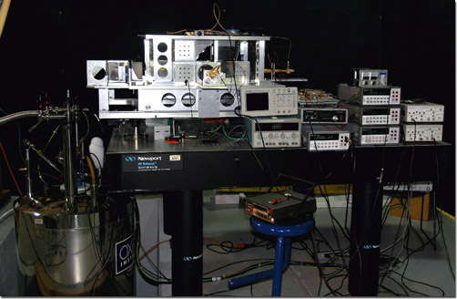
Electron paramagnetic resonance
Photons reflected
Magnetic field, B_{z}
Bruker
J van Tol, L-C Brunel & RJ Wylde, Rev Sci Instrum 76, 076101 (2005)
f_{res} = 10 GHz
f_{res} = 240 GHz

Slide 16
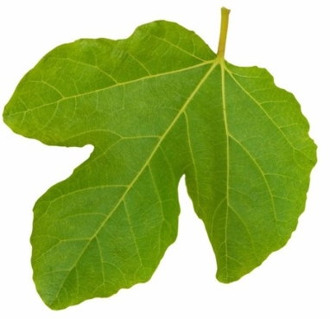
Electron paramagnetic resonance
S = ½
m_{s} = ±½
I = ½
m_{I} = ±½ (= m)
Photons reflected
Magnetic field, B_{z}
Energy of a spin system
Energy gap |ΔE| = g μ_{B} B_{z}
Magnetic field, B_{z}
Notes:
mu_N is the nuclear magneton and it is ~1000 times smaller than mu_B

Slide 17
Electron paramagnetic resonance
S = ½
m_{s} = ±½
I = ½
m_{I} = ±½ (= m)
Photons reflected
Magnetic field, B_{z}
Energy of a spin system
Energy gap |ΔE| = g μ_{B} B_{z}
Magnetic field, B_{z}

Slide 18

Electron paramagnetic resonance
m_{I} = ½ m_{I} = -½
S = ½
m_{s} = ±½
I = ½
m_{I} = ±½ (= m)
Photons reflected
A
Magnetic field, B_{z}
Energy of a spin system
Energy gap |ΔE| = g μ_{B} B_{z} ± A/2
Magnetic field, B_{z}

Slide 19
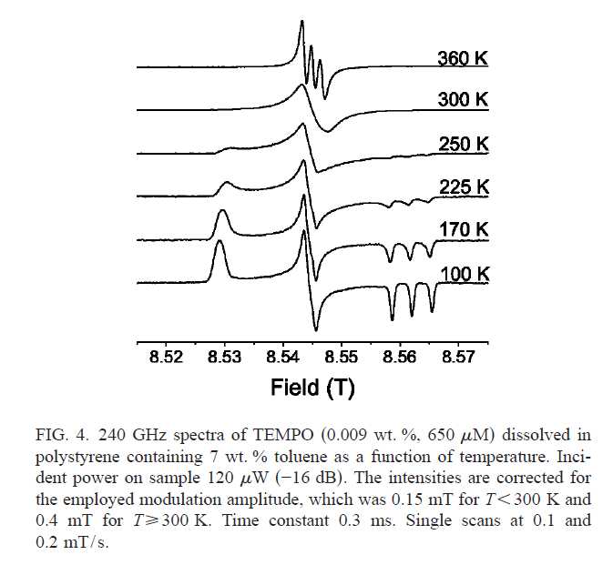
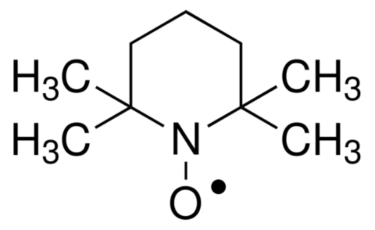
Electron paramagnetic resonance
m_{I} = ½ m_{I} = -½
Photons reflected
A
Stable free radicals:
BDPA
Nitroxides
DPPH
Magnetic field, B_{z}
TEMPO
£20/g from Aldrich
J van Tol, L-C Brunel & RJ Wylde, Rev Sci Instrum 76, 076101 (2005)

Slide 20
Electron paramagnetic resonance
m_{I} = ½ m_{I} = -½
Photons absorbed
A
Magnetic field, B_{z}
TEMPO
£20/g from Aldrich
J van Tol, L-C Brunel & RJ Wylde, Rev Sci Instrum 76, 076101 (2005)

Slide 21
Electron paramagnetic resonance
m_{I} = 1 m_{I} = 0 m_{I} = -1
Photons absorbed
A
Magnetic field, B_{z}
TEMPO
£20/g from Aldrich
J van Tol, L-C Brunel & RJ Wylde, Rev Sci Instrum 76, 076101 (2005)

Slide 22
Electron paramagnetic resonance
m_{I} = 1 m_{I} = 0 m_{I} = -1
Photons absorbed
Differential
absorption
Magnetic field modulation
(~10 to 100 kHz)
Advantage: noise only at
modulation frequency
Magnetic field, B

Slide 23
Electron paramagnetic resonance
m_{I} = 1 m_{I} = 0 m_{I} = -1
Differentialabsorption
A
Magnetic field, B
TEMPO
£20/g from Aldrich
J van Tol, L-C Brunel & RJ Wylde, Rev Sci Instrum 76, 076101 (2005)

Slide 24
Electron paramagnetic resonance
m_{I} = 1 m_{I} = 0 m_{I} = -1
Differentialabsorption
Magnetic field, B
TEMPO
£20/g from Aldrich
J van Tol, L-C Brunel & RJ Wylde, Rev Sci Instrum 76, 076101 (2005)

Slide 25
Electron paramagnetic resonance
spectrometer
Microwave bridge
Console
Computer
S
Electromagnet (up to 1.5 T) or superconducting magnet for higher field

Slide 26
Electron paramagnetic resonance
spectrometer
Bridge
source
detector
Modulation coils
S
Microwave resonator

Slide 27
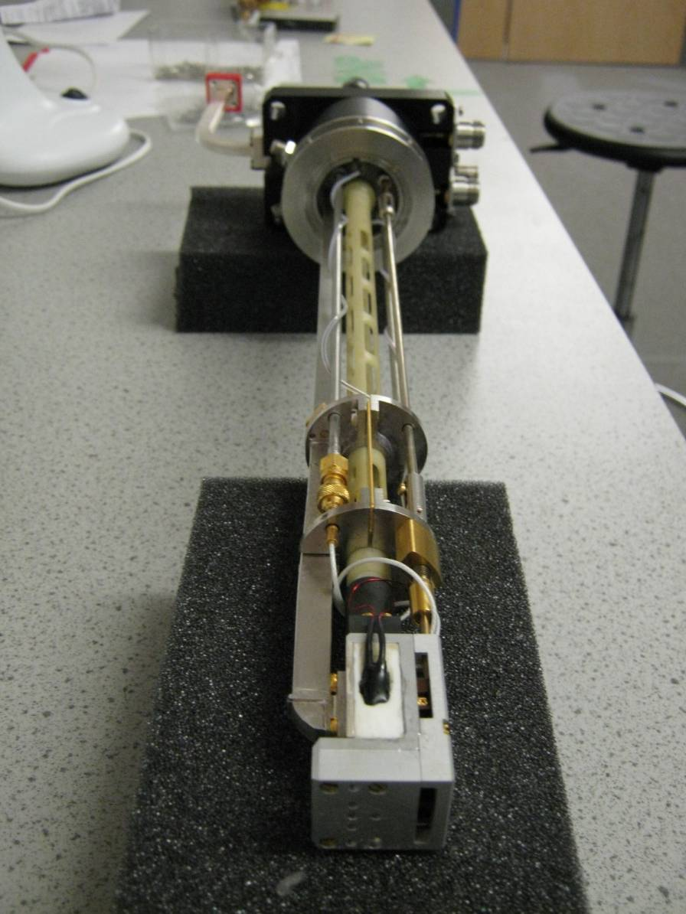
Electron paramagnetic resonance
spectrometer
Bridge
source
detector
Modulation coils
S
Microwave resonator

Slide 28
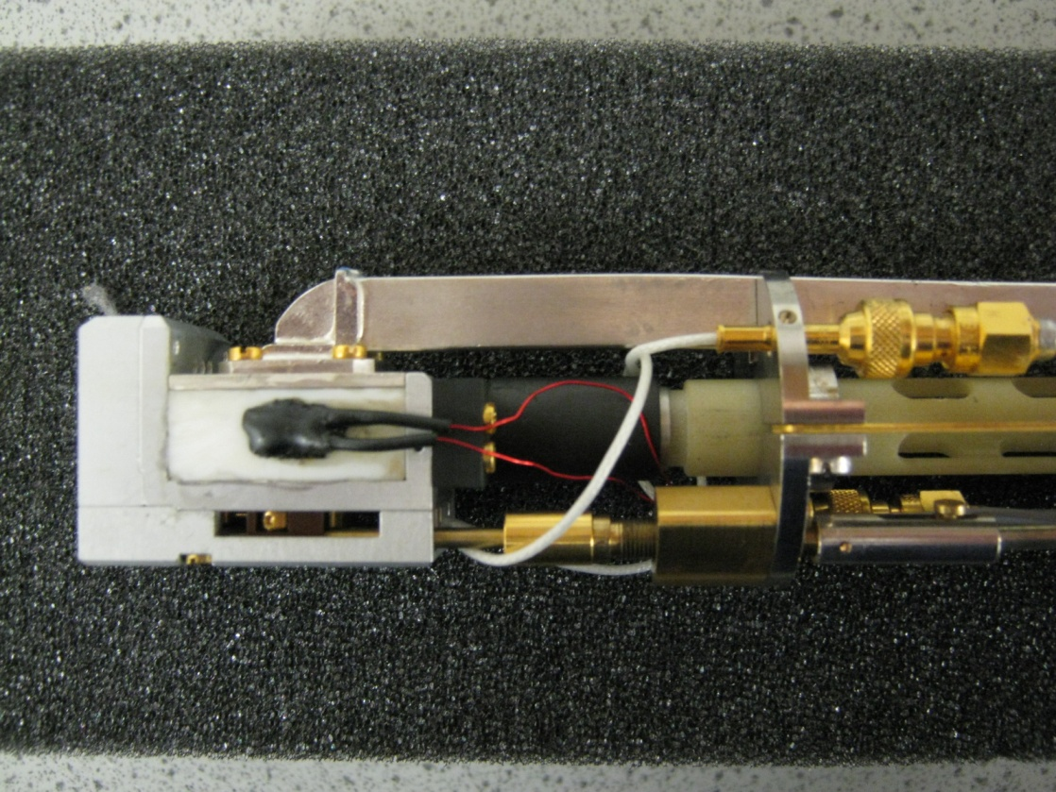
Electron paramagnetic resonance
spectrometer
Bridge
source
detector
Modulation coils
S
Microwave resonator

Slide 29
Electron paramagnetic resonance
spectrometer
CW EPR so far…
Pulsed EPR next

Slide 30
Pulsed electron paramagnetic resonance spectrometer
Bridge
High power pulsed source
Protected detector
Modulation coils off
S
Microwave resonator

Slide 31
Pulsed electron paramagnetic resonance

Slide 32
Pulsed electron paramagnetic resonance
resonance condition g μ_{B} B_{res} = h f
B_{res}
Polarize (thermalise) on timescale T₁
f
^{π}/₂
Free induction decay (FID) on timescale T₂*

Slide 33
Pulsed EPR
J van Tol, L-C Brunel & RJ Wylde, Rev Sci Instrum 76, 076101 (2005)
~100 MHz width
Pulse width < 500 MHz
Resonator ringing → deadtime
Short T₂ and T₂* compared to NMR
Homogeneous (T₂) can be much longer than inhomogeneous (T₂*) so most pulsed EPR uses spin echo
f
^{π}/₂

Slide 34
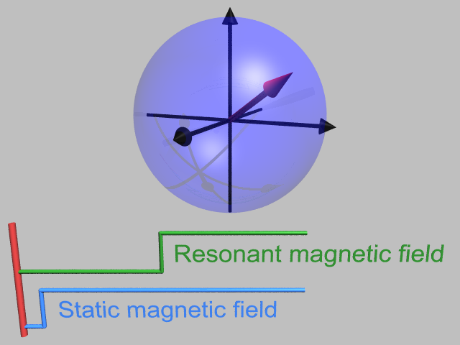
Rotating frame

Slide 35
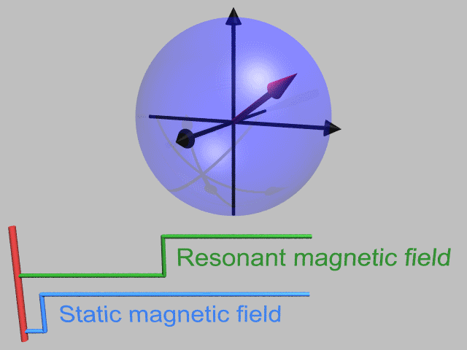
Rotating frame

Slide 36
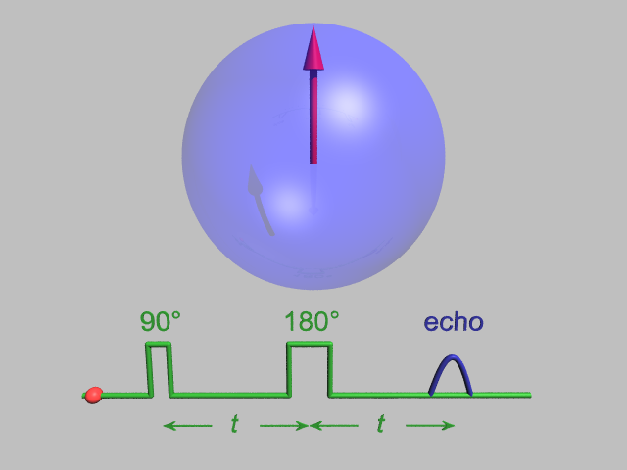
Spin echo
In rotating frame

Slide 37
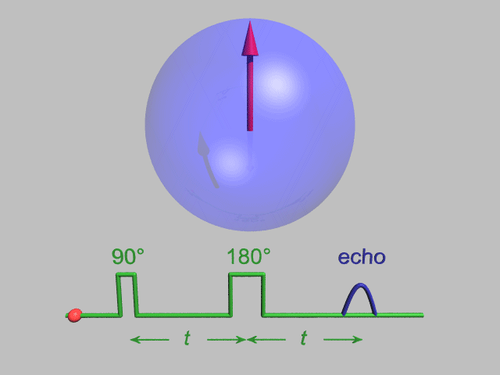
Spin echo
In rotating frame

Slide 38
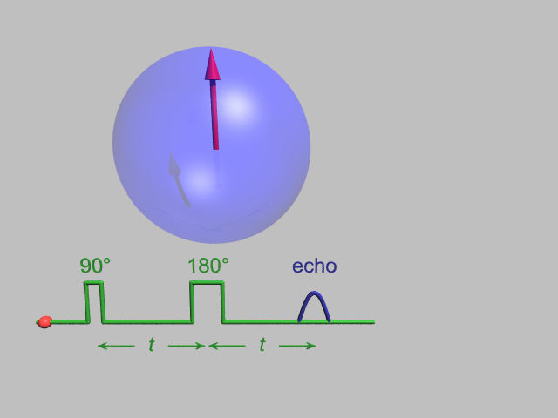
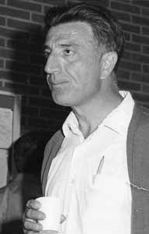
Spin echo decay
Erwin L Hahn (born 1921) Photo: AIP Emilio Segre Visual Archives, Stephen Jacobs Collection

Slide 39

Spin echo decay
Erwin L Hahn (born 1921) Photo: AIP Emilio Segre Visual Archives, Stephen Jacobs Collection
Notes:
Hahn echo

Slide 40
Pulsed EPR
Double electron-electron resonance (DEER) allows distances between two electron spins in the range 2 to 6 nm to be measured (cf < 1 nm by NMR for two nuclear spins)
Dipolar coupling α 1/r³
Site directed spin labelling with
one or more TEMPO

Slide 41
Electron nuclear double resonance (ENDOR)
m_{I} = ½ m_{I} = -½
S = ½
m_{s} = ±½
I = ½
m_{I} = ±½ (= m)
Photons reflected
A
Magnetic field, B_{z}
Energy of a spin system
Energy gap |ΔE| = g μ_{B} B_{z} ± A/2
Magnetic field, B_{z}

Slide 42
Electron nuclear double resonance (ENDOR)
Why do ENDOR instead of NMR?
only need ~10¹⁰ spins instead of ~10¹⁵
NMR may be difficult near the electron spin
Energy of a spin system
Energy gap |ΔE| = g μ_{B} B_{z} ± A/2
Magnetic field, B_{z}

Slide 43
Electron nuclear double resonance (ENDOR)
B₀ is static magnetic field
B₁ is EPR magnetic field
B₂ is NMR magnetic field
Energy of a spin system
Energy gap |ΔE| = g μ_{B} B₀ ± A/2
Magnetic field, B₀

Slide 44
ENDOR for quantum computing
Classical Quantum
computer computer
Bits Qubits
0 or 1 α |0⟩ + β |1⟩
Notes:
A normal computer stores information as bits that can be 1 or 0. A quantum computer uses qubits: two level quantum systems such as spins 1/2

Slide 45
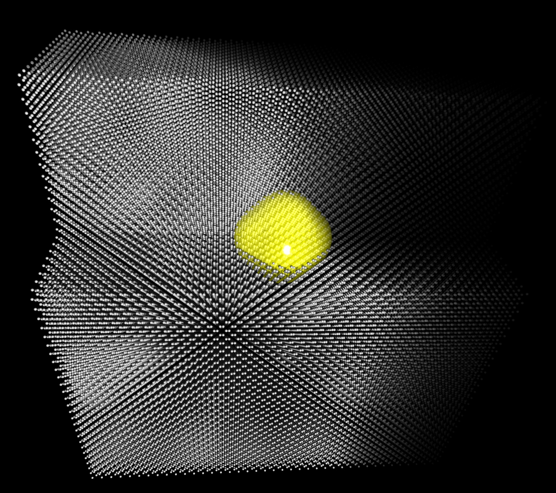

Spin qubits in silicon
Image by
Manuel Vögtli (UCL)
Notes:
Phosphorus atoms in silicon are called donors because they donate an electron to the silicon at RT. This is used in modern computers. I work at helium temperatures where the atoms bind their electrons. The donor nucleus has a nuclear spin and the bound electron has a spin also. This is an envelope wavefunction

Slide 46
Other EPR applications
Quality control in beer, wine etc
Radiation dose received by teeth

Slide 47
Overview
Electron paramagnetic resonance
What it is
Why it’s useful
Dynamic nuclear polarization
Why it’s useful
What it is

Slide 48
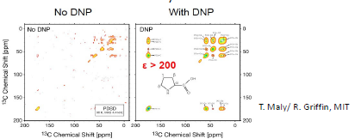
Dynamic nuclear polarization (DNP)
Dynamic nuclear polarization
More signal

Slide 49


Dynamic nuclear polarization (DNP)
Thermal (Boltzmann) equilibrium:
Define polarization as:
$${\frac{n_{2}}{n_{1}}=e}^{−\frac{∆E}{k_{B}T}}$$
$$P=\frac{n_{1}−n_{2}}{n_{1}+n_{2}}$$
n₂
ΔE
n₁

Slide 50

Dynamic nuclear polarization (DNP)
Boltzmann polarization:
So transfer electronic
polarization to nuclei
$${\frac{n_{2}}{n_{1}}=e}^{−\frac{∆E}{k_{B}T}}$$

Slide 51
Electron paramagnetic resonance
S = ½
m_{s} = ±½
I = ½
m_{I} = ±½ (= m)
Photons reflected
Magnetic field, B_{z}
Energy of a spin system
Energy gap |ΔE| = g μ_{B} B_{z}
Magnetic field, B_{z}
Notes:
Show these energy levels again

Slide 52
Electron paramagnetic resonance
m_{I} = ½ m_{I} = -½
S = ½
m_{s} = ±½
I = ½
m_{I} = ±½ (= m)
Photons reflected
A
Magnetic field, B_{z}
Energy of a spin system
Energy gap |ΔE| = g μ_{B} B_{z} ± A/2
Magnetic field, B_{z}
Notes:
…including the hyperfine term, and then redraw the energy levels at some fixed magnetic field

Slide 53
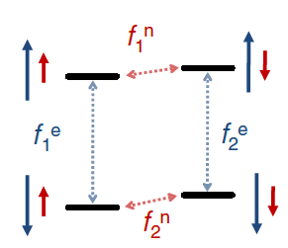
Dynamic nuclear polarization (DNP)
Initial polarizations:
Electrons > 95%
Nuclei < 0.1%
For 8.6 T and 3 K
Notes:
At 8.6T and 3K, electronic polarization is 95% and nuclear polarization is 0.06%.

Slide 54
Dynamic nuclear polarization (DNP)
Nuclear magnetic resonance (NMR)

Slide 55
Dynamic nuclear polarization (DNP)
Electron paramagnetic resonance (EPR)

Slide 56
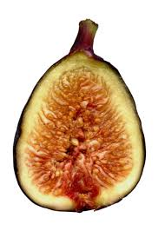
Dynamic nuclear polarization (DNP)
Forbidden transition
→ Overhauser Effect
Electron paramagnetic resonance (EPR)

Slide 57
Magnetic resonance
S = ½
m_{s} = ±½
I = ½
m_{I} = ±½ (= m)
Photons reflected
Magnetic field, B_{z}
Energy of a spin system
Energy gap |ΔE| = g μ_{B} B_{z}
Magnetic field, B_{z}

Slide 58
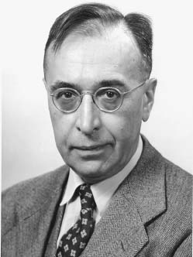
Breit-Rabi diagram
m_{I} = ½ m_{I} = -½
Photons reflected
A
Gregory Breit (1899-1981)
Magnetic field, B_{z}
Energy of a spin system
Energy gap |ΔE| ≈ g μ_{B} B_{z} ± A/2
...in high enough magnetic fields
Magnetic field, B_{z}
Notes:
Breit-Rabi diagram

Slide 59
Breit-Rabi diagram
For a coupled two-spin system at low magnetic field, the spin states of the two spins are not good quantum numbers. Instead:
Energy of a spin system
A
Triplet, F = 1: ↑↑
(↑↓ + ↓↑)/√2
↓↓
Singlet, F = 0: (↑↓ - ↓↑)/√2
Magnetic field, B_{z}
Energy gap |ΔE| = A
...at zero magnetic field

Slide 60
Dynamic nuclear polarization (DNP)
Electron paramagnetic resonance (EPR)
more Forbidden
at high magnetic fields

Slide 61
Dynamic nuclear polarization (DNP)
Solid effect DNP
also gets weaker at high magnetic fields

Slide 62
Dynamic nuclear polarization (DNP)
Solid effect DNP
also gets weaker at high magnetic fields

Slide 63
Dynamic nuclear polarization (DNP)
Cross effect Thermal Mixing
also get weaker at high magnetic fields
e-
e-
e-
n
n
n
e-
e-
e-
n

Slide 64
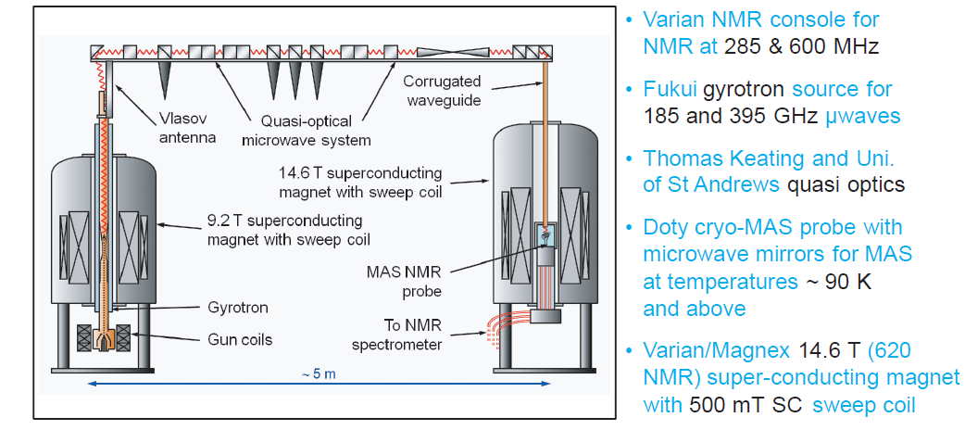
Dynamic nuclear polarization (DNP)
Ray Dupree, Steven Brown, Mark Newton, Kevin Pike, Andrew Howes, Tom Kemp, Mark Smith at Warwick,
see KJ Pike et al, J Mag Res 215, 1 (2012), also Griffin Group (MIT)

Slide 65
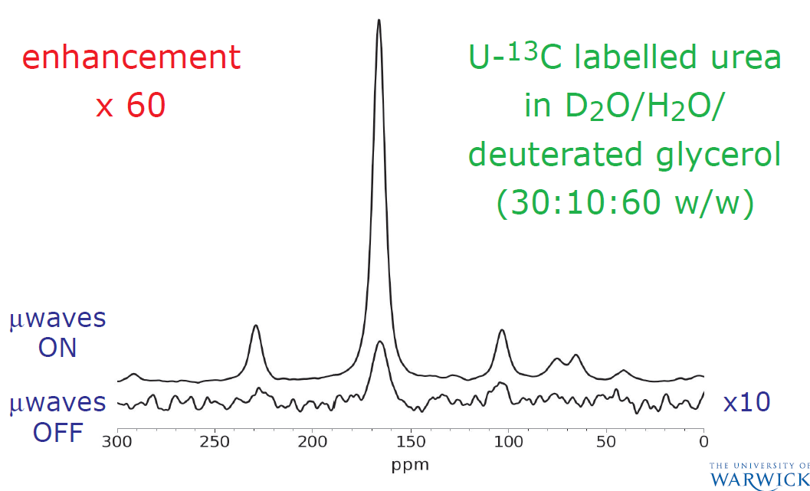
Dynamic nuclear polarization (DNP)
Ray Dupree, Steven Brown, Mark Newton, Kevin Pike, Andrew Howes, Tom Kemp, Mark Smith at Warwick,
see KJ Pike et al, J Mag Res 215, 1 (2012)

Slide 66
Dynamic nuclear polarization (DNP)
EPR + NMR = Electron nuclear double resonance (ENDOR)
ENDOR-DNP:
A S Brill, PRA 66 043405 (2003)

Slide 67
Dynamic nuclear polarization (DNP)
EPR + NMR = Electron nuclear double resonance (ENDOR)
ENDOR-DNP:
A S Brill, PRA 66 043405 (2003)

Slide 68
Dynamic nuclear polarization (DNP)
EPR + NMR = Electron nuclear double resonance (ENDOR)
ENDOR-DNP:
A S Brill, PRA 66 043405 (2003)

Slide 69
Background Our research
Dynamic nuclear polarization
240 GHz excitation, A/ħ = 16 MHz
A
Notes:
Need resolved HFS. Intrinsic linewidth less than 0.3microTesla: 80kHz! Hyperfine A=16MHz

Slide 70
Background Our research
Dynamic nuclear polarization
240 GHz excitation, A/ħ = 16 MHz
ENDOR-DNP at 4 K
Notes:
High field resonance is 8% of total after DNP, 33% before. 15N@C60 gives 62% polarization with enhancement of 1000. Intrinsic linewidth less than 0.3microTesla: 80kHz! Hyperfine A=16MHz

Slide 71
Dynamic nuclear polarization
Temperature jump
plus
gain x50 from DNP
and x200 from temp
x10,000 total
See Ardenkjaer-Larsen et al, PNAS 100, 10158 (2003)

Slide 72
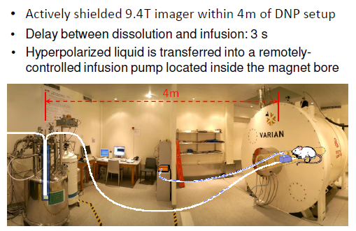
Dynamic nuclear polarization
Temperature jump with dissolution
plus
Arnaud Comment and Rolf Gruetter, Lausanne

Slide 73
Conclusion
Electron paramagnetic resonance
What it is
Why it’s useful
Dynamic nuclear polarization
Why it’s useful
What it is

